Slide 1
Visual Vocabulary eSlides
Mathematics
Kindergarten
© Partners for Learning, Inc. 2013

Slide 2
SITE LICENSE / TERMS OF USE
The academic vocabulary power point slides are sold on a per grade, per school basis.
TERMS OF USE:
All slides included in this presentation are for use only by the purchasing school
  Additional copies can be purchased for use
By using the slides you agree to only use the slides in the school for which they were purchased.
You further agree not to copy or distribute the slides for use outside of the purchasing school.
Thank You

Slide 3
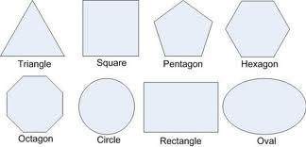
2-dimensional
Lying flat.

Slide 4
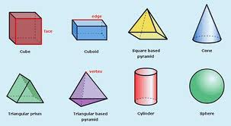
3-dimensional
Solid shapes; Having points or sides that are not all on one plane.

Slide 5
Above
The smiley face is above the blue box.
On top of/ over; indicates location of an object.

Slide 6
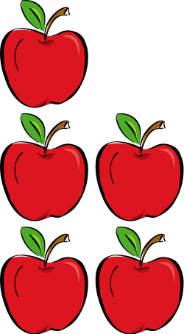
Add/Addition
4 + 2 = 6
To bring two or more numbers (or things) together to make a new total.

Slide 7
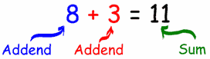
Addend
Any of the numbers that are added together.

Slide 8
Alike
These are alike amounts.
Same size, quantity, or amount.

Slide 9
Analyze
Examining parts to understand how they work together.

Slide 10
And
4 and 2 = 6
To bring two or more numbers (or things) together to make a new total.

Slide 11
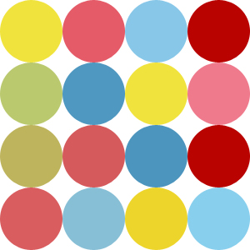
Array
A set of objects arranged in rows or columns.

Slide 12
Attribute
The box is blue
The box has 4 sides
A character that something has, such as color, weight or height.

Slide 13
Behind
The smiley face is behind the blue box.
In back of; indicated location of an object.

Slide 14
Below
The face is below the box.
Under; indicates location of an object.

Slide 15
Beside
The face is beside the box.
Next to; indicates location of an object.

Slide 16
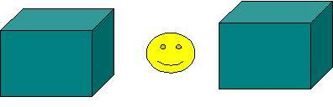
Between
The smiley face is between the two boxes
The space that separates two things

Slide 17
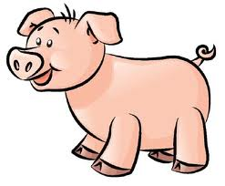
Bigger
Pig 3 is bigger than pigs 1 & 2.
1
2
3
Larger in size.

Slide 18
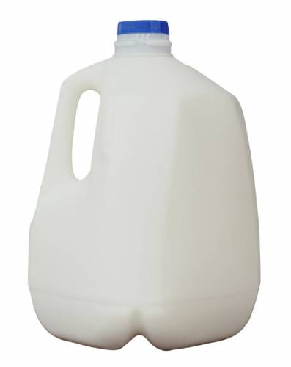
Capacity
This carton of milk has a capacity of one gallon.
A measure of the amount something can hold.

Slide 19
Category
color categories
red
purple
blue
A particular type of thing within a larger group; class. A kind of something.

Slide 20
Circle
A 2-dimensional shape made by drawing a curve that is always the same distance from a center.

Slide 21
Classify
Classify by color.
To sort into categories or to arrange into groups by attribute.

Slide 22
Compare
Same size
Same shape
Different colors
To find how things are different or the same

Slide 23
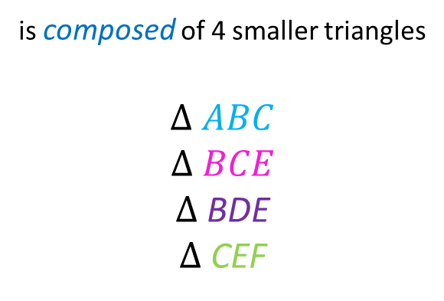
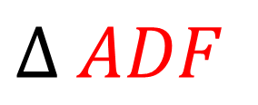
Compose
A
$$∆ ADF$$
is composed of 4 smaller triangles
$$∆ ABC$$
$$∆ BCE$$
$∆$ BDE
$∆$ CEF
B
C
D
F
E
To form by putting together (e.g., a geometric shape or a number).

Slide 24
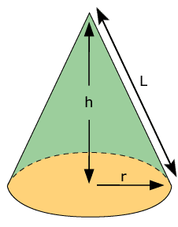
Cone
A solid 3 dimensional object that a has a circular base and one vertex

Slide 25
Corner
The place where two lines meet.

Slide 26

Count
1
2
3
There are 3 apples.
To say numbers in order.

Slide 27
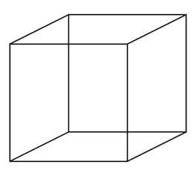
Cube
A box shaped, solid object that has 6 identical square faces.

Slide 28
Curve
A line that is rounded.

Slide 29
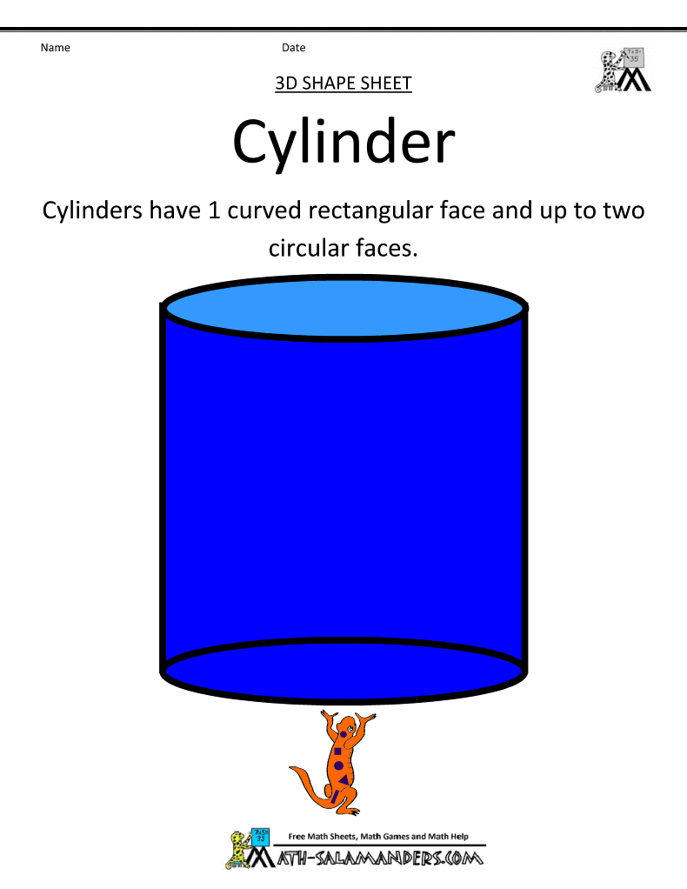
Cylinder
A solid object with 2 identical flat ends that are circular and 1 curved side

Slide 30
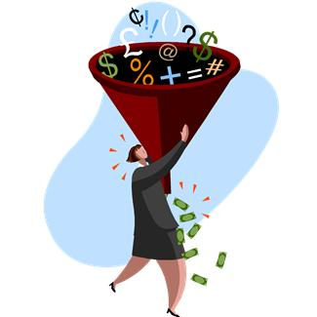
Data
A collection of facts, such as values or measurements.

Slide 31
Day
A 24 hour period from midnight to the next midnight.

Slide 32
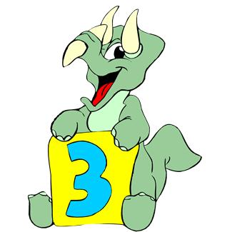
Decompose
3 + 0
2 + 1
1 + 2
0 + 3
To separate into parts or elements (e.g., geometric figures or numbers).

Slide 33

Difference
-
=
6 – 4 = 2
The result when one number is subtracted from another.

Slide 34
Different/Difference
These shapes are different.
Not the same; unlike.

Slide 35
Digit
0 1 2 3 4 5 6 7 8 9
A symbol used to write the numbers.

Slide 36
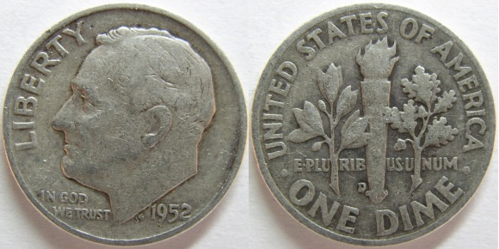
Dime
A coin with a value of ten cents.

Slide 37
Eight
0 1 2 3 4 5 6 7 8 9 10 11
One more than seven; one less than nine.

Slide 38
Eighteen
18
1 ten and 8 ones.

Slide 39
Eleven
11
1 ten and 1 one.

Slide 40
Equal/Equivalent
Two plus one equals three
2 + 1 = 3
Exactly the same amount or value

Slide 41
Equation
2 + 2 = 1 + 3
Says that two things are the same, using math symbols.

Slide 42
Expression
+
=
2 + 1 = 3
Numbers or symbols grouped together to show the value of something

Slide 43
Fewer
There are fewer (less) blue hearts than red hearts
Smaller amount than something else.

Slide 44
Fifteen
15
1 ten and 5 ones.

Slide 45
Fifth
Friday is the fifth day of the week.
The number five in a position or order of things.

Slide 46
First
Monday is the first day of the week.
The number one in a position or order of things.

Slide 47
Five
0 1 2 3 4 5 6 7 8 9 10 11
One more than four; one less than six.

Slide 48
Flat
Not curved or bumpy.

Slide 49
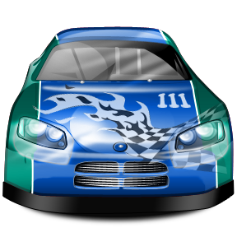
Forward
To move ahead.

Slide 50
Four
0 1 2 3 4 5 6 7 8 9 10 11
One more than three; one less than five.

Slide 51
Fourteen
14
1 ten and 4 ones.

Slide 52
Fourth
Thursday is the fourth day of the week.
The number four in a position or order of things.

Slide 53
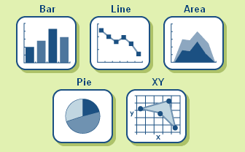
Graph
A drawing used to record information.

Slide 54
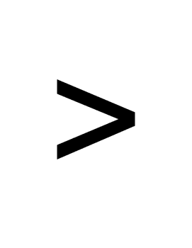
Greater than
3 > 1
three is greater than one
Bigger. The symbol > means greater than.

Slide 55
Half
One of two equal parts of a whole

Slide 56
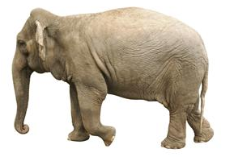
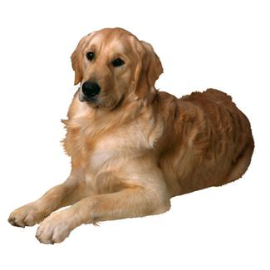
Heavier
An elephant is heavier than a dog.
Weighing more than something else.

Slide 57
Height
h=height
d=depth
w=width
The distance or length from top to bottom of a three-dimensional object.
©Partners for Learning, Inc.

Slide 58
Hexagon
A six-sided polygon.

Slide 59
In front of
The smiley face is in front of the blue box.
In front of; indicates location of an object.

Slide 60
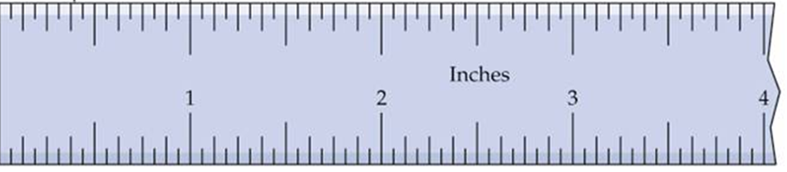
Inch
An inch is a measure of length.

Slide 61
Larger
Pig 3 is larger than the others.
1
2
3
Greater in size or amount.

Slide 62
Length
length
How long something is from end to end.

Slide 63
Less
3
The boxes on the left have less squares than the one on the right.
5
2
Smaller; not as many.

Slide 64
Less than
Two is less than three.
2 < 3
Smaller than another.

Slide 65
Lighter
A dog is lighter than an elephant.
Weighing less than something else.

Slide 66
Line
A long thin mark made by a pen, pencil, etc

Slide 67
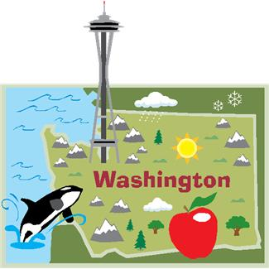
Location
Where something is.

Slide 68
Longer/Longest
longest
Having a length that is greater than another.

Slide 69
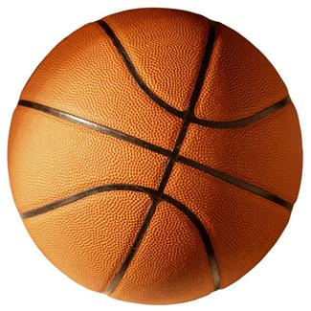
Match/Pair
To pick two or more of the same thing.

Slide 70
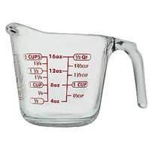
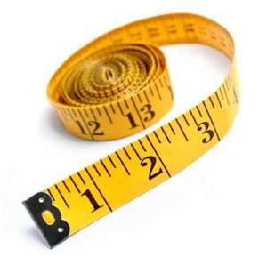
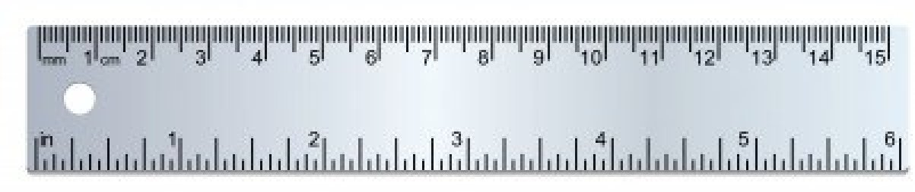
Measure
To find a number that shows the size or amount of something.

Slide 71

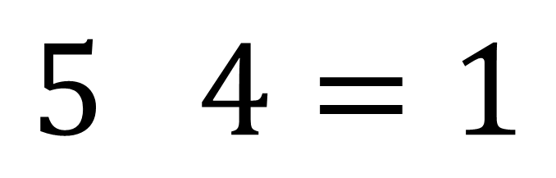
Minus
$$5 4=1$$
$$−$$
A symbol used to show subtraction; to take away one quantity from another.

Slide 72
More
There are more red hearts than blue hearts
Larger amount than something else.

Slide 73
Most
3
5
This box has the most squares.
2
The largest (biggest) group

Slide 74
Next to
The face is next to the box.
Beside; indicates location of an object.

Slide 75
Nine
0 1 2 3 4 5 6 7 8 9 10 11
One more than eight; one less than ten.

Slide 76
Nineteen
19
1 ten and 9 ones.

Slide 77
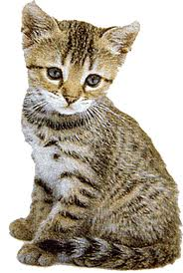
Number
1
2
There are 2 kittens
A number is a count or measurement.

Slide 78
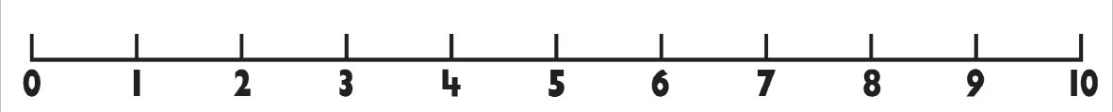
Number line
A line on which each point represents a number.

Slide 79
Numeral
0, 1, 2, 3, 4, 5, 6, 7, 8, 9
A symbol used to represent a number.

Slide 80
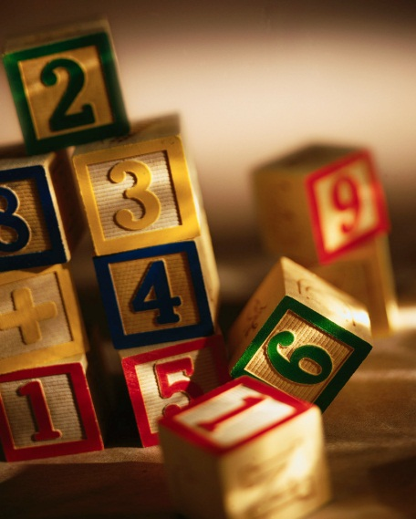
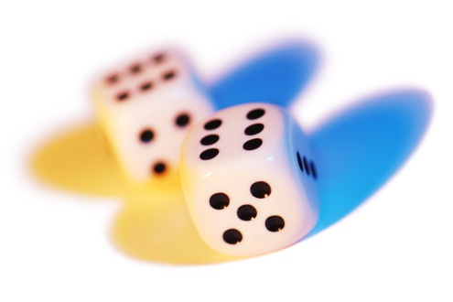
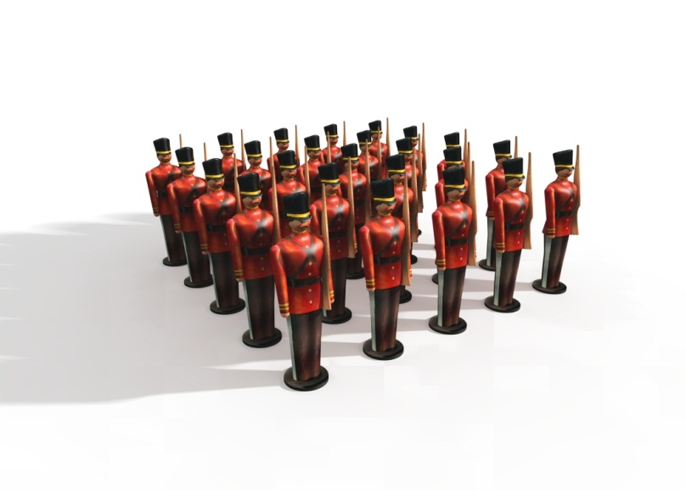
Object
Something that can be seen and touched.

Slide 81
One hundred
100
10 sets of 10; 100.

Slide 82
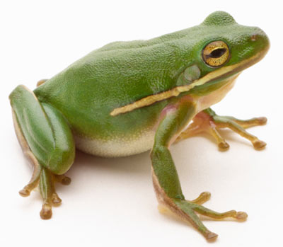

Order
The frogs are in order from smallest to largest.
Arrangement according to size, amount or value

Slide 83
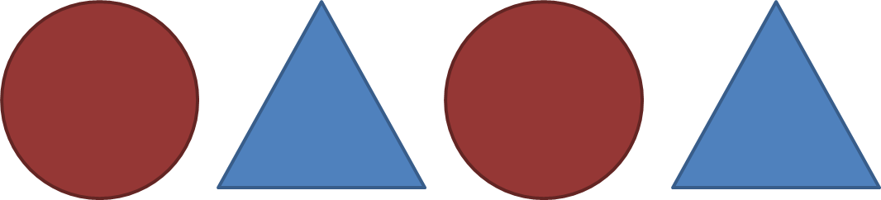
Pattern
Things that are arranged following a rule or rules.

Slide 84
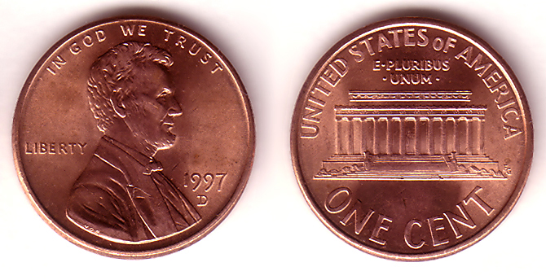
Penny
A coin with the value of 1 cent.

Slide 85
Place value
18
Tens
Ones
The value of a digit in a number, based on the location of the digit.

Slide 86
Plus
5 + 2 = 7
The symbol ( +), shows addition, to add or combine.

Slide 87
Problem
How many squares are there?
A question that needs a solution.

Slide 88
Quantity
How many squares are there?
How many there are of something.

Slide 89
Rectangle
A parallelogram with four right angles.

Slide 90
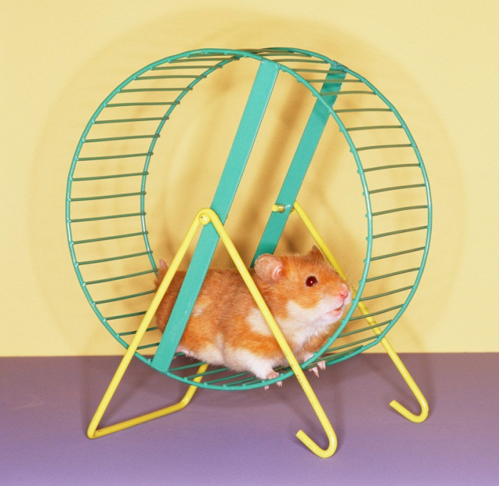
Roll
To move something by turning it over and over

Slide 91
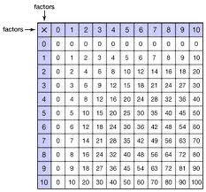
Row
row
An arrangement of figures, side by side.
©Partners for Learning, Inc.

Slide 92
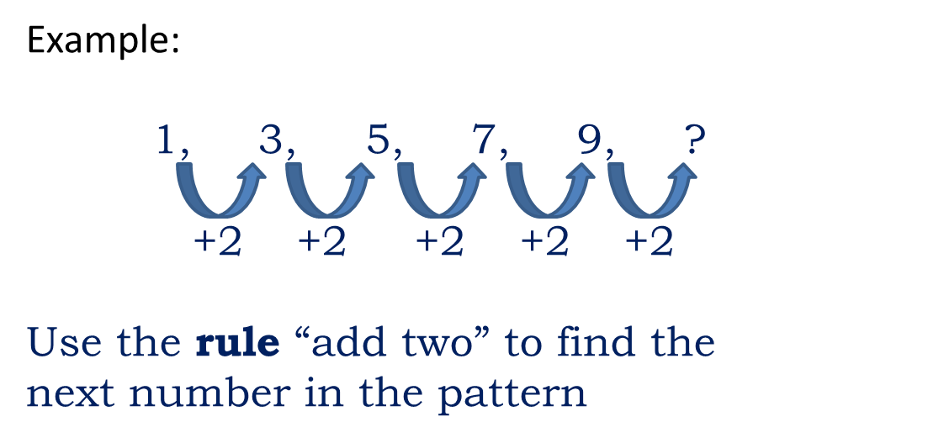
Rule
The procedure that a count must follow.

Slide 93
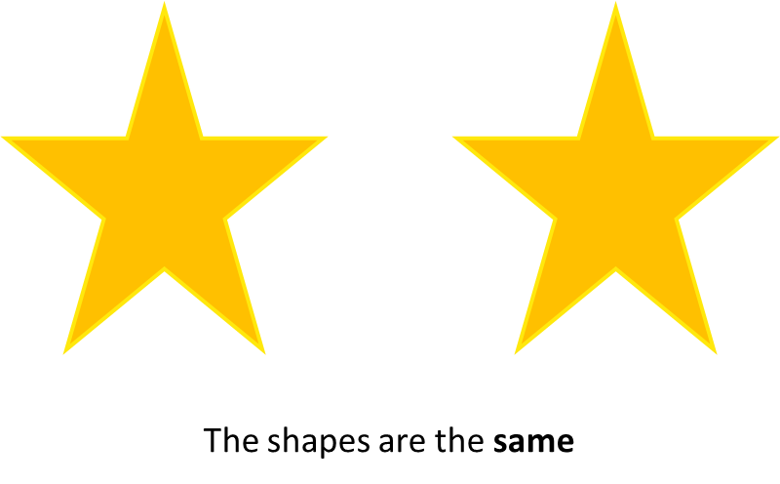
Same
Alike in size, quantity, or amount.

Slide 94
Second
Tuesday is the second day of the week.
Number two in a position or order of things.

Slide 95
Sequence
Example: Count Sequence
6, 7, 8, 9, 10, 11, 12, 13, 14
A set of numbers or objects arranged according to a specific rule or pattern.

Slide 96
Seven
0 1 2 3 4 5 6 7 8 9 10 11
One more than six; one less than eight.

Slide 97
Seventeen
17
1 ten and 7 ones.

Slide 98
Shape
The form of an object. How it is laid out in space (not what it is made of, or where it is).

Slide 99
Shorter
shorter
Less height or length than another.

Slide 100
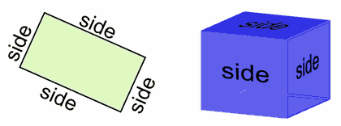
Side
One of the lines that make a flat shape or one of the surfaces that make a solid object.

Slide 101
Similar
Having the same shape but not necessarily the same size or color; alike but not exactly the same.

Slide 102
Six
0 1 2 3 4 5 6 7 8 9 10 11
One more than five; one less than seven.

Slide 103
Sixteen
16
1 ten and 6 ones.

Slide 104
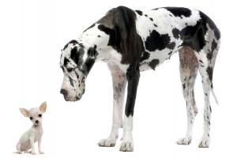
Size
This dog is BIG
This dog is little.
How big something is.

Slide 105
Slide
Shape A
Shape A
To move a shape without rotating or flipping it. The shape still looks exactly the same, just in a different place.

Slide 106
Smaller
This dog is bigger.
This dog is smaller.
Having a size that is less than that of another object.

Slide 107
Solid
A shape that is not flat; an object that has three dimensions. (height, length and width)

Slide 108
Sort
sorted by colors
red
purple
blue
To group or organize according to shared attributes.

Slide 109
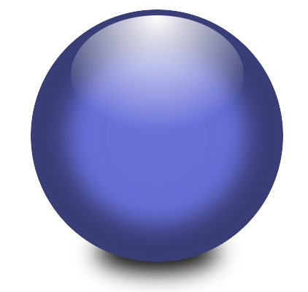
Sphere
Three-dimensional object that is completely round; a ball.

Slide 110
Square
A 4-sided polygon (a flat shape with straight sides) where all sides have equal length and every angle is a right angle (90°)

Slide 111

Stack
To put one object on top of another.

Slide 112
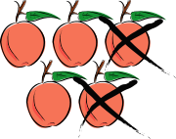
Subtract/Subtraction
5
-2
3
5 apples – 2 apples = 3 apples
To take one number away from another.

Slide 113
Sum
5 + 3 = 8
The result of adding numbers together.

Slide 114
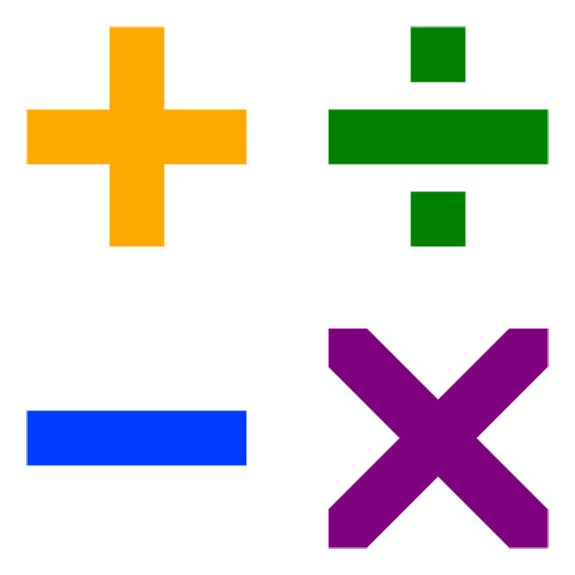
Symbol
A mark or sign used instead of words.

Slide 115
Take away
5
-2
3
5 apples take away 2 apples = 3 apples
To subtract.

Slide 116
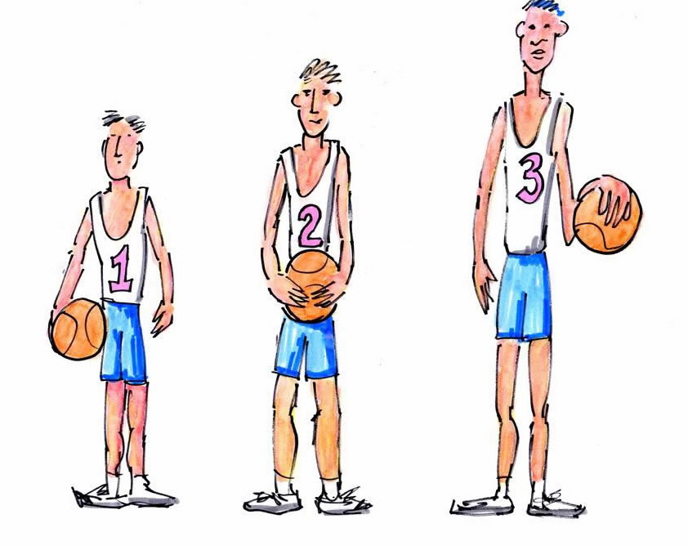
Taller/Tallest
tallest
Having more height than others.

Slide 117
Ten
0 1 2 3 4 5 6 7 8 9 10 11
One more than nine; one less than eleven.

Slide 118
Tens
26
Tens
Ones
Place value next to ones.

Slide 119
Third
Wednesday is the third day of the week.
The number three in a position or order of things.

Slide 120
Thirteen
13
1 ten and 3 ones.

Slide 121
Three
0 1 2 3 4 5 6 7 8 9 10 11
One more than two; one less than four.

Slide 122
Triangle
A three-sided polygon.

Slide 123
Twelve
12
1 ten and 2 ones.

Slide 124
Twenty
20
Two sets of ten.

Slide 125
Two
0 1 2 3 4 5 6 7 8 9 10 11
One more than one; one less than three.

Slide 126
Vertex/Vertices
A corner point of a geometric figure.

Slide 127
Week
Seven days.

Slide 128
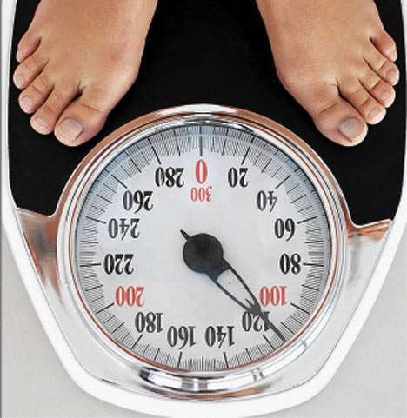
Weight
How heavy something is or how much mass it has.

Slide 129
Zero
0
A numerical figure which means the lack of any quantity; nothing, none, nil.

