Slide 1
Visual Vocabulary eSlides
Mathematics
Grade 2
© Partners for Learning, Inc. 2013

Slide 2
SITE LICENSE / TERMS OF USE
The academic vocabulary power point slides are sold on a per grade, per school basis.
TERMS OF USE:
All slides included in this presentation are for use only by the purchasing school
  Additional copies can be purchased for use
By using the slides you agree to only use the slides in the school for which they were purchased.
You further agree not to copy or distribute the slides for use outside of the purchasing school.
Thank You

Slide 3
2-dimensional
Lying flat.

Slide 4
3-dimensional
Solid shapes; having points or sides that are not all on one plane.

Slide 5
A.M.
noon
P.M.
A.M.
6 pm
6 am
midnight
Before noon; the time between midnight and noon.

Slide 6

Add/Addition
4 + 2 = 6
To bring two or more numbers (or things) together to make a new total.

Slide 7
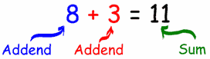
Addend
Any of the numbers added together to get the sum.

Slide 8
Additive Identity Property of 0
5 + 0 = 5
The rule that states that any number plus 0 is equal to that number.

Slide 9
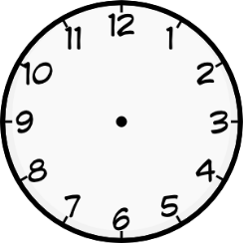
After
It is 20 minutes after 11.
Describes a time that is later than some other time.

Slide 10
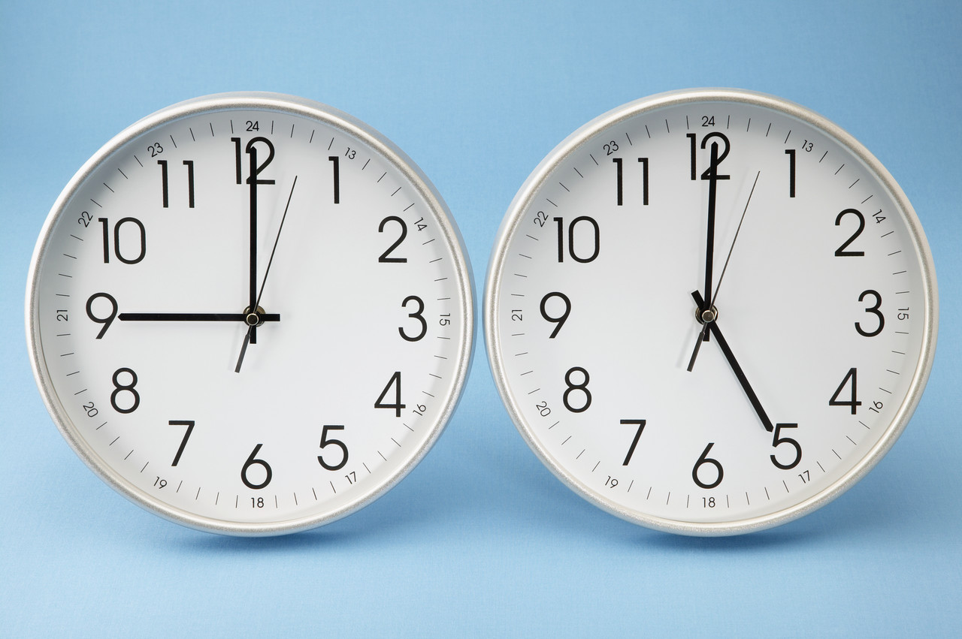
Analog clock
minute hand
hour hand
A clock with a minute hand and a hour hand.

Slide 11
Analyze
Examining parts to understand how they work together.

Slide 12
Angle
A figure formed by two rays with the same endpoint (vertex).

Slide 13

Area
x
y
$$area=x ×y$$
The amount of surface inside a closed shape. Measured in square units.

Slide 14
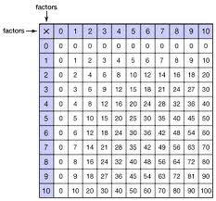
Array
A set of objects arranged in rows or columns.

Slide 15
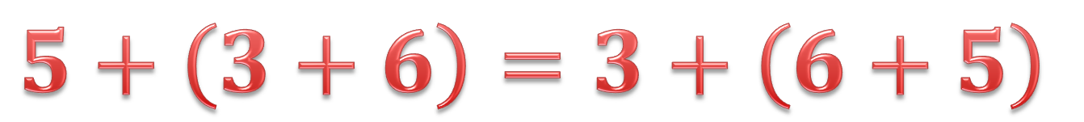
Associative Property of Addition
$$5+\left(3+6\right)=3+\left(6+5\right)$$
The property that states that when adding three or more real numbers, the sum is always the same, regardless of their grouping.

Slide 16
Attribute
The box is blue
The box has 4 sides
A character that something has such as color, weight, height.

Slide 17
Average
Formula: add up all the numbers, then divide by how many numbers there are
5 + 1 + 9 + 3 + 2 = 20
20 ÷ 5 = 4
The average is 4
The calculated “central” value of a set of numbers.

Slide 18
Bar graph
A graph that uses horizontal or vertical bars to represent data.

Slide 19
Base ten
1,245,678.9301
Millions
Tenths
Hundreds
Tens
Thousands
Ones
Hundredths
Ten Thousands
Thousandths
Hundred Thousands
Ten Thousandths
A number system based on ten; also known as the decimal system.

Slide 20
Before
It is 20 minutes before 12.
Describes a time that is earlier than some other time.

Slide 21
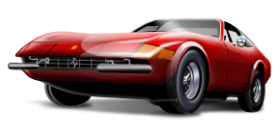



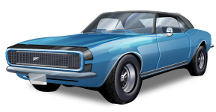
Cardinal number
This set contains 5 elements.
The cardinal number of this set is
5
The number of unique items in a set.

Slide 22
Category
color categories
red
purple
blue
A particular type of thing within a larger group; class. A kind of something.

Slide 23
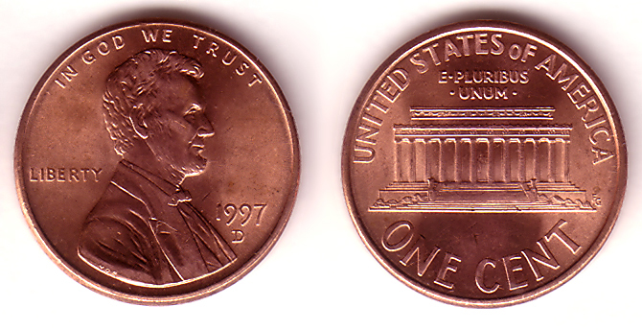
Cent
Smallest money value in the US.

Slide 24
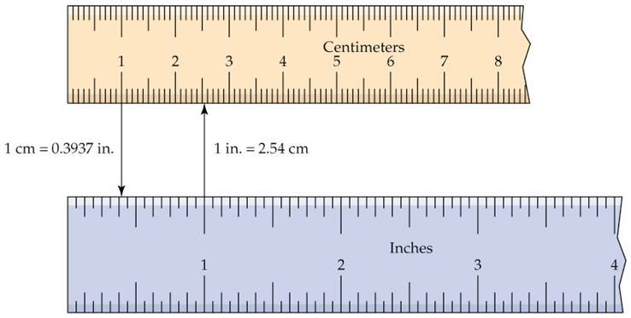
Centimeter
A metric unit of length equal to one hundredth of a meter.

Slide 25
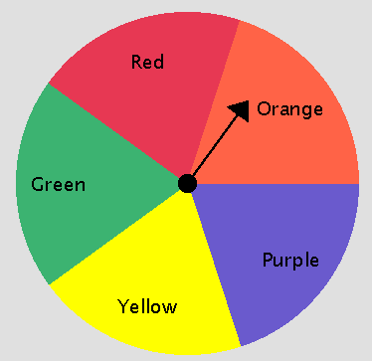
Chance
The chance that the dial will stop on Orange is 1 in 5
The likelihood that a particular outcome will occur.

Slide 26
Circle
A 2-dimensional shape made by drawing a curve that is always the same distance from a center.

Slide 27
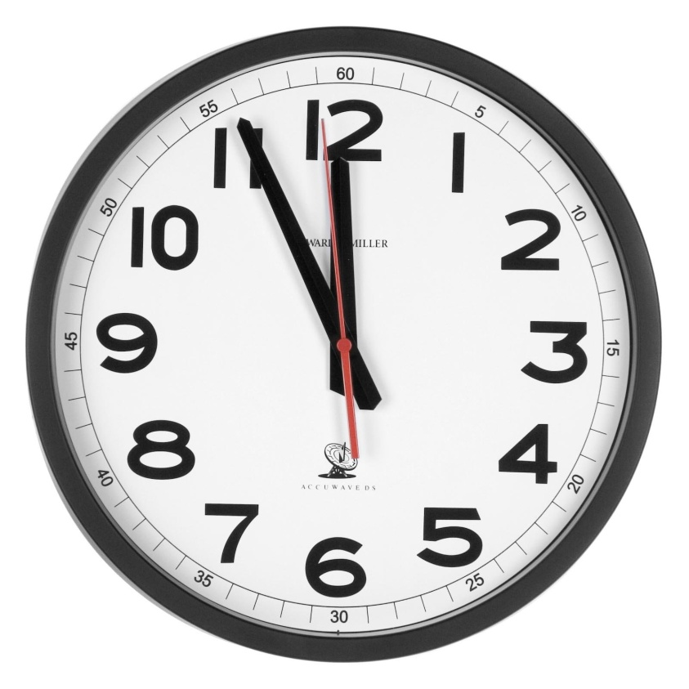
Clock
A device used for measuring and indicating time, usually by means of pointers moving over a dial.

Slide 28
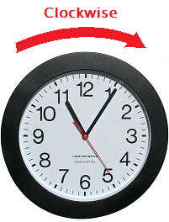
Clockwise
Moving in the direction of the hands on a clock

Slide 29
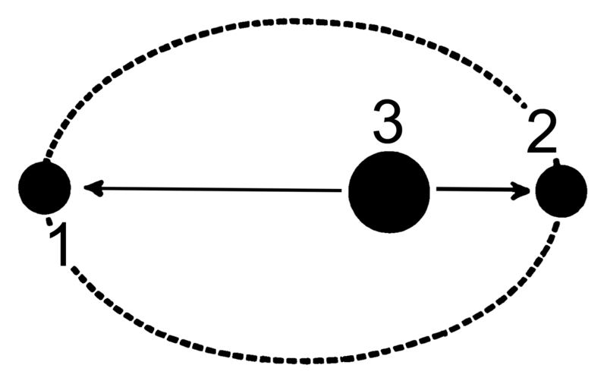
Closest
The number 2 dot is the closest to the number 3 dot
The shortest distance away.

Slide 30
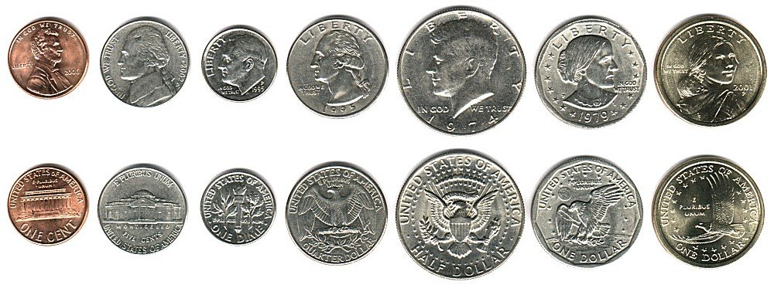
Coins
A kind of money.

Slide 31
Column
column
An arrangement of figures, one above the other.

Slide 32
Commutative Property of Addition
Example:
3 + 4 = 7
4 + 3 = 7
This property means that the addends can be added in any order and the sum is always the same.

Slide 33
Compare
Both fruits
Both grow on trees
Both are edible
One is red, the other is yellow
They are different shapes
To find how things are different or the same.

Slide 34
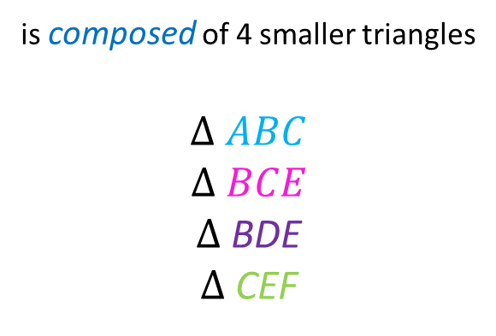
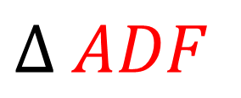
Compose
A
$$∆ ADF$$
is composed of 4 smaller triangles
$$∆ ABC$$
$$∆ BCE$$
$∆$ BDE
$∆$ CEF
B
C
D
F
E
To put together or make up by combining parts.

Slide 35
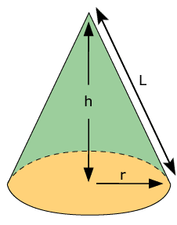
Cone
A solid 3 dimensional object that a has a circular base and one vertex.

Slide 36
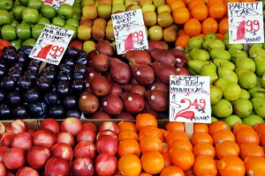
Cost
The amount of money asked for or paid for an item.

Slide 37

Count
1
2
3
There are 3 apples.
To say numbers in order.

Slide 38
Count backwards
3
2
1
There are 3 apples.
To say numbers in order backward.

Slide 39
Counting order
1, 2, 3, 4, 5, 6, 7, 8, 9, 10
Any number you can use for counting things; does not include zero.

Slide 40
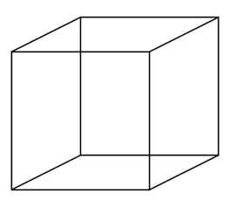
Cube
A box shaped solid object that has 6 identical square faces.

Slide 41
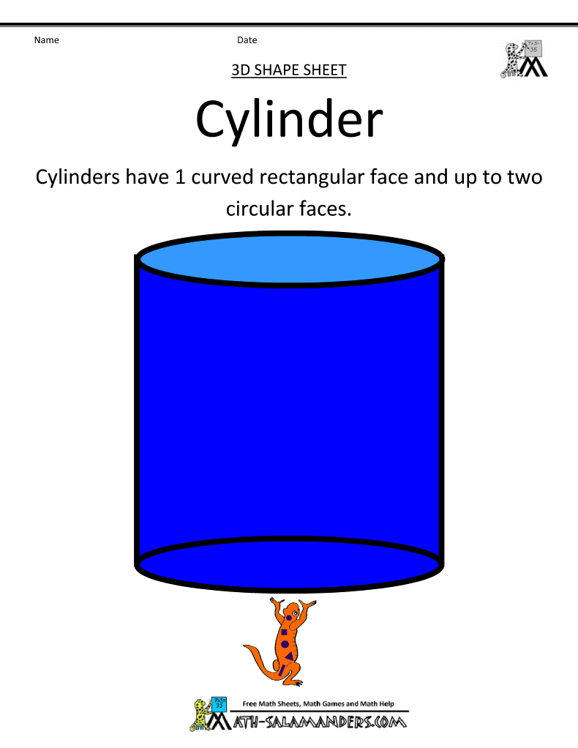
Cylinder
A solid object with 2 identical flat ends that are circular and 1 curved side

Slide 42
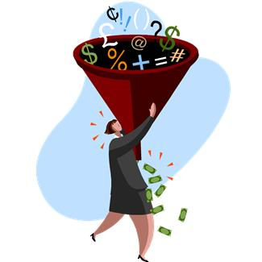
Data
A collection of facts, such as values or measurements.

Slide 43
Day
A 24 hour period from midnight to the next midnight.

Slide 44
Decompose
example:
decomposition of the number 5,432
5,432
=
5,000 + 400 + 30 + 2
To separate into parts or elements (e.g., geometric figures or numbers).

Slide 45
Defining attribute
This shape is a quadrilateral.
A characteristic that defines an object or shape.

Slide 46
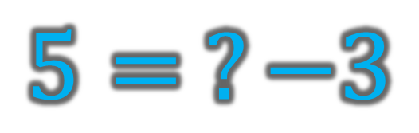
Determine
Determine the value that makes this equation true.
$$5= ?−3$$
To find or figure out.

Slide 47
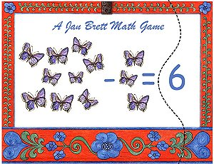
Difference
9
3
The result when one number is subtracted from another.

Slide 48
Different/Difference
These shapes are different.
Not the same; unlike.

Slide 49
Digit
0 1 2 3 4 5 6 7 8 9
A symbol used to write the numbers.

Slide 50
Digital clock
A clock that shows the time in digits.

Slide 51
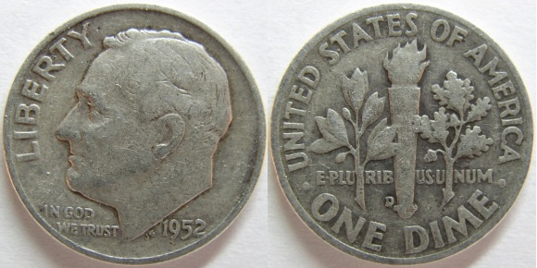
Dime
A coin with a value of ten cents.

Slide 52
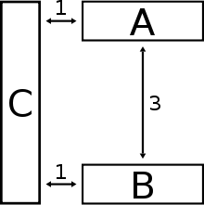
Distance
The length between two points or objects.

Slide 53
Divide/Division
9 ÷ 3 = ?
To split into equal parts or groups. It is “fair sharing”.

Slide 54
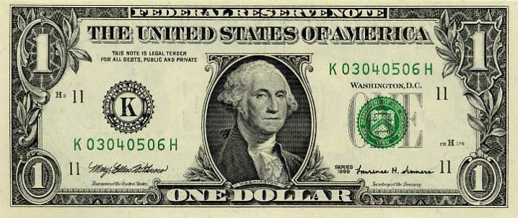
Dollar
A unit of money; equal to 100 cents or pennies.

Slide 55
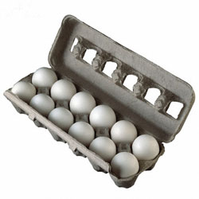
Dozen
A group or set of 12.

Slide 56
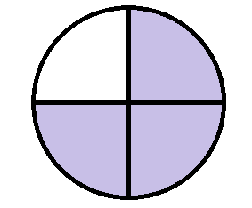
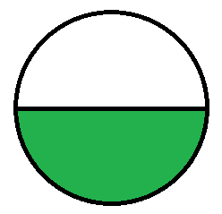
Equal shares
4 equal shares
2 equal shares
An equal part of a group, number or whole.

Slide 57
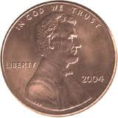
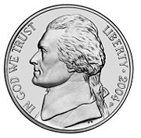
Equal/Equivalent
=
1 nickel is equal to 5 pennies
Exactly the same amount or value.

Slide 58
Equation
2 + 2 = 1 + 3
Says that two things are the same, using math symbols.

Slide 59
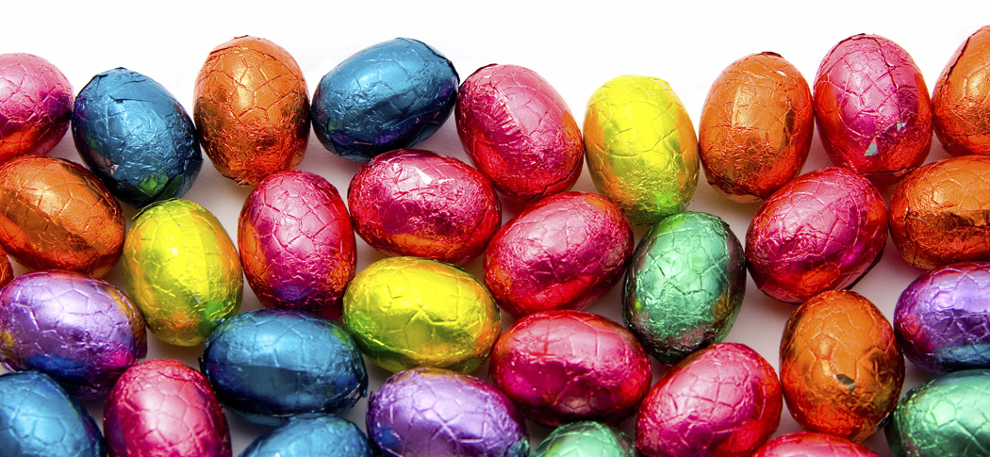
Estimate/Estimation
I estimate that there are 25 candies in the picture.
To guess closely; an answer that is close to the exact answer.

Slide 60
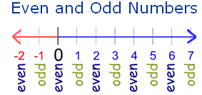
Even number
Number that is divisible by 2. Even numbers end with 2,4,6,8,0.

Slide 61
Expanded form
1,642
( 1 x 1000 ) + ( 6 x 100 ) + ( 4 x 10 ) + ( 2 x 1 )
Expanded form
Writing a number to show the value of each digit.

Slide 62
Face
The sides outlined in red
are faces.
The blue squares are bases
A flat surface on the outside of a solid.

Slide 63
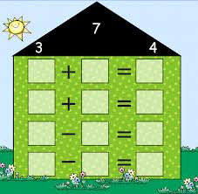
Fact family
3
4
7
4
3
7
7
4
3
7
3
4
A group of related facts using the same set of numbers.

Slide 64

Factor
There are 3 groups of 5 flowers.
3 X 5 = 15
factors
product
A number that is multiplied by another number to find a product.

Slide 65
Figure
A flat or solid shape.

Slide 66
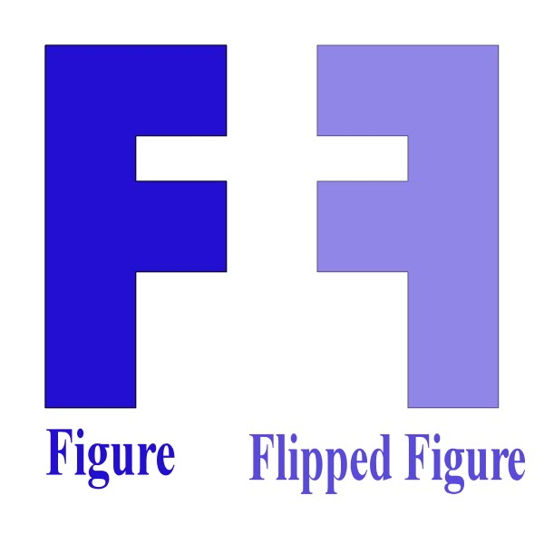
Flip
A geometric transformation; to turn over.

Slide 67
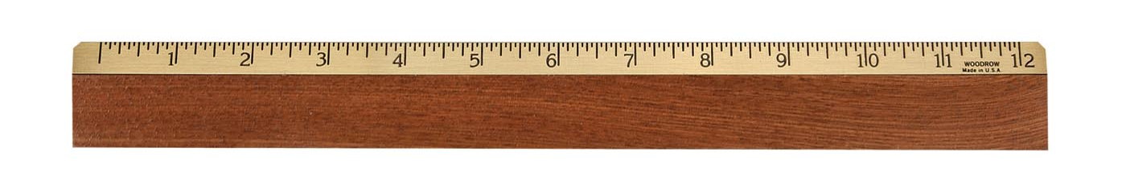
Foot
12 inches = 1 foot
Imperial unit for measuring length; equal to 12 inches.

Slide 68
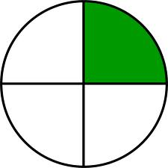
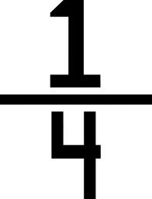
Fourths
One or more of four equal parts.

Slide 69
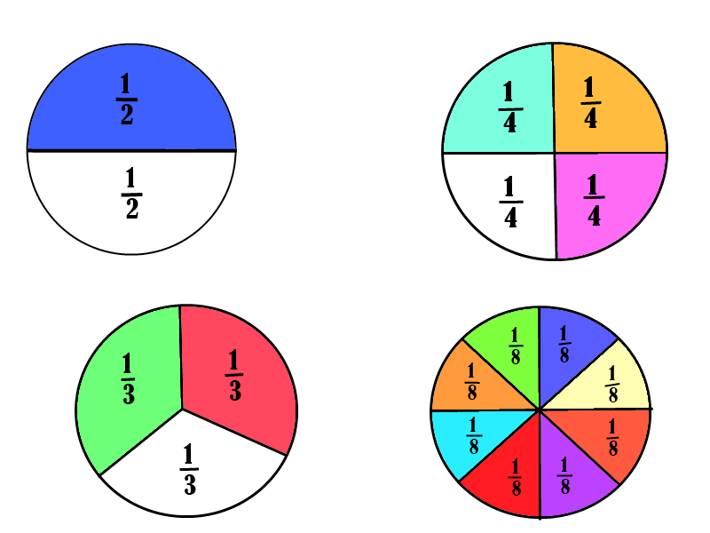
Fraction
One ore more of the equal parts of a whole; fragment.

Slide 70

Greater than
3 > 1
three is greater than one
Bigger. The symbol > means greater than.

Slide 71
Half circle
On of two equal parts of a circle.

Slide 72
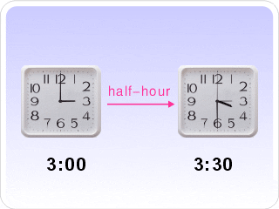
Half hour
A unit of time equal to 30 minutes.

Slide 73
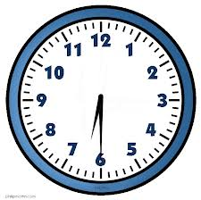
Half past
6:30
Thirty minutes past any hour.

Slide 74
Half/Halves
One of two equal parts of a whole.

Slide 75
Hexagon
A six-sided polygon.

Slide 76
Horizontal
Parallel to or in the plane of the horizon.

Slide 77

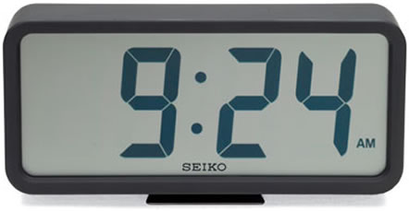
Hour
Hour
Minutes
Unit of time equal to 60 minutes.

Slide 78
Hour hand
hour hand
minute hand
The hand on an analog clock that represents the hour; the shorter hand.

Slide 79
Hundreds
1,245,678.9301
Millions
Tenths
Tens
Thousands
Hundreds
Ones
Hundredths
Ten Thousands
Thousandths
Hundred Thousands
Ten Thousandths
The place value in a number that represents how many 100’s there are.

Slide 80
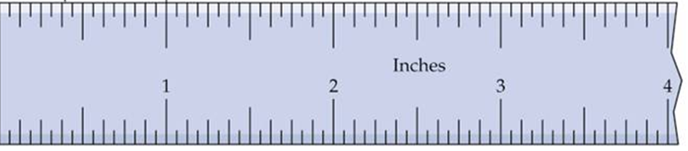
Inch
A measure of length.

Slide 81
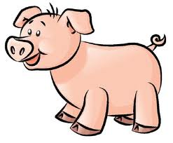
Large
Medium
Large
Small
Big as compared with others of its kind.

Slide 82
Length
length
How long something is from end to end.

Slide 83
Less
3
The boxes on the left have less squares than the one on the right.
5
2
Smaller; not as many.

Slide 84
Less than
Two is less than three.
2 < 3
Smaller than another.

Slide 85
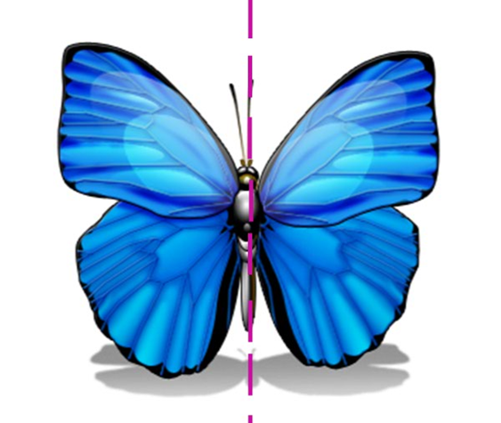
Line of symmetry
A line that divides a figure in halves so that each half is a mirror image of the other.

Slide 86
Line plot
Sample Line Plot:
Math Test Scores
X
X
X
X
X
X
X
X
X
X
X
X
X
60
65
70
75
80
85
90
95
A number line showing frequency of data.

Slide 87
Line segment
A portion of a line with a start and a stop.

Slide 88


Lowest
Highest
Lowest
Closest to the bottom or zero.

Slide 89
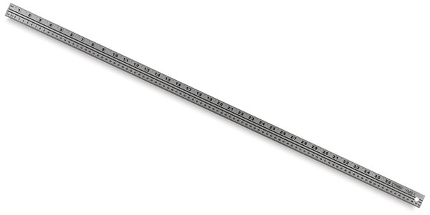
Meter (m)
A metric unit for measuring length equal to 100 centimeters.

Slide 90
Metric system
milli-
deci-
deca-
kilo-
centi-
gram
hecto-
liter
meter
10 millimeters = 1 centimeter
10 centiliters = 1 deciliter
10 decigrams = 1 gram
10 meters = 1 decameter
10 dekaliter = 1 hectoliter
10 hectograms = 1 kilogram
A system of measurement.

Slide 91
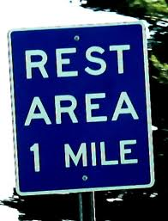
Mile
1 mile = 5,280 feet
A standard imperial unit for measuring distance.

Slide 92
Minute
Hour
Minutes
Unit of time equal to 60 seconds.

Slide 93
Minute hand
hour hand
minute hand
The hand on an analog clock that represents the minute; the longer hand.

Slide 94
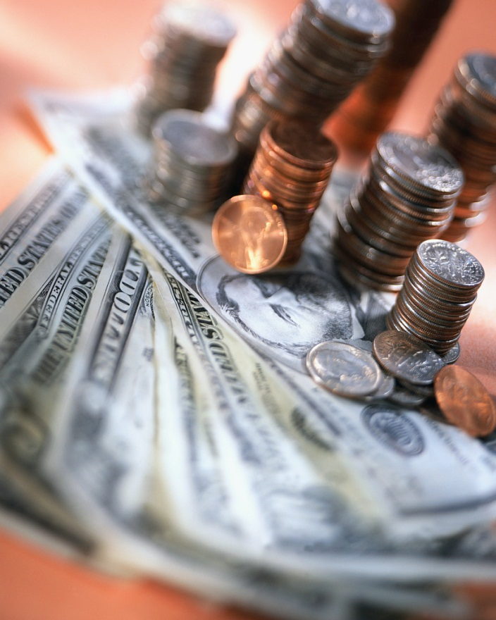
Money
Coins and bills used to pay for things.

Slide 95
Month
One of twelve parts of the year.

Slide 96

Morning
The first or early part of the day.

Slide 97
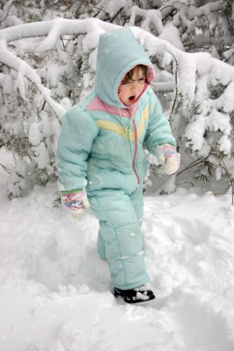
Most likely
In the winter, the weather will most likely be cold
Has the best chance of happening.

Slide 98

Most often
The orange square appears most often (more than the other shapes).
The largest or larger amount in a group.

Slide 99
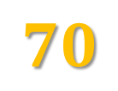









Multiples of ten
$$70$$
$$50$$
$$100$$
$$10$$
$$40$$
$$30$$
$$80$$
$$60$$
$$90$$
$$20$$
Numbers into which ten will divide evenly.

Slide 100


Multiplication/Multiply
4x5=?
$$4+4+4+4+4=20$$
The basic idea of multiplication/multiply is repeated addition.

Slide 101

Nickel
A with a value equal to 5 cents.

Slide 102

Noon
Twelve o’clock in the day time; midday.

Slide 103

Number line
A line on which each point represents a number.

Slide 104
Number pattern
1, 2, 3, 4, 5, 6, 7, 8, 9, 10
2, 4, 6, 8, 10, 12, 14, 16, 18, 20
5, 10, 15, 20, 25, 30, 35, 40, 45, 50
10, 20, 30, 40, 50, 60, 70, 80, 90, 100
A list of numbers that follow a certain sequence or pattern.

Slide 105
Numeral
0, 1, 2, 3, 4, 5, 6, 7, 8, 9
A symbol used to represent a number.

Slide 106

O’clock
When the time is at a whole hour with no minutes.

Slide 107

Odd number
A number that is not divisible by 2. Odd numbers end with 1, 3, 5, 7, or 9.

Slide 108
Ones
1,325
The place value in a number that represents how many 1’s there are.

Slide 109




Operation
$$+$$
$$×$$
$$−$$
$$÷$$
The math process of addition, subtraction, multiplication and division.

Slide 110
Outside
Inside of the box
Outside of the box
The outer side, part; exterior.

Slide 111
P.M.
noon
P.M.
A.M.
6 pm
6 am
midnight
After noon; the time between noon and midnight.
©Partners for Learning, Inc.

Slide 112
Partition
The circle is partitioned into four equal parts.
To divide a whole into parts.

Slide 113
Penny
A coin with the value of 1 cent.

Slide 114
Pentagon
A five-sided polygon.
©Partners for Learning, Inc.

Slide 115




Picture graph
A class of 30 second graders was asked about their favorite sports. Their responses are represented by this picture graph.
Baseball
Football
Soccer
Basketball
A graph that uses pictures or symbols to show numbers or quantities.
©Partners for Learning, Inc.

Slide 116
Place value
1,245,678.9301
Millions
Tenths
Hundreds
Tens
Thousands
Ones
Hundredths
Ten Thousands
Thousandths
Hundred Thousands
Ten Thousandths
The value of a digit in a number, based on the location of the digit.

Slide 117

Pound
A scale tells someone how many pounds they weigh.
A standard imperial unit for measuring weight, equal to 16 oz.

Slide 118
Quadrilateral
quadrilateral shapes
A four-sided polygon.

Slide 119

Quart
A standard imperial unit for measuring liquid capacity; equal to 32 fluid ounces, 2 pints or 4 cups.

Slide 120

Quarter
A coin with a value of 25 cents.

Slide 121

Quarter
$$\frac{1}{4}$$
One of four equal parts.

Slide 122

Rate
Days | 1 | 2 | 3 | 4 | 5 | 6 | 7
Cost | $50 | $100 | $150 | $200 | $250 | $300 | $350
A ratio that compares two quantities measured in different units.

Slide 123
Rectangle
A parallelogram with four right-angles.

Slide 124

Regroup
tens
1
ones
First, add the ones column.
$$7+5=12$$
Next we put the 2, under the line in the ones column, and regroup, by carrying the one to the top of the tens column.
Finally, we add the tens column.
$$1+2+4=7$$
27
+45
12
72
The process used to assist when trading or carrying in addition and subtraction.
©Partners for Learning, Inc.

Slide 125
Represent
$
A dollar sign represents money.
%
A percent sign represents a part of a whole.
To present clearly, describe, show.

Slide 126
Rotation/Turn
The light blue triangle represents a clockwise rotation of 90$°$.
A circular movement around a fixed point.
©Partners for Learning, Inc.

Slide 127



Round
$$π=\text{3.1415926}\text{5...}$$
hundredths
Round $π$ to the nearest hundredth.
$$3.14$$
To approximate a number to a specified place value.

Slide 128
Row
row
An arrangement of figures, side by side.
©Partners for Learning, Inc.

Slide 129
Ruler
A tool used to measure distances or to make straight lines.
©Partners for Learning, Inc.

Slide 130
Scale
The measurements on a ruler are a scale
Sequenced marks, usually at regular intervals or representing equal steps.

Slide 131

Second
A stopwatch can measure to a fraction of a second.
The basic unit of time. There are 60 seconds in 1 minute, and 3600 seconds in an hour.
©Partners for Learning, Inc.

Slide 132
Sentence
object
subject
Johnny got an A on his math test.
verb
A statement or question made with a group of words including a subject, verb and object.
©Partners for Learning, Inc.

Slide 133

Sequence
Use the rule “add two” to find the next number in the sequence.
A set of numbers or objects arranged according to a specific rule or pattern.
©Partners for Learning, Inc.

Slide 134
Set
A set of classic cars
A collection of unique “things” (objects, numbers, etc.). Each member is called an element of the set.
©Partners for Learning, Inc.

Slide 135
Seventh
One of seven equal parts.
©Partners for Learning, Inc.

Slide 136
Similar
Having the same shape but not necessarily the same size or color; alike but not exactly the same.

Slide 137

Skip count
$$2, 4, 6, 8, 10, 12, 14, 16$$
Count by 2’s.
To count by a given number.
©Partners for Learning, Inc.

Slide 138
Slide
Shape A
Shape A
To move a shape without rotating or flipping it. The shape still looks exactly the same, just in a different place.

Slide 139
Smallest
1
2
3
smallest
Least in size or value.

Slide 140
Solve
Problem:
John ate 2 apples and Jennifer ate 1 apple.
How many apples did they eat in all?
Solve: 2 + 1 = 3
To work out the answer.

Slide 141
Sort
sorted by colors
red
purple
blue
To group or organize according to shared attributes.

Slide 142

Sphere
Three-dimensional object that is completely round; a ball.

Slide 143
Square
A 4-sided polygon (a flat shape with straight sides) where all sides have equal length and every angle is a right angle (90°).

Slide 144
Square unit
Square Inch: each side measures one inch
Square foot: each side measures one foot
Square Mile: each side measures one mile
A measurement of size based on square shaped units.

Slide 145
Standard form
1,234
is the standard form of the number
One thousand two hundred thirty-four.
A way to write numbers using the digits 0-9, with each digit having a place value.

Slide 146



Standard units of measure
Accepted measuring devices and units of the customary or metric system.

Slide 147

Subtract/Subtraction
5
-2
3
5 apples – 2 apples = 3 apples
To take one number away from another.

Slide 148
Sum
The result of adding numbers together.

Slide 149

Symbol
A mark or sign used instead of words.

Slide 150

Table
Numbers or quantities arranged in rows and columns

Slide 151

Tablespoon
teaspoon
tablespoon
A unit of measure, used especially in cookery, equal to ½ fluid oz. or 15 milliliters.
©Partners for Learning, Inc.

Slide 152

Taller/Tallest
tallest
Having more height than others.

Slide 153
Teaspoon
teaspoon
tablespoon
A unit of measure, used especially in cookery, equal to 1/6 fluid oz. or 5 milliliters.
©Partners for Learning, Inc.

Slide 154

Temperature
A measurement of how hot or cold something is.

Slide 155
Ten thousand
10,000
A 1 followed by 4 zeros; 10⁴.

Slide 156
Tens
1,245,678.9301
Millions
Tenths
Tens
Thousands
Ones
Hundredths
Ten Thousands
Hundreds
Thousandths
Hundred Thousands
Ten Thousandths
The value given to the digit located two places to the left of the decimal point.

Slide 157



Thermometer
Instrument for measuring temperature.

Slide 158
Thirds
One or more of three equal parts.

Slide 159
Thousand
1,000
A 1 followed by three zeros; 10³.

Slide 160
Thousands
1,245,678.9301
Millions
Tenths
Hundreds
Tens
Ones
Hundredths
Thousands
Thousandths
Ten Thousands
Ten Thousandths
Hundred Thousands
The value given to the digit located four places to the left of the decimal.
©Partners for Learning, Inc.

Slide 161

Time
Ongoing sequence of events take place-past, present, future. Clocks measure time.

Slide 162
Triangle
A three-sided polygon.

Slide 163
Mathematics Vocabulary - Grade 7
Twice
2 4
Twice
as many
triangles
Two times.

Slide 164
Unit
1,245,678.9301
Millions
Tenths
Hundreds
Units
Thousands
Tens
Hundredths
Ten Thousands
Thousandths
Hundred Thousands
Ten Thousandths
Another name for one.

Slide 165

Unknown number
$$2x+5=y$$
variables
The missing number in an equation.

Slide 166


Value
$$x=5$$
How much something is worth; the numerical quantity assigned to a variable.

Slide 167
Vertex/Vertices
vertex
vertex
vertex
vertex
vertex
A corner; a place where surfaces meet.

Slide 168

Week
A time period equal to seven days.
©Partners for Learning, Inc.

Slide 169

Weight
How heavy something is or how much mass it has.

Slide 170

Whole
Half
Whole
All of an object; the entire thing.

Slide 171
Whole numbers
9
8
2
4
1
7
3
6
5
A set of counting numbers including zero.

Slide 172

Yard
Standard Imperial unit for measuring length; approximately equal to 3 feet or 36 inches.
©Partners for Learning, Inc.

Slide 173
Year
A period of 365 days; 12 months.
©Partners for Learning, Inc.

