Slide 1
Visual Vocabulary eSlides
English Language Arts (ELA)
Grade 7
Partners for Learning, Inc.
(208) 322-5007
resources@partnersforlearning.org
www.partnersforlearning.org

Slide 2
SITE LICENSE / TERMS OF USE
The academic vocabulary power point slides are sold on a per grade, per school basis.
TERMS OF USE:
All slides included in this presentation are for use only by the purchasing school
  Additional copies can be purchased for use
By using the slides you agree to only use the slides in the school for which they were purchased.
You further agree not to copy or distribute the slides for use outside of the purchasing school.
Thank You

Slide 3
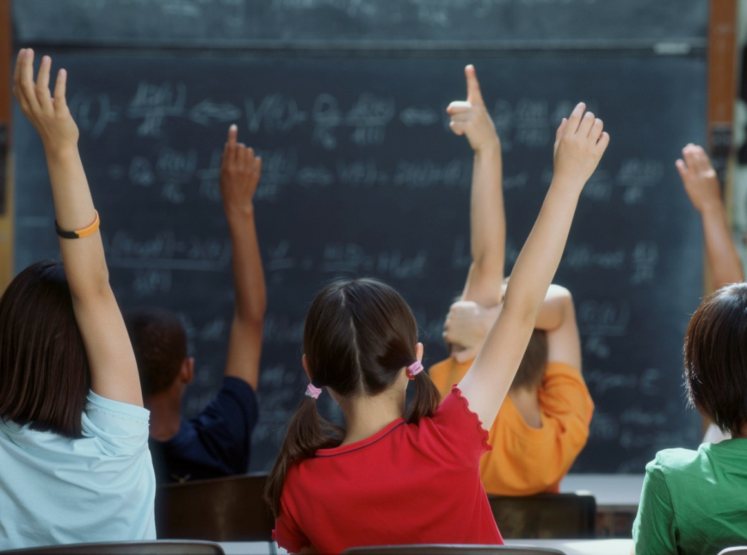
Academic
Having to do with school or what you learn in school.

Slide 4
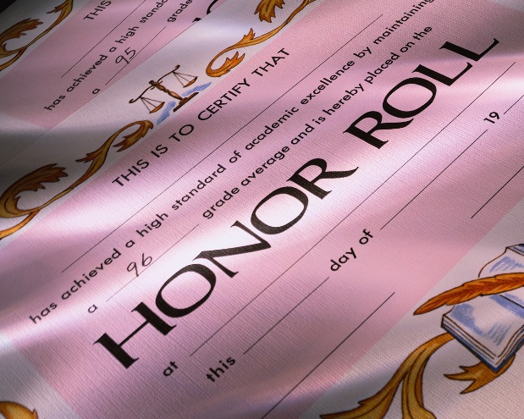
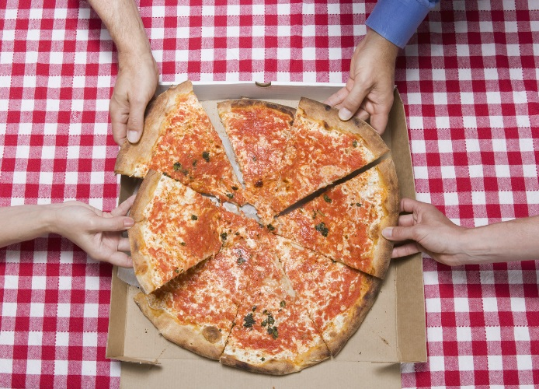
Acknowledge
The principal chose to acknowledge the Honor Roll students with certificates and a pizza party.
To admit the truth or existence of.

Slide 5
Acquire
The satellite was used to acquire the signal.
To get or come to have as one's own.

Slide 6
Address
The purpose of her speech is to address the issue of bullying in schools today.
To give attention to; deal with.

Slide 7
Affix
Unwrapped
The prefix un means not, or opposite of.
The suffix ed means happened in the past.
affix
An affix can be added to the root of a word to change its meaning. Added to the beginning of the word, it is a prefix. Added to the end of a word, it is a suffix.

Slide 8
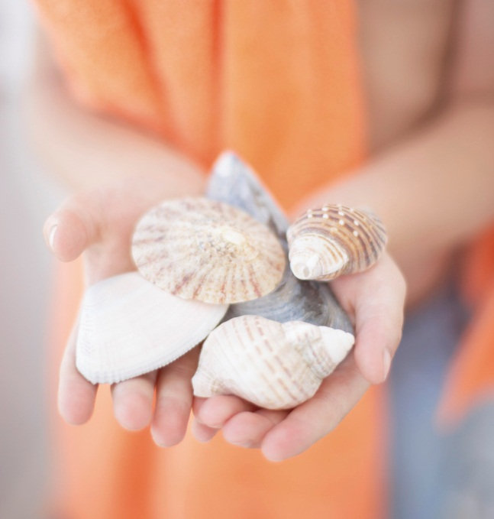
Alliteration
Sally Sells Seashells by the Seashore.
The repetition of the same initial letter in successive words; it is done for effect.

Slide 9
Allusion
He has told so many lies, I’m surprised his nose isn’t a mile long.
The connection between lies and a growing nose is an allusion to the story of Pinocchio.
A passing or casual reference; an incidental mention of something.

Slide 10
Alter
The prankster used a disguise to alter his appearance.
To make different in some way; change.

Slide 11
Ambiguous
example of an ambiguous line from the movie Animal Crackers (1930):
While hunting in Africa, I shot an elephant in my pajamas.
Was the hunter wearing the pajamas when he shot the elephant?
or
Was the elephant wearing the pajamas when the hunter shot it?
Having more than one possible meaning.

Slide 12
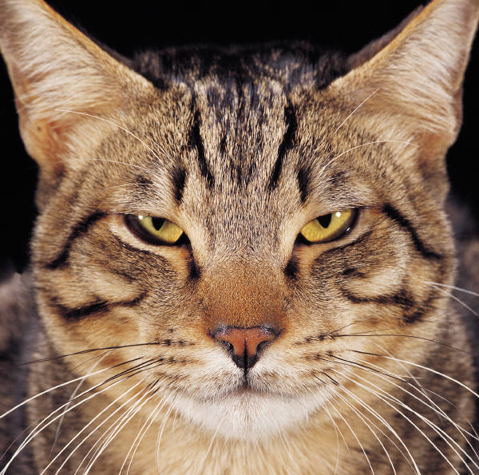
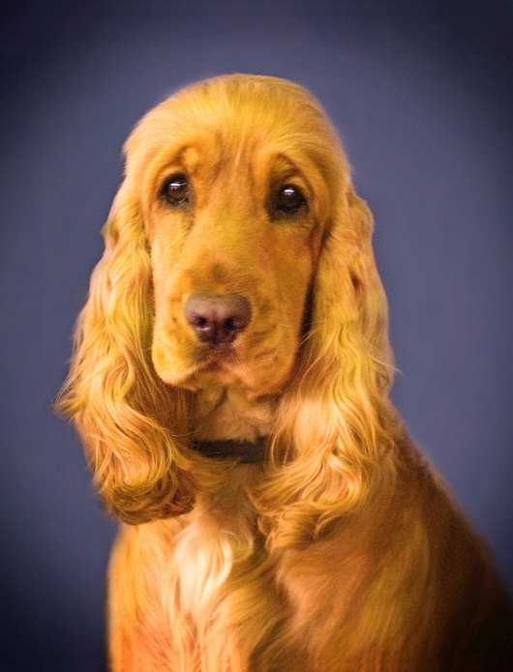
Analogy
Meow is to Cats
as
Bark is to Dogs
A comparison of two different things that are similar in some way.

Slide 13
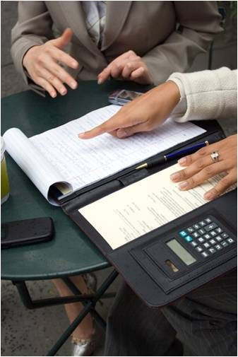
Analysis/Analyze
Examining parts to understand how they work together to create meaning as a whole.

Slide 14
Antagonist
Red Riding Hood
protagonist
Big Bad Wolf
antagonist
A principal character or force in opposition to a protagonist, or main character.

Slide 15
Antecedents
antecedent
Sally’s dad is teaching her how to ride her bike.
pronoun
A word, phrase or a clause to which a pronoun refers.

Slide 16
Antonym
Happy
Sad
A word having a meaning opposite to that of another word.

Slide 17
Aphorism
Lost time is never found again.
~Benjamin Franklin
A short statement of a general truth or idea.

Slide 18
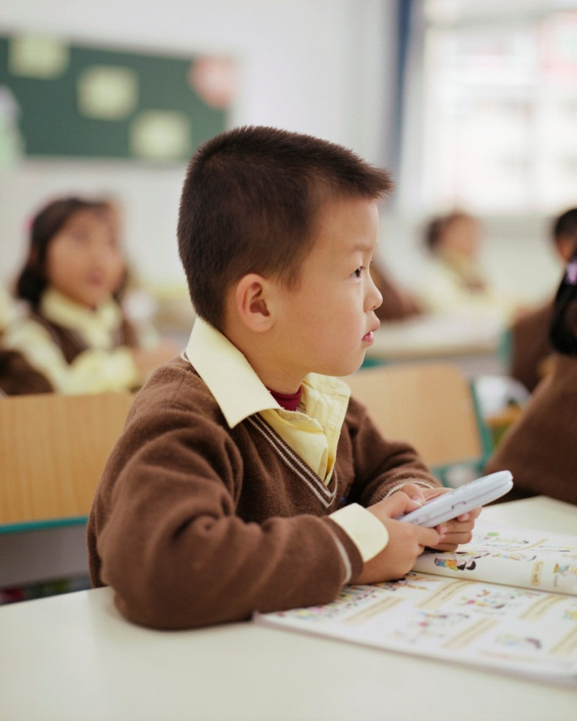
Appropriate
It is not appropriate to play with your cell phone in class.
Right for a certain time and place; proper.

Slide 19
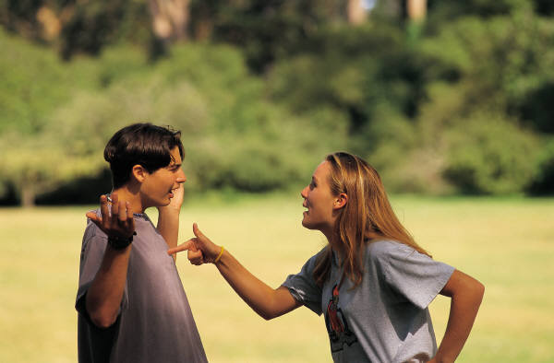
Argument
Verbal exchange between people with opposite views

Slide 20
Assonance
“Hear the mellow wedding bells”
~Edgar Allen Poe
The repetition of vowel sounds, but not consonants, in words for poetic effect.

Slide 21
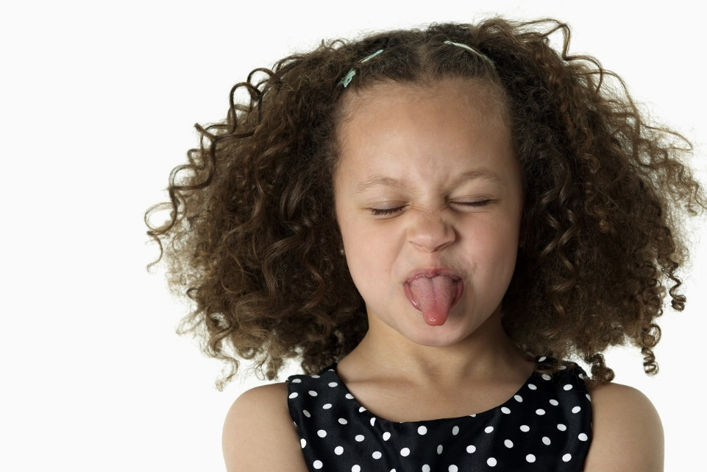
Attitude
The little girl has a bad attitude.
A way of feeling or thinking about something or someone.

Slide 22
Audio
Having to do with or using sound.

Slide 23
Author’s purpose
Narrate
Argue
Amuse
Scare
Entertain
Purpose
Report
Persuade
Inform
Motivate
Analyze
Compare/Contrast
Enlighten
The reason the author created a writing.

Slide 24
Base word
UNBELIEVEABLE
A complete word that can stand alone without a prefix or suffix.

Slide 25
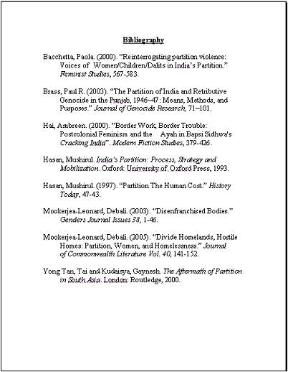
Bibliography
A list of writings used as sources, with year and place of publication.

Slide 26

Blog
An online journal where people post about their experience.

Slide 27
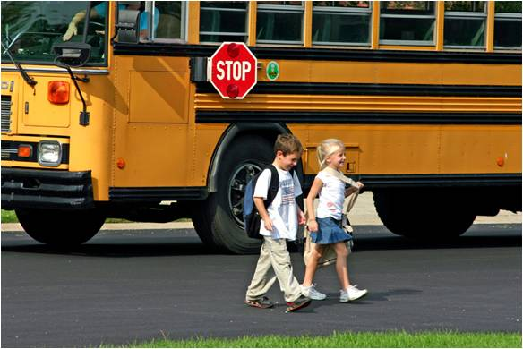
Caption
caption
Brian and Sarah on the first day of school
A sentence or phrase written under a picture to tell about or explain the picture.

Slide 28
Cause and effect
It rained last night, so the grass is all wet.
cause
effect
A text structure that explains why things happen; the events that happen first are the causes and the events that happen as a result are the effects.

Slide 29
Central idea
Detail
Detail
Cats are playful.
Cats like to cuddle.
Central Idea
key details
Why I like cats.
key details
Detail
Detail
My cat is friendly.
Cats are cute.
The main thought of focus of a piece of writing.

Slide 30
Character development
Surrounding Environment
Physical Details
Other Characters
The method(s) a writer uses to create and develop characters.

Slide 31
Character traits
Loyal
Religious
Sincere
Honest
Loving
Persistent
Devoted
Kind
Ambitious
Features that identify the character.

Slide 32
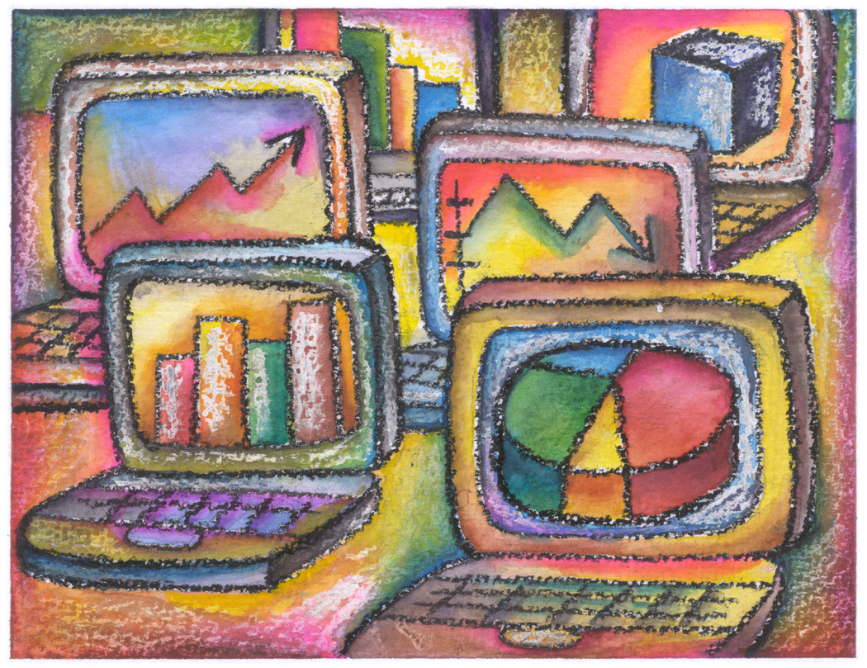
Chart
A group of facts about something in the form of a diagram, table, graph, etc.

Slide 33


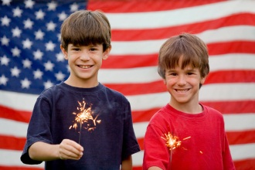


Chronological order
New Years Day – January 01
Valentine’s Day – February 14
St. Patrick’s Day – March 17
Independence Day – July 04
Halloween – October 31
Christmas Day – December 25
A list of events in the order in which they occur.

Slide 34
Cite
As the story went on, it became quite clear that Peter’s intentions were mischievous. This was made evident when Greg said, “I have found Peter’s notebook, and I’m sure that he is the one behind this crime.” (Smith, 2006)
Works Cited
Smith, Mary (2006). A Great Day. Hoboken, New Jersey: Willardson & Briggs.
citation
Make reference to; to quote (a passage, book, author, etc.).

Slide 35
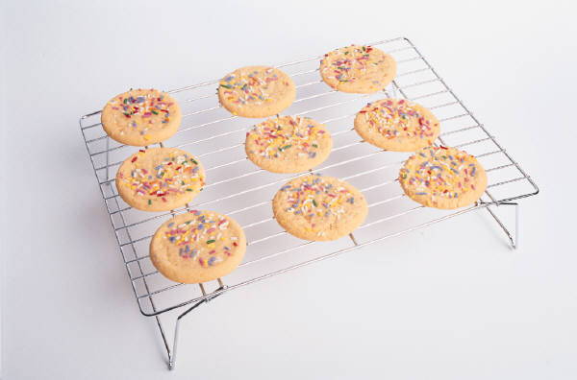
Claim
My grandma bakes the best cookies.
To state (something) as true although not proven to be; assert, contend.

Slide 36
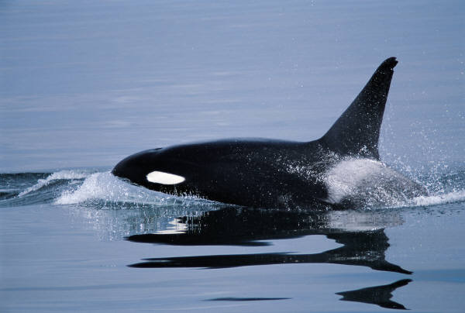
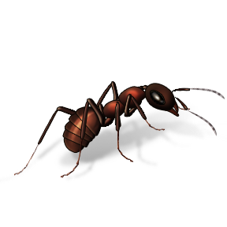
Classification
Small
Ant
Mouse
Kitten
Puppy
Large
Elephant
Horse
Whale
Lion
The act of distributing things into classes or categories.

Slide 37
Clause
independent clause
John and Mary went to the mall
after they finished doing their homework.
dependent clause
A group of words containing a subject and a predicate and forming part of a compound or complex sentence.

Slide 38
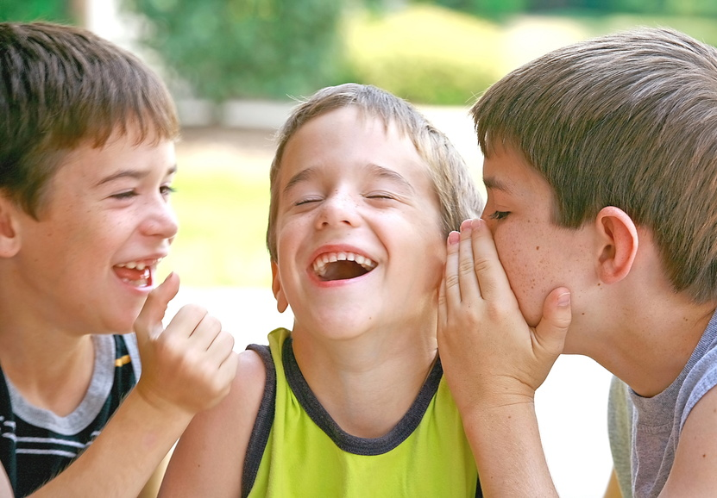
Cliché
Laughter is the best medicine.
An overly used expression or idea.

Slide 39
Coherent
The boy is riding a unicycle.
Logical and clear.

Slide 40
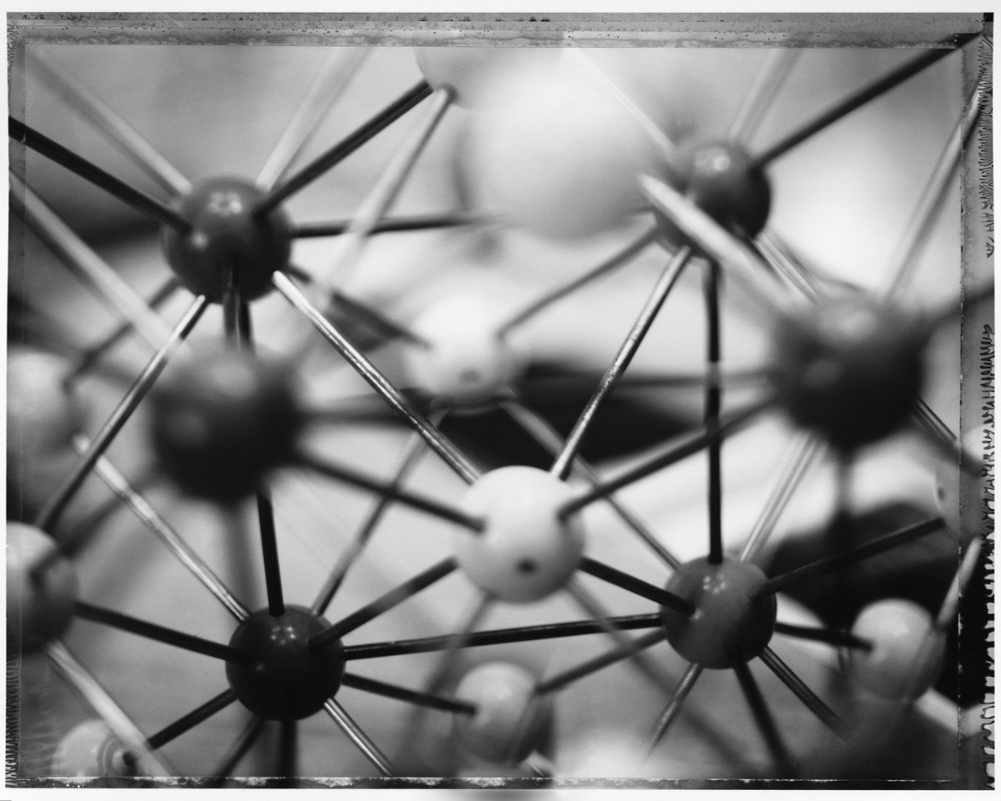
Cohesion
To lump, hold, or stick together.

Slide 41

Collaborate
Working together toward a common goal.

Slide 42
Collegial
A work environment where responsibility and authority is shared equally by colleagues.

Slide 43


Compare and Contrast
red or green skin
grown in many climates
edible skin
fruit
seeds
grown on trees
good for you
juicy
sweet
orange skin
grown in subtropical climate
don’t eat skin
How two or more things are alike and/or different.

Slide 44
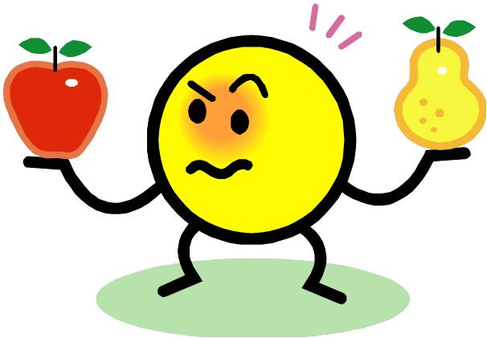
Comparison
Both fruits
Both grow on trees
Both are edible
An examination of how two or more things are similar or alike.

Slide 45
Complex sentence
independent clause
subordinator
John and Mary went to the mall
after they finished doing their homework.
dependent clause
A sentence with one independent clause and one or more dependent clauses.

Slide 46
Component
A part of something.

Slide 47
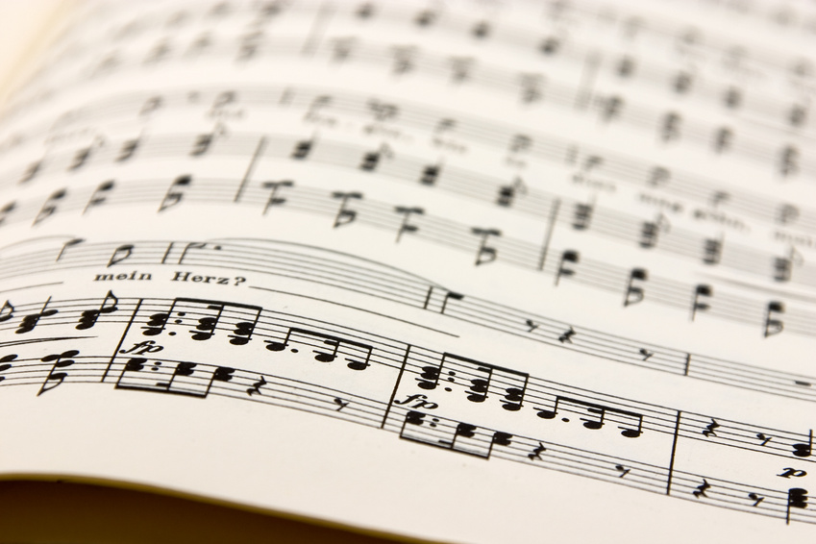
Compose
To write or create.

Slide 48

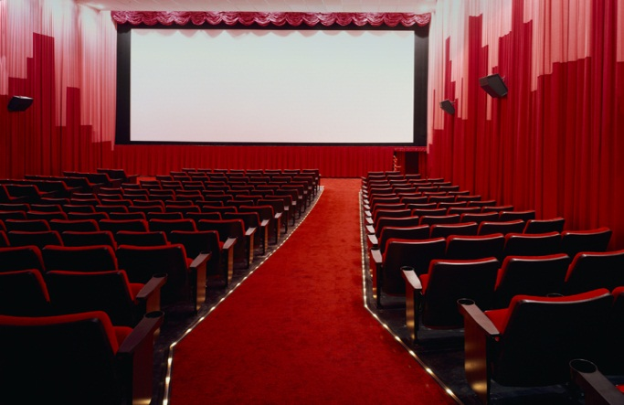
Compound sentence
independent clause
She hasn’t seen the movie.
She has read the book, but she hasn’t seen the movie.
She has read the book.
independent clause
A sentence containing two or more independent clauses.

Slide 49
Compound-complex sentence
independent clause
She hasn’t seen the movie.
She has read the book, but she hasn’t seen the movie because theater prices are too high.
She has read the book.
because theater prices are too high.
independent clause
A sentence containing two or more independent clauses, and at least one dependent clause.

Slide 50
Comprehend/Comprehension
To understand or grasp the meaning of.

Slide 51
Concept
A general idea or thought.

Slide 52
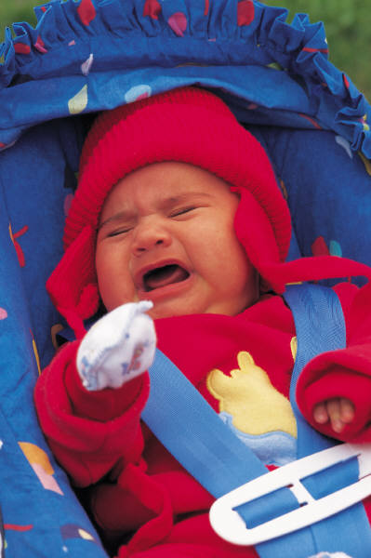
Concise
The baby is very unhappy.
Saying much in a few words; short and to the point.

Slide 53
Conclude/Conclusion
Climax
Conflict
Resolution
Rising Action
Falling Action
Introduction
Conclusion
To bring to an end or close; the final part.

Slide 54
Concrete details
The bite of the frigid air was
nearly unbearable as I made my
way through the frozen forest.
Explicit details adding to the visual perception of the text, describes in great detail how things might feel, smell, look like, sound like, and/or taste like.

Slide 55
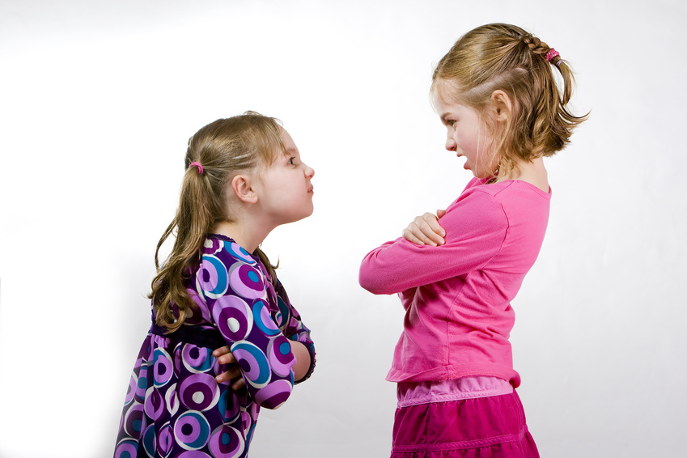
Conflict
A problem or disagreement between people, society, or nature.

Slide 56
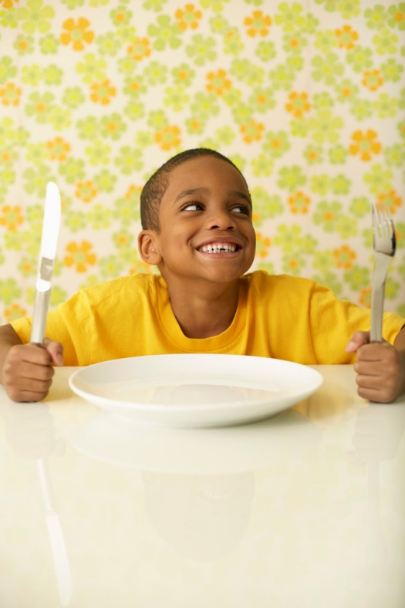
Connotation
I’m wasting away.
I’m famished.
I’m starving.
I’M HUNGRY
A meaning suggested by a word or an expression in addition to its exact meaning.

Slide 57

Consonance
“If two witches were watching two watches, which witch would watch which watch?”
The repetition of consonants (or consonant patterns) especially at the ends of words.

Slide 58
Consult
To look for advice or information.

Slide 59

Consumer documents
INSTRUCTION
MANUAL
Printed materials that accompany products and services…manuals, instructions, warranties, etc.

Slide 60
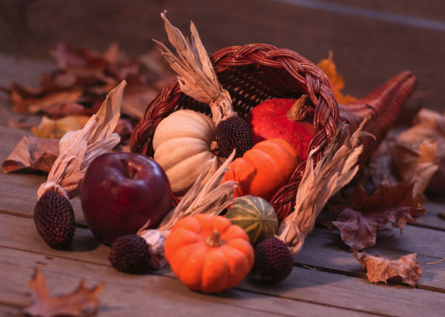
Content
Whatever is held or contained in something.

Slide 61
Context
She greeted him in a very cold manner.
cold in this sentence refers to an unfriendly attitude.
COLD
It’s very cold outside.
cold in this sentence refers to the temperature.
The set of facts or circumstances that surround a situation or event.

Slide 62
Context clues
She greeted him in a very cold manner.
cold in this sentence refers to an unfriendly attitude.
context clue
COLD
context clue
It’s very cold outside.
cold in this sentence refers to the temperature.
Clues given in a passage as to the meaning of the word.

Slide 63
Contribute
To give for a purpose.

Slide 64
Convention/Conventional
This is conventional classroom.
Things that are normal, ordinary, and following the accepted way.

Slide 65
Convey
To communicate; express.

Slide 66
Credible/Credibility
She was a credible witness.
Believable or plausible.

Slide 67
Dash
Even the simplest tasks—washing, dressing, and going to work—were nearly impossible after I broke my leg.
A punctuation mark that is used to indicate an abrupt pause or break in the thought or structure of a sentence.

Slide 68
Delineate
The bite of the frigid air was
nearly unbearable as I made my
way through the frozen forest.
To describe or portray in precise or vivid detail.

Slide 69
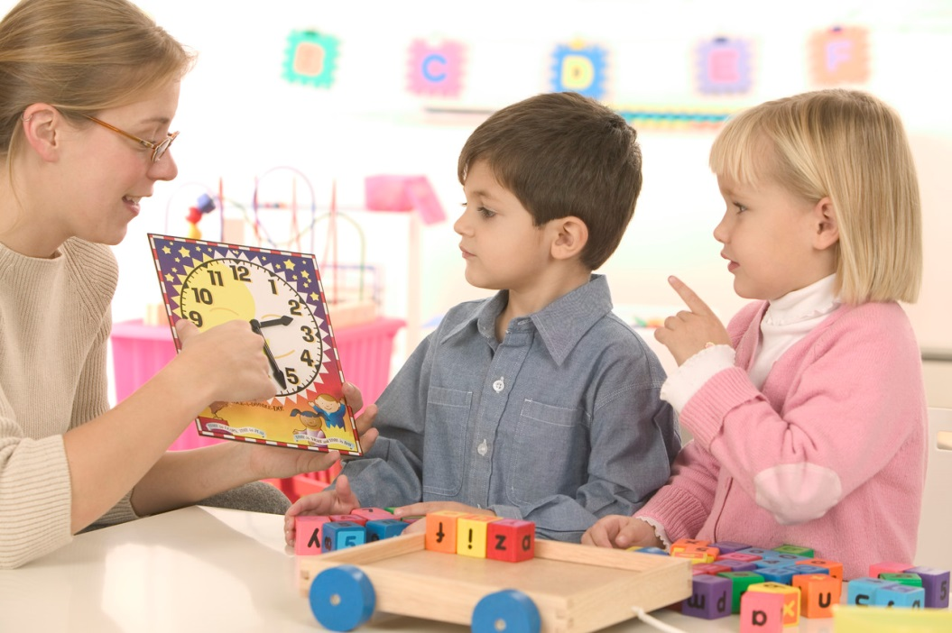
Demonstrate
The teacher is demonstrating how to tell time.
To show how to do something.

Slide 70
Denotation
I’m wasting away.
I’m famished.
I’m starving.
I’M HUNGRY
denotation
The direct meaning of a word or expression.

Slide 71
Dependent clause
independent clause
John and Mary went to the mall
after they finished doing their homework.
dependent clause
A group of words that has both a subject and a verb but (unlike an independent clause) cannot stand alone as a sentence.

Slide 72
Descriptive language
The bite of the frigid air was
nearly unbearable as I made my
way through the frozen forest.
Words intended to create a mood, person, place, thing, event, emotion, or experience.

Slide 73
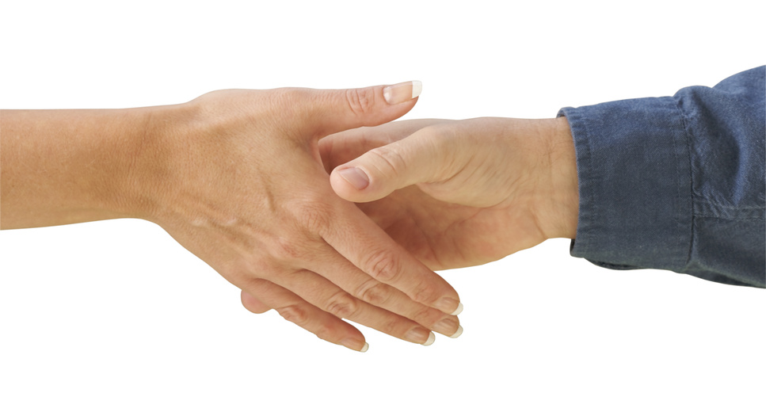
Determine
To decide or settle finally and without question.

Slide 74
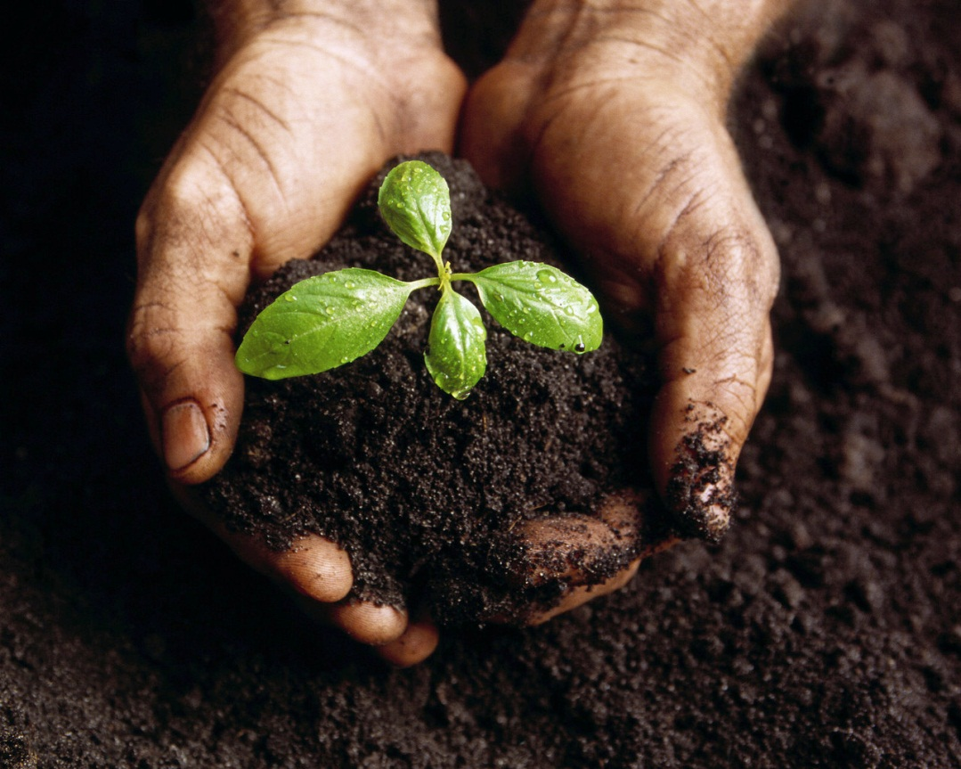
Develop
To grow or cause to grow.

Slide 75
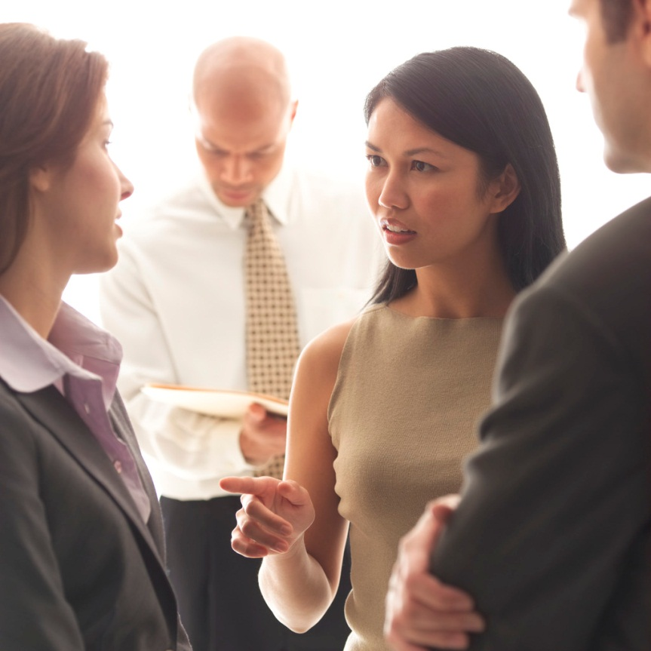
Dialogue
A talk between two or more people or between characters in a play, film, or novel.

Slide 76
Distinguish
Can you distinguish which one is different?
To tell apart by seeing differences.

Slide 77
Diverse
Of different kinds or sorts.

Slide 78
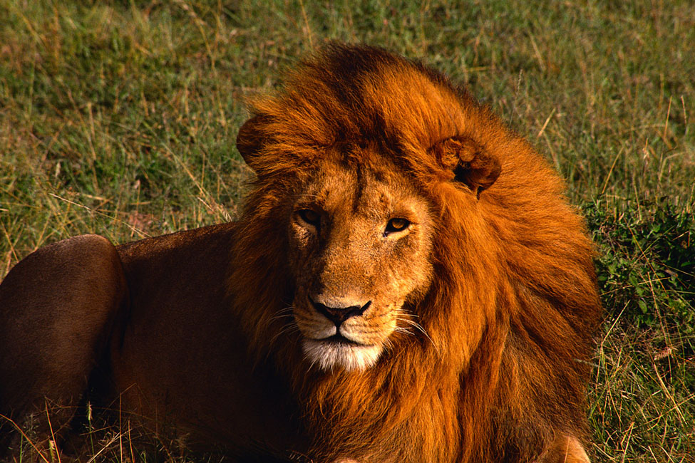
Domain
The lion, King of his domain.
A particular environment or walk of life.

Slide 79
Drama
A type of literature which is meant to be performed.

Slide 80
Drawing conclusions
There are puddles on the ground.
We can draw the conclusion that it rained recently.
Making a decision or voicing an opinion based on reasoning or inferring.

Slide 81
Edit/Editing
To correct and revise.

Slide 82
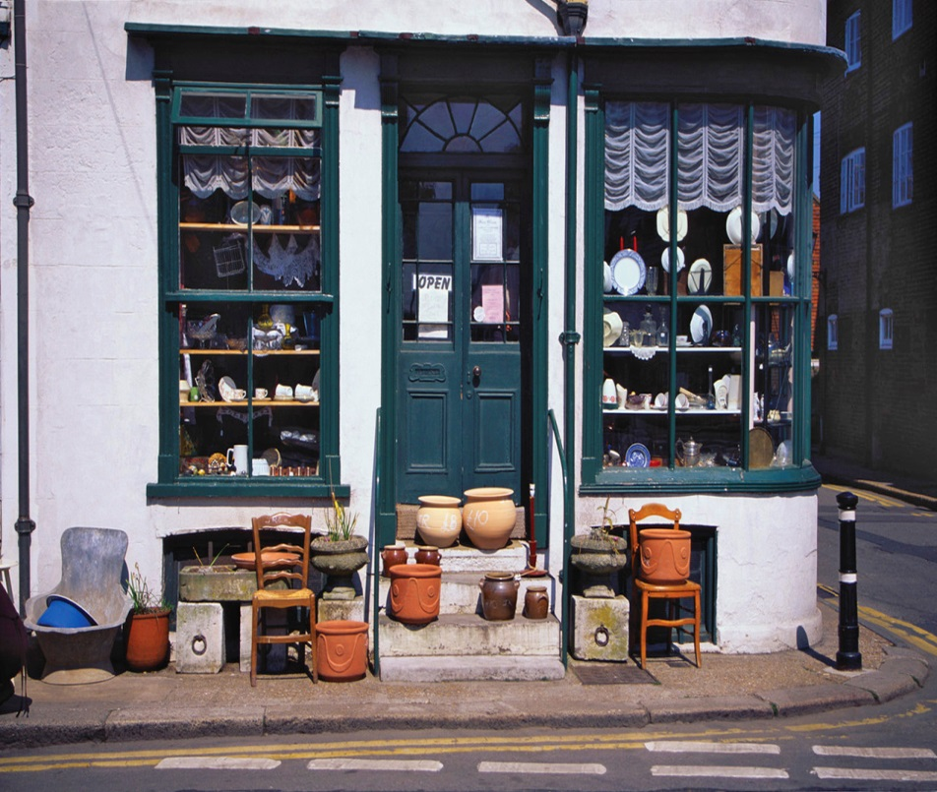
Elaborate
The antique store is on the corner.
The antique store is on the corner of 3rd and Main Street.
To add details to something; explain more fully.

Slide 83
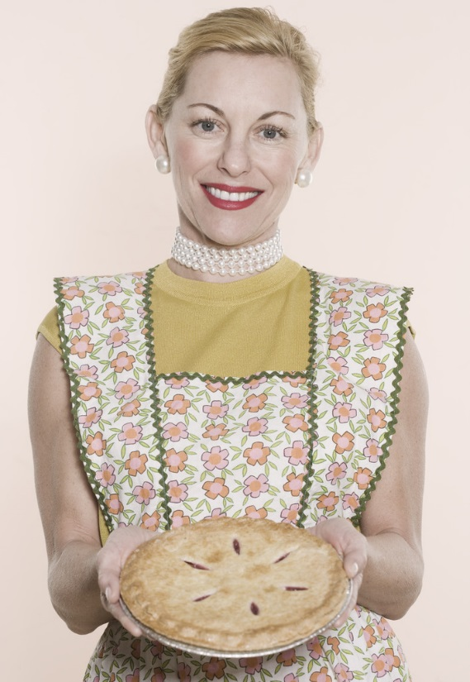
Elicit
The smell of fresh baked pie always elicits fond memories of home.
To draw or bring out.

Slide 84
Emphasis/Emphasize
Boldface, italic, and underlined font is often used to emphasize important pieces of text.
To give particular attention to; stress.

Slide 85
Engage
The comedian did a great job of engaging the audience.
To get or hold the interest of.

Slide 86
Enhance
They decided to enhance the value of their home by remodeling the kitchen.
To improve or add to the quality, value, or attractiveness of.

Slide 87
Enunciate
Gonna
poor enunciation
Going To
proper enunciation
To speak or pronounce in a clear voice.

Slide 88

Etymology
SCHOOL
"place of instruction," Old English scol, from Latin schola, from Greek skhole "school, lecture, discussion,"
The history of a word shown by tracing it or its parts back to the earliest known forms.

Slide 89

Evaluate
To judge the value or worth of someone or something.

Slide 90
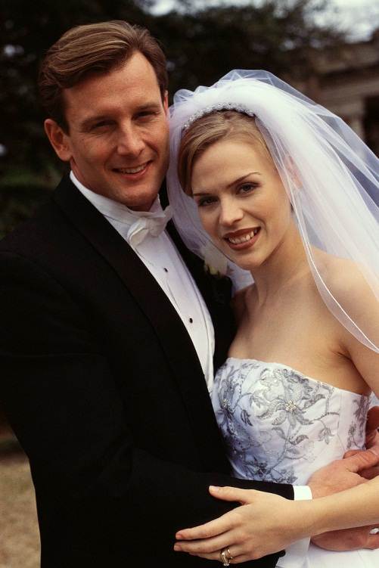
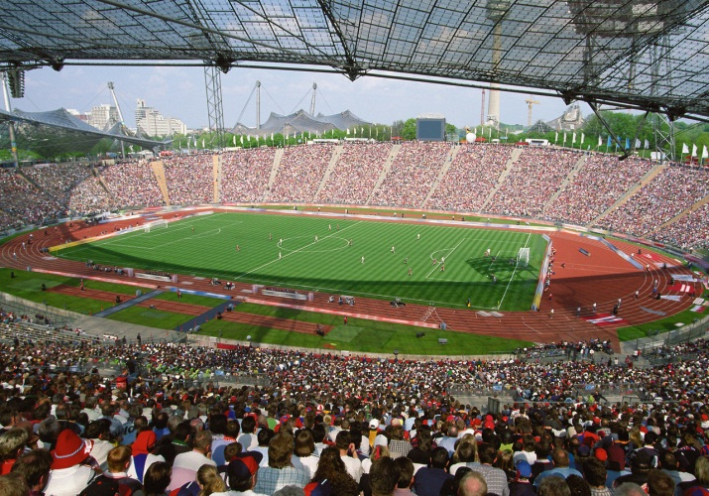

Events
Sporting Event
Graduation
Wedding
Something that happens.

Slide 91

Evidence
Anything that can be used to prove something.

Slide 92
Excerpt
an excerpt from The Gettysburg Address:
“Four score and seven years ago our fathers brought forth on this continent a new nation, conceived in liberty, and dedicated to the proposition that all men are created equal.”
~Abraham Lincoln, November 19, 1863
A passage or segment taken from a text…phrase, sentence, paragraph, or chapter.

Slide 93

Explain/Explanation
The doctor is explaining the diagnosis to his patient.
To make clear, plain, or understandable.

Slide 94
Explicit
Close the refrigerator door.
Said or written in a clear and direct way.

Slide 95
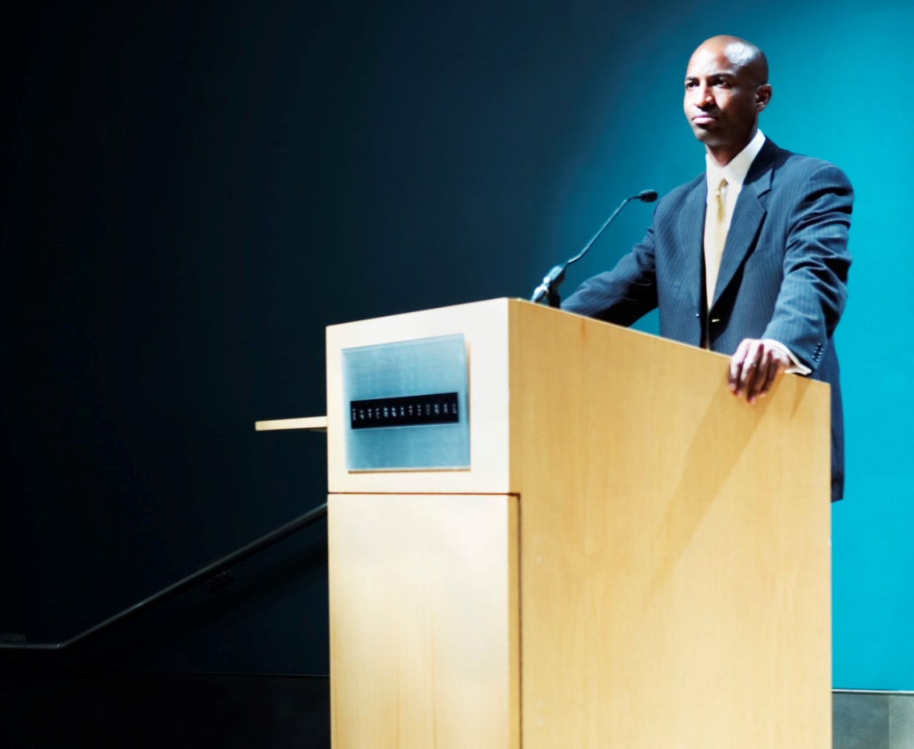
Exposition
Writing or speech primarily intended to convey information or to explain; a detailed statement or explanation.

Slide 96
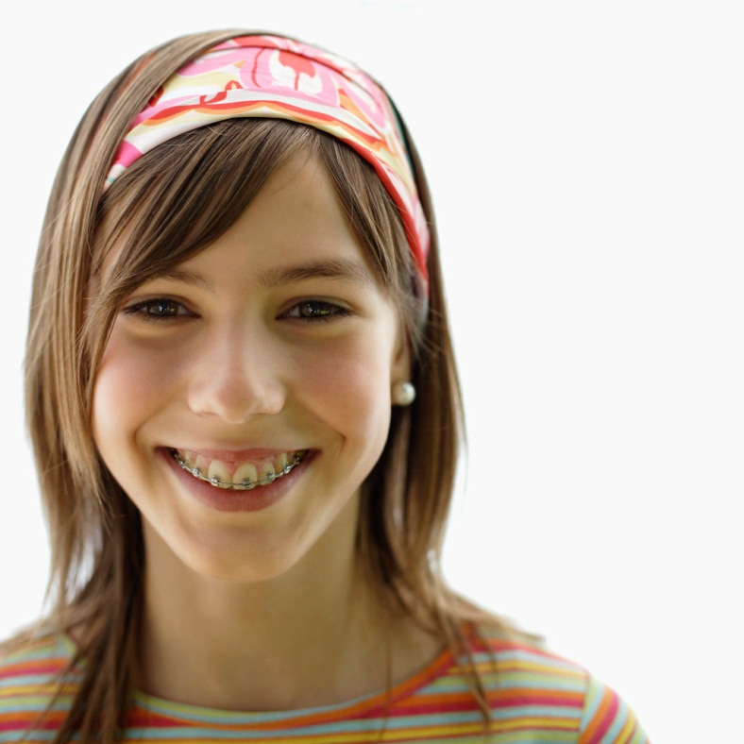
Expression
A smile is an expression of happiness.
The act of telling or showing thoughts or feelings.

Slide 97
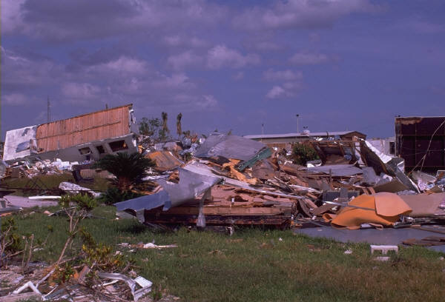
External conflict
A struggle against an outside force, which may be another character, society, or nature.

Slide 98

Fact
George Washington was the first president of the United States of America.
A statement that can be proven.

Slide 99
Falling action
Climax
Conflict
Resolution
Rising Action
Falling Action
Introduction
Conclusion
In the plot, this action occurs after the climax, when conflicts are resolved and problems solved.

Slide 100
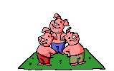
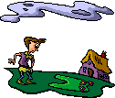
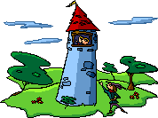


Fiction/Fictional
A story that is not true or is made up.

Slide 101
Figurative language
It’s raining
cats and dogs.
Language that goes beyond the literal meaning of the words.

Slide 102

Film
A movie.

Slide 103
First person
First Person
I, Me, My, Mine
A set of words or forms (as pronouns or verb forms) referring to the person speaking or writing them.

Slide 104

Fluency/Fluent
The girl speaks three languages fluently: English, Chinese, and Japanese.
The ability to speak or write smoothly and easily.

Slide 105
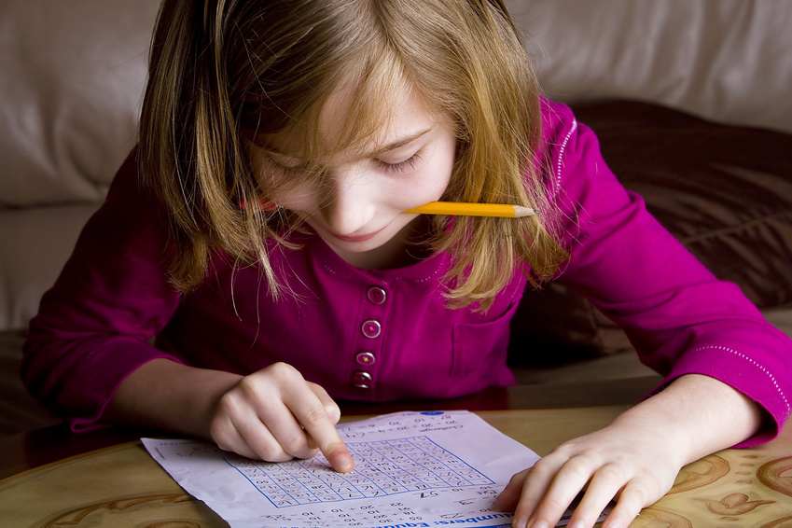
Focus
To direct one's attention or efforts towards one thing; concentrate.

Slide 106
Foreshadowing
He had no idea of the excitement that awaited him.
A writer’s use of hints or clues to suggest events that will occur later in the plot.

Slide 107
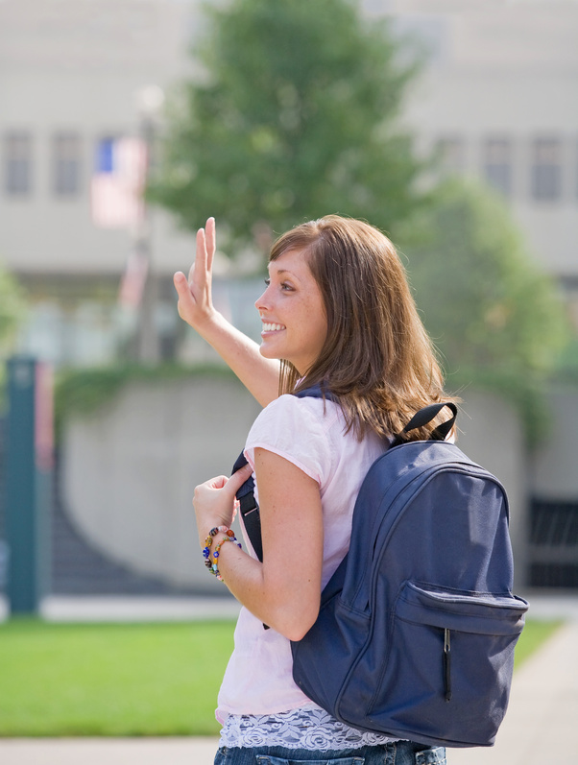
Form
Waving is a form of saying “hello” or “goodbye”.
An established manner of doing or saying something.

Slide 108
Formal English
informal
Thanks a bunch!
formal
Thank you very much!
Language spoken according to the rules of English. It sounds more educated and professional.

Slide 109
Format
Title of Book:
Author:
Introduction: (Introduce your book report)
Main Characters:
Story:
Beginning:
Middle:
End:
Conclusion: (Give your opinion of the book)
Example format for a book report.
To arrange or organize so that a particular appearance is achieved.

Slide 110
Function
The function of a clown is to entertain.
The purpose for which an object or a person is used.

Slide 111
Functional materials
A form of informational nonfiction…websites, how-to-articles, brochures, fliers, etc.

Slide 112
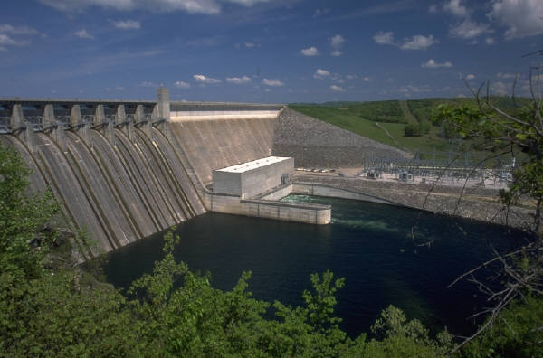
Generate
To bring into being or to produce.

Slide 113

Genre
Science-Fiction
Fantasy
Historical
A category of art, music or literature.

Slide 114

Glossary
An alphabetical listing of key words from a book and their definition.

Slide 115
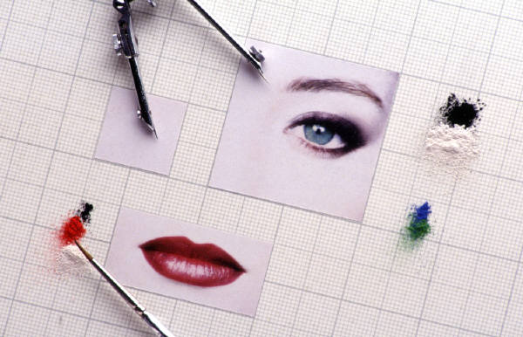
Graphics
Charts, maps, drawing, and other images used in printed works such as books and magazines.

Slide 116

Header/Heading
heading
The title of a passage of text which announces the topic to be covered, generally printed in bold type for emphasis.

Slide 117
Historical
Belonging to the past; of what is important or famous in the past.

Slide 118

Homophone
HERE
HEAR
Two or more words that are pronounced alike, but different in meaning, origin or spelling.

Slide 119
Hyperbole
I’m so hungry I could eat a whole cow.
A figure of speech in which a statement is exaggerated for emphasis or for humorous effect.

Slide 120
Illustrate
To make something more clear or visible.

Slide 121
Imagery
The bite of the frigid air was
nearly unbearable as I made my
way through the frozen forest.
Language that appeals to the senses…sight, hearing, smell, taste, and touch.

Slide 122
Impact
The tornado had a tremendous impact on the community.
To have a strong effect upon someone or something.

Slide 123
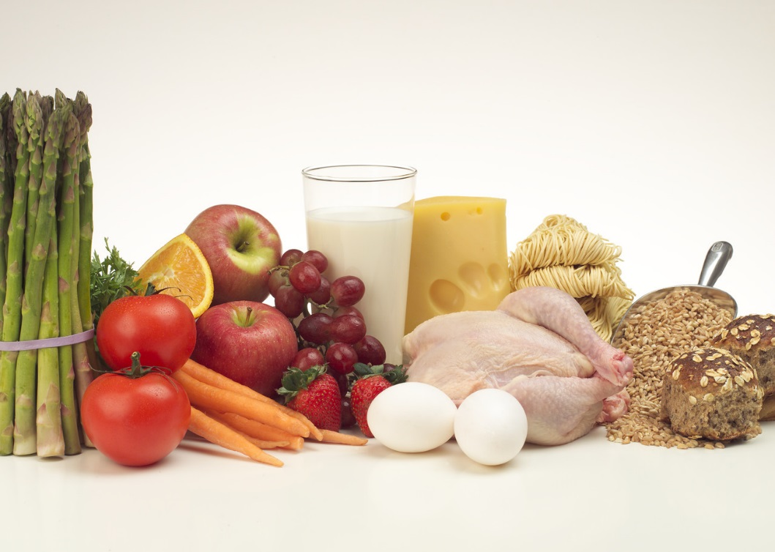
Incorporate
Be sure to incorporate all four food groups in your diet.
To include as part of a larger thing; blend.

Slide 124
Independent clause
independent clause
John and Mary went to the mall
after they finished doing their homework.
dependent clause
A clause that can function independently as a complete sentence.

Slide 125
Individual
A single thing or person.

Slide 126
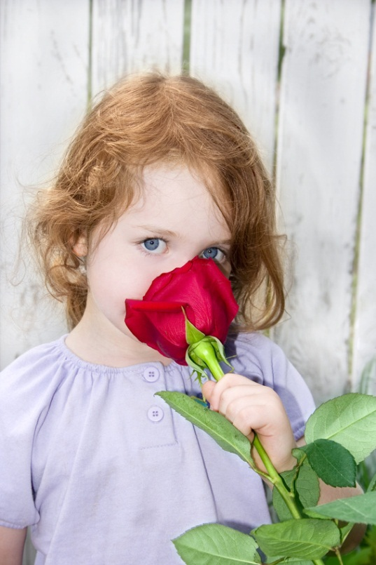
Inference
What we know:
The little girl is smelling a beautiful rose.
We might infer that roses are her favorite flower.
A conclusion reached using facts, observations, logic and reasoning.

Slide 127
Influence
The power or invisible action of a thing or person that causes some kind of effect on another.

Slide 128
Informal English
informal
Thanks a bunch!
formal
Thank you very much!
Characteristic of or appropriate for ordinary, casual, or familiar use.

Slide 129
Informational nonfiction
INSTRUCTION
MANUAL
Writing that provides factual information and that often explains ideas or teaches processes.

Slide 130
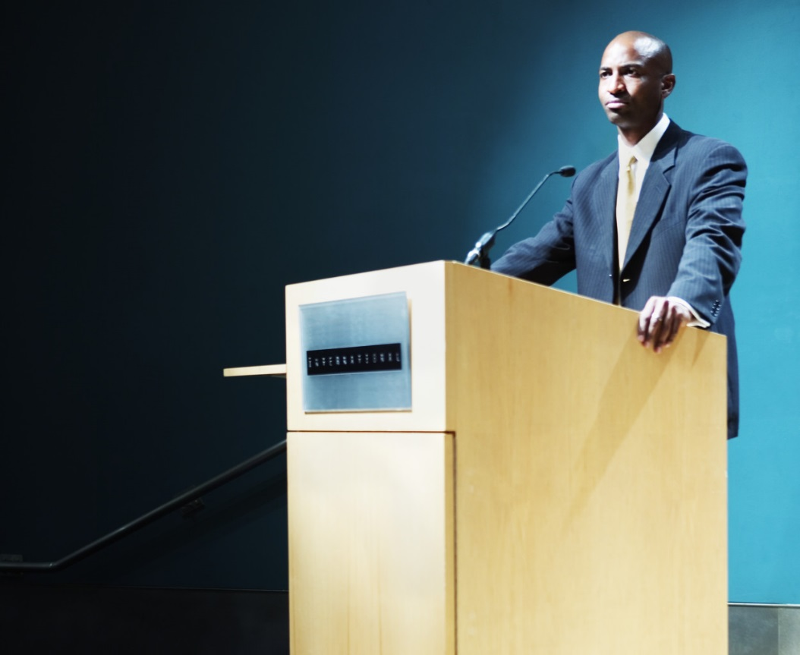
Informative
His speech was very informative.
Providing information, or adding to one's knowledge or understanding.

Slide 131

Inquire/Inquiry
Where should we go for lunch?
A question or request for information.

Slide 132
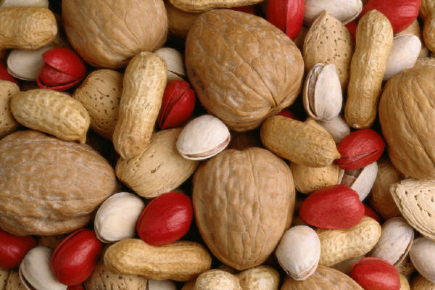
Integrate
To bring together and mix into a whole.

Slide 133
Intensive pronoun
I myself love the color purple.
Pronouns that are used for emphasis. They are formed by adding "-self" or "-selves" to an appropriate pronoun.

Slide 134
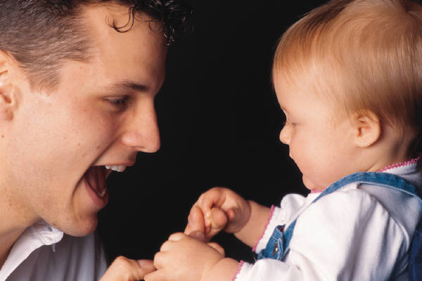
Interact
To respond to one another in a social situation.

Slide 135
Interaction
Action of one upon another or others; action in response to others; influence, or effect

Slide 136

Internal conflict
A struggle between opposing needs, desires, or emotions within a single character.

Slide 137
Interpret
To translate, analyze, or give examples drawn from a text.

Slide 138
Introduction
Introduction:
My favorite day of the year is my birthday.
For my birthday, I always get a chocolate cake and pizza for dinner. My family comes to my house and we have a party.
Because I always have a good day, my birthday is my favorite day of the year.
Body:
Conclusion:
Writing at the beginning of a selection that tells you what will come.

Slide 139
Investigation
To look into carefully and closely so as to learn the facts; examine.

Slide 140

Irony
You finally got the puppy you’ve been begging for,
but you find out you’re allergic to dogs.
A contrast between what is expected and what actually exists or happens.

Slide 141
Journalism
The work of collecting news and information and giving it out to the public through newspapers, magazines, radio, television, or other media.

Slide 142

Key
Good customer service is key to running a successful business.
Main; primary; essential.

Slide 143

Link/Hyperlink
Click here to visit our webpage.
Text or an image that when clicked on, causes a web page or another point on the same page to be displayed on the computer screen.

Slide 144
Listing
How to Make a Peanut Butter & Jelly Sandwich:
Take out two slices of bread.
Put peanut butter on one slice.
Put jelly on the other slice.
Put your two slices of bread together.
Enjoy your sandwich!
Pieces of information (facts, reasons, ideas, examples, features, steps, etc.) that are listed.

Slide 145
Literary device
Metaphor
Alliteration
Figurative Language
Anagram
Onomatopoeia
A technique used to achieve a particular effect.

Slide 146
Literary element
Plot
Setting
Characters
Includes all the elements in a story.; setting, characters, plot (problem, solution, conclusion)

Slide 147

Literary nonfiction
Author: Susie Caldwell Rinehart
Illustrator: Anisa Claire Hovemann
Like fiction, except that the characters, setting, and plot are real rather than imaginary.

Slide 148
Literature
Writings that have lasting value.

Slide 149
Main idea
Detail
Detail
They are playful.
They like to cuddle.
Main Idea
I like cats.
Detail
Detail
My cat is friendly.
Cats are cute.
The most important idea expressed in a piece of writing.

Slide 150
Manner
The receptionist had a very friendly manner about her.
A way of doing something; style.

Slide 151

Meaning
What is meant by a word; definition.

Slide 152
Media
The means of distributing information to large numbers of people, through newspapers, magazines, radio, and television.

Slide 153


Medium
Books
Conversation
Television
A means or tool.

Slide 154
Metaphor
Laughter is the
music of the soul.
A comparison of two things that have something in common.

Slide 155
Modify
To change in some way; alter.

Slide 156
Mood
The bite of the frigid air was
nearly unbearable as I made my
way through the frozen forest.
The feeling or atmosphere that a writer created for the reader.

Slide 157
Moral
The moral found in the story of Pinocchio is:
“Don’t tell lies.”
The lesson learned from a story.

Slide 158
Multimedia
The combination of sound, still pictures, and video.

Slide 159
Multiple meaning
She greeted him in a very cold manner.
cold in this sentence means unfriendly.
COLD
It’s very cold outside.
cold in this sentence means temperature.
When something has more than one meaning.

Slide 160
Myth
An imaginary or fictitious thing or person.

Slide 161

Narrative
Writing that tells a story.

Slide 162
Narrator
narrator
Someone who tells a story.

Slide 163
Non-fiction
Writing that tells about real people, places, and events.

Slide 164
Nonrestrictive clause
My mom, asleep by the fire, is snoring loudly.
A word, phrase, or dependent clause that provides added information to a sentence but does not limit the element it modifies.

Slide 165
Novel
A printed and bound book of fiction.

Slide 166
Objective
Not influenced by personal feelings or opinions.

Slide 167

Omniscient
She is very smart, but she’s not omniscient.
Having total knowledge.

Slide 168
Onomatopoeia
The use of words whose sounds suggest their meaning.

Slide 169
Opposing
To think, act, or be against; resist.

Slide 170
Orally
Spoken, rather than written; carried out by speaking.

Slide 171
Organizational patterns
Chronological/Sequential
Cause and Effect
Compare and Contrast
Problem/Solution
Text structures found in all types of nonfiction and some fiction.

Slide 172

Pace/Pacing
The speed of progress or change.

Slide 173

Paraphrasing
The Golden Gate Bridge in San Francisco is a
must-see attraction if you’re visiting the state.
Whenever you visit California, be sure to check out the Golden Gate Bridge.
A restatement of a passage or text in different words so as to simplify or clarify.

Slide 174
Parenthesis/Parenthetical element
We will have the party
inside if it rains .
( )
parentheses
Either of a pair of punctuation marks. They are used to enclose information that is not part of the main sentence.

Slide 175
Parody
Gnomeo & Juliet
is a parody of
Romeo & Juliet
A written or musical work in which the style of an author or work is imitated for comic effect.

Slide 176
Parts of speech
Interjections
Noun
Adverbs
Prepositions
Pronouns
Conjunctions
Verbs
Adjectives
A class of words (as adjectives, adverbs, conjunctions, interjections, nouns, prepositions, pronouns, or verbs) identified according to the kinds of ideas they express and the way they work in a sentence.

Slide 177
Personification
Opportunity is knocking,
To give human qualities to something that isn’t human.

Slide 178
Perspective
First Person
Second Person
I, Me, My, Mine
You, Your, Yours, You’re
Third Person
He, She, They, Their
A position from which something is considered or evaluated; standpoint.

Slide 179

Persuade/Persuasive
If you finish all your chores,
you can have some ice cream.
To talk someone into doing or believing something; convince.

Slide 180
Persuasive argument
If you finish all your chores,
you can have some ice cream.
An argument that aims to influence a person's attitudes, ideas or feelings.

Slide 181
Pertinent
The police are asking anyone with pertinent information to come forward.
Having to do with or connected to a subject; relevant.

Slide 182

Phrase
The girl with the brown
hair is planting a flower.
Two or more words that express an idea and are part of a sentence.

Slide 183
Plagiarize
To quote an author without proper citation is plagiarism.
To steal and pass off (as the ideas or words of another) as one's own.

Slide 184
Planning
She is planning her vacation.
The act of figuring out how to do something ahead of time.

Slide 185
Plot
Climax
Conflict
Resolution
Rising Action
Falling Action
Introduction
Conclusion
The story line or order of events in a book, play, or movie.

Slide 186
Poem/Poetry
A piece of writing in a special form, style, language, often expressing emotion.

Slide 187
Point of view
First Person
Second Person
I, Me, My, Mine
You, Your, Yours, You’re
Third Person
He, She, They, Their
The vantage point from which a writer tells a story.

Slide 188
Possessive
I am walking my dog.
Shows ownership, or a similar relation.

Slide 189
Precise
Close the refrigerator door.
Stated in a clear way and with details.

Slide 190


Predicate noun
The flowers that I want to plant are roses and tulips.
Noun (or noun phrase ) that is used to predicate a description or identification of the subject.

Slide 191
Predict
To say in advance (what one believes will happen); foretell (a future event or events).

Slide 192
Prefix
Un
wrap
The prefix un means not, or opposite of
A letter or a group of letters added to the beginning of a word, that changes the meaning.

Slide 193
Preliminary
All applicants must submit to a preliminary drug screening before being offered a position.
Coming before, so as to prepare for something else.

Slide 194

Presentation
A show or display; the act of presenting something to an audience.

Slide 195
Primary source
He used an interview with the star as the primary source for his article.
An original source of the information being discussed such as a person with direct knowledge of a situation, or a document created by such a person.

Slide 196
Probe
The officer probed the suspect for details.
Question or examine thoroughly and closely.

Slide 197

Problem/Solution
The girl wouldn’t stop yelling, so I put on my headphones and listened to music.
A text structure which identifies and describes a problem and then offers one or more possible solutions.

Slide 198
Produce/Production
To put together and present for the public to enjoy.

Slide 199
Project
Any activity that takes great effort or planning.

Slide 200

Pronunciation
C A T
/k/ - /æ/ - /t/
The act or manner of saying the sounds of words.

Slide 201
Prospective
She is interviewing a prospective employee.
Likely or intended to become.

Slide 202
Protagonist
Robin Hood
The main character in fiction or drama; the person who sets the plot in motion.

Slide 203
Publish
To prepare and issue (printed material) for public distribution.

Slide 204

Pun
Why are teddy bears never hungry?
Because they’re stuffed.
Play on multiple meanings of a word or on two words that sound alike but have different meanings.

Slide 205

Purpose
Hard work is necessary to achieve success.
action
purpose
A reason or plan that guides an action; design or goal.

Slide 206

Quantitatively
A liter of water weighs 1000 grams.
Of, concerning, or capable of being measured or expressed as, a quantity.

Slide 207
Question/Answer
When the author poses questions about a topic, then provides support to answer them.

Slide 208
Quotation mark
One of a pair of punctuation marks used chiefly to indicate the beginning and end of a direct quote.

Slide 209
Quote/Quotation
"Four score and seven years ago, …”
To repeat the exact words used by someone else.

Slide 210
Reasoning
There are puddles on the ground.
Using reasoning, we can conclude that it rained recently.
The process of using reason to draw conclusions based on a premise or known facts.

Slide 211
Redundant
Advance Warning
By definition, a warning comes in advance of an event.
Unnecessarily repetitive.

Slide 212

Reference materials
Text containing facts and information, items that you can look at to find information.

Slide 213
Reflect/Reflection
The process of deep or serious thinking, or a particular thought that results from this process.

Slide 214
Reflexive pronoun
She bought herself a new outfit.
A pronoun that is preceded by the noun, adjective, adverb or pronoun to which it refers (its antecedent) within the same clause.

Slide 215
Relevant
U.S. Presidents
George Washington
1st President
Grover Cleveland
22nd President
Barack Obama
44th President
Related to or connected with the present matter; pertinent.

Slide 216

Repetition
The act or process of doing something over and over again.

Slide 217


Research
Careful and organized study or gathering of information about a specific topic.

Slide 218
Resolution
Climax
Conflict
Resolution
Rising Action
Falling Action
Introduction
Conclusion
The portion of a play or story where the central problem is solved.

Slide 219
Revise/Revision
To look over again in order to correct or improve.

Slide 220
Rewriting
A restatement of the same sentence:
Yesterday was his birthday.
His birthday was yesterday.
Something that is stated again in another way.

Slide 221
Rising action
Climax
Conflict
Resolution
Rising Action
Falling Action
Introduction
Conclusion
The events in a story that move the plot forward, which involves conflicts and complications.

Slide 222
Root word
Unwrapped
The base word you start with before adding prefixes or suffixes.

Slide 223

Rough draft
A rough or preliminary sketch of a piece of writing, or a version still subject to revision.

Slide 224
Run-on sentence
Example:
Let’s go get some popsicles I think there are some in the freezer if there are I want a blue one.
A sentence formed from two or more sentences improperly joined.

Slide 225

Salient
Extremely noticeable or prominent; conspicuous; important.

Slide 226
Sarcasm
He, who laughs last, thinks slowest.
A form of verbal irony, usually harsh, that is often used as an insult.

Slide 227
Scene
The place in which any event, real or imagined, occurs.

Slide 228

Search engine
A software program that searches a database or network, typically the internet, for data, files, or documents containing terms specified by the user.

Slide 229
Second person
Second Person
You, Your, Yours, You’re
The category of pronouns, inflections, and the like that indicates the person being spoken to.

Slide 230
Secondary sources
Reference Books
Journal Articles
Historical Works/Monographs
History Textbooks
Periodical Literature
Documents or recordings that relate or discuss information originally presented elsewhere.

Slide 231
Selection
a selection from The Gettysburg Address:
“Four score and seven years ago our fathers brought forth on this continent a new nation, conceived in liberty, and dedicated to the proposition that all men are created equal.”
~Abraham Lincoln, November 19, 1863
A passage selected from a larger work.

Slide 232
Sensory language
The cool morning sun cast long fingers of shadow and light across the green field as our visitors tramped across the dewy grass.
Wording that describes how something feels, tastes, looks, or sounds.

Slide 233

Sequence
First, we went to the store.
Next, we went to the park.
Then, we went to see my grandma.
Finally, we went back home.
A text structure in which one event or action follows another.

Slide 234

Setting
…In
A
Castle
Far, Far
Away…
Once
Upon
A
Time…
The time and place of the action in a story, play, or poem.

Slide 235
Shades of meaning
When Johnny’s dog went missing,
he was ________________.
(distressed, heartsick, troubled)
All of these words mean sad.
Small, subtle differences in meaning between similar words or phrases.

Slide 236
Similarities
Both fruits
Both grow on trees
Both are edible
The quality of being alike.

Slide 237
Simile
Quiet as a mouse.
A figure of speech comparing two things using like or as.

Slide 238
Simple sentences
The baby is crying.
A sentence that only has one clause.

Slide 239
Soliloquy
The “to be or not to be” speech in Hamlet, is an example of a soliloquy.
A speech voicing his or her own thoughts as if to himself.

Slide 240

Sonnet
How do I love thee? Let me count the ways.
I love thee to the depth and breadth and height
My soul can reach, when feeling out of sigh
For the ends of Being and ideal Grace.
I love thee to the level of every day's
Most quiet need, by sun and candlelight.
I love thee freely, as men strive for Right;
I love thee purely, as they turn from Praise.
I love thee with the passion put to use
In my old griefs, and with my childhood's faith.
I love thee with a love I seemed to lose
With my lost saints--I love thee with the breath,
Smiles, tears, of all my life!--and, if God choose,
I shall but love thee better after death.
~Elizabeth Barrett Browning
A poem of fourteen lines that usually rhymes in set ways.

Slide 241
Sound
The lawyer gave her some very sound advice.
Sensible; logically valid.

Slide 242

Source
Encyclopedia
Dictionary
Interview
Any person, place, or thing by which something is supplied.

Slide 243
Specific
Komodo dragons are naturally specific to a group of islands in Indonesia.
Special or unique to something.

Slide 244
Stage
A raised floor in a theater.

Slide 245
Stanza
I’ve made me a moon-catchin’ net,
And I’m goin’ huntin’ tonight,
I’ll run along swingin’ it over my head,
And grab for that big ball of light.
So tomorrow just look at the sky,
And if there’s no moon you can bet
I’ve found what I sought and I finally caught
The moon in my moon-catchin’ net.
But if the moon’s still shinin’ there,
Look close underneath and you’ll get
A clear look at me in the sky swingin’ free
With a star in my moon-catchin’ net.
stanza
Moon-Catchin’ Net
~Shel Silverstein
A fixed number of lines of verse forming a unit of a poem.

Slide 246
Strategic
Relating to an elaborate and systematic plan of action.

Slide 247

Subjective
His opinion of clowns is purely subjective.
Affected or shaped by personal experience, beliefs, and feelings.

Slide 248

Sufficient
There is not sufficient wind to fly a kite today.
Enough; as much as needed.

Slide 249
Suffix
Unwrapped
suffix
The suffix ed means happened in the past
One or more letters added to the end of a root (base) word

Slide 250
Summary statement
Versatile, reliable, and efficient administrative professional with 12+ years experience supporting managers and executives to advance internal operations.
Example summary statement from experience section of a resume.
A general statement that presents the main points or facts in condensed form.

Slide 251
Summary/Summarize
Goldilocks and The Three Bears, is a story about a young girl who happens upon the home of a family of bears.
While the bears are away, the young girl makes herself at home.
To describe the main idea and important details of a passage using your own words.

Slide 252
Support
The lawyer presents evidence to support his case.
To provide proof or evidence for.

Slide 253
Symbolism
In Mrs. Jones’ class, gold stars symbolize a job well done!
The use of something concrete that is used to represent something more than itself.

Slide 254
Synonym
Danger Hazard
A word that has the same or almost the same meaning as another word.

Slide 255

Table
A type of graphic aid that presents a group of facts in rows and columns.

Slide 256
Tale
Paul Bunyan
A story about an imaginary event.

Slide 257

Technical language
Home Run
Line Drive
Batter Up
Foul Ball
Baseball
Written or oral communication that has specialized content.

Slide 258

Technology
The use of science in solving problems.

Slide 259
Text box
This
Is
A
Text
Box
A box for text that can be placed and formatted independently of other text.

Slide 260
Text features
Table of Contents
Title
Heading
Glossary
Design elements that include structure of a text and help with the understanding of the text.

Slide 261
Text structure
Cause and Effect
Problem/Solution
Sequence of Events
The pattern and arrangement of ideas in a text passage.

Slide 262
Theme
Winter Sports
Figure Skating
Hockey
Luge
Snowboarding
The main subject for a work of literature, art, or music.

Slide 263

Thesaurus
A book which lists words with the same meaning.

Slide 264

Thesis statement
Thesis Topic:
Year-round Schooling
Thesis Statement:
Year-round schooling offers the most benefit to a community.
The sentence or two in your text that contains the focus of your essay and tells your reader what the essay is going to be about.

Slide 265
Third person
Third Person
He, She, They, Their
A set of words or forms (as verb forms or pronouns) referring to someone or something that is neither the speaker/writer nor the audience/reader.

Slide 266
Tone
The bite of the frigid air was
nearly unbearable as I made my
way through the frozen forest.
This selection sets a cold, lonely tone.
An expression of a writer’s attitude toward a subject.

Slide 267
Trace
Sarah used the internet to trace her family history.
To discover through investigation.

Slide 268


Transitions
A changing from one state, stage, place, or subject to another.

Slide 269

URL
The address of a web page on the world wide web.

Slide 270
Vague
Maybe, maybe not.
Unclear in conveying; unintentionally or intentionally unspecific or ambiguous.

Slide 271

Valid/Validity
Based on truth, fact, or logic.

Slide 272

Variety
A number of different things in a group or class.

Slide 273

Voice
Marilyn mailed the letter.
active voice
passive voice
The letter was mailed by Marilyn.
The relationship between a sentence's subject and verb.

Slide 274
Warranted
The severity of his crime warranted long term incarceration.
To serve as reasonable grounds, adequate reason, or justification for.

Slide 275
Workplace documents
Materials that are produced or used within a work setting.

Slide 276
World literature
Literature that is circulated beyond its country of origin.

