Slide 1
Visual Vocabulary eSlides
English Language Arts (ELA)
Grade 2
Partners for Learning, Inc.
(208) 322-5007
resources@partnersforlearning.org
www.partnersforlearning.org

Slide 2
SITE LICENSE / TERMS OF USE
The academic vocabulary power point slides are sold on a per grade, per school basis.
TERMS OF USE:
All slides included in this presentation are for use only by the purchasing school
  Additional copies can be purchased for use
By using the slides you agree to only use the slides in the school for which they were purchased.
You further agree not to copy or distribute the slides for use outside of the purchasing school.
Thank You

Slide 3

Reading/Language Arts Vocabulary - Grade 2
Academic
Having to do with learning or study

Slide 4

Reading/Language Arts Vocabulary - Grade 2
Action
Something that is done or is happening

Slide 5
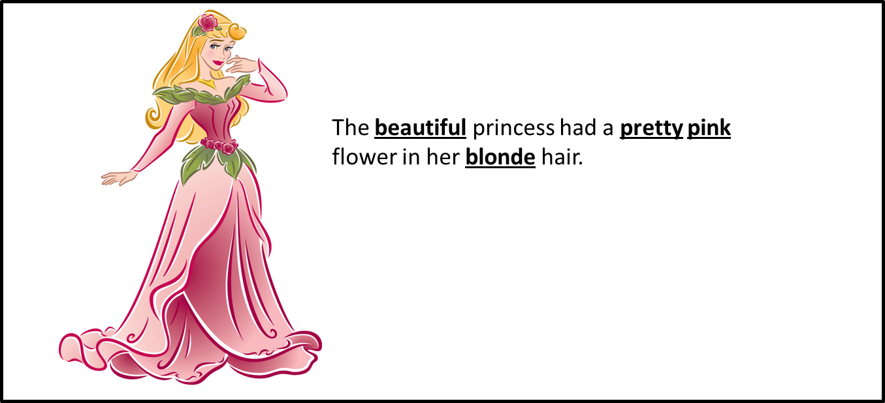
Reading Vocabulary Grade 2
Adjective
A word that describes a noun

Slide 6
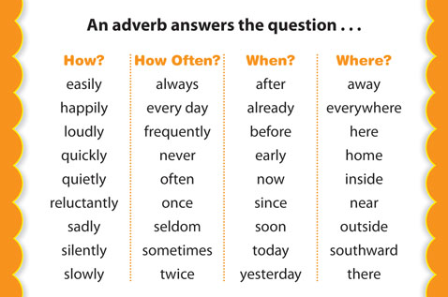
Reading/Language Arts Vocabulary - Grade 2
Adverb
A word that answers questions like how, when, where, and why

Slide 7
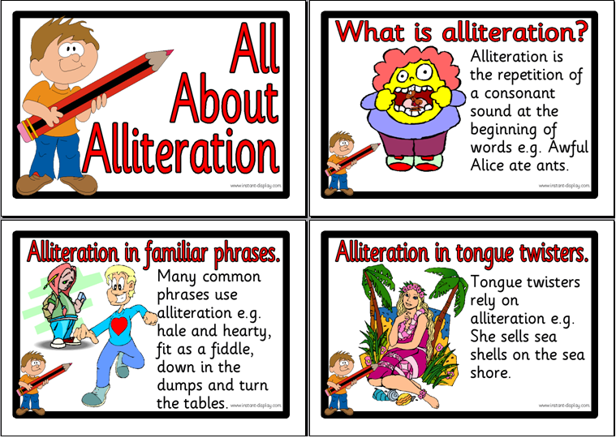
Reading/Language Arts Vocabulary - Grade 5
Alliteration
The repetition of the same sound at the beginning of words in a phrase or sentence.

Slide 8
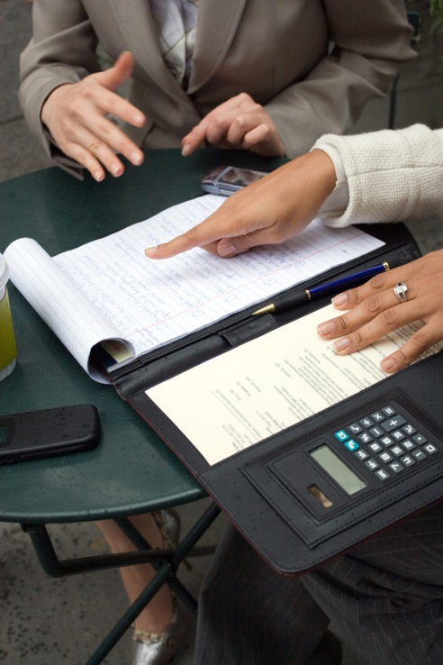
Reading/Language Arts Vocabulary - Grade 2
Analyze
To separate into parts for close study; examine and explain

Slide 9
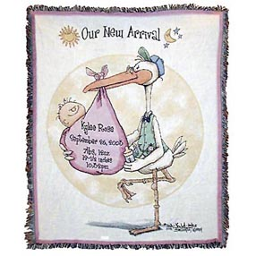
Reading/Language Arts Vocabulary - Grade 2
Announcement
Public or formal notice announcing something

Slide 10
Reading/Language Arts Vocabulary - Grade 2
Answer
Question
Would you like another cookie?
Answer
Yes I would like another cookie.
What you say or write after someone asks you a question

Slide 11
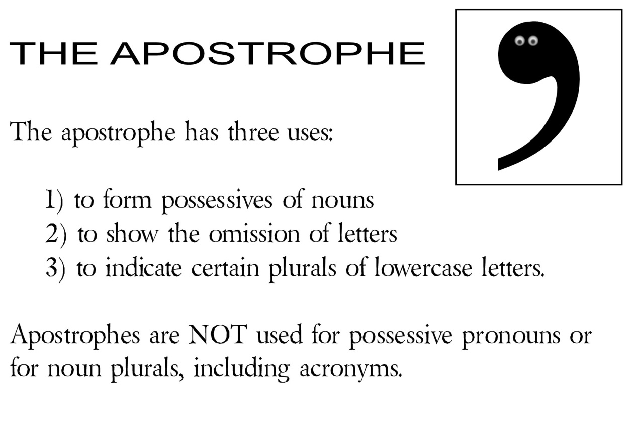
Reading/Language Arts Vocabulary - Grade 2
Apostrophe
A mark ' used to show that letters or figures are missing

Slide 12
Reading/Language Arts Vocabulary - Grade 2
Appropriate
It is appropriate to raise your hand when you have a question in class.
Right for the purpose; proper

Slide 13
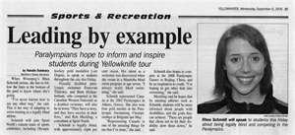
Reading/Language Arts Vocabulary - Grade 2
Article
A written piece often found in a newspaper or magazine

Slide 14
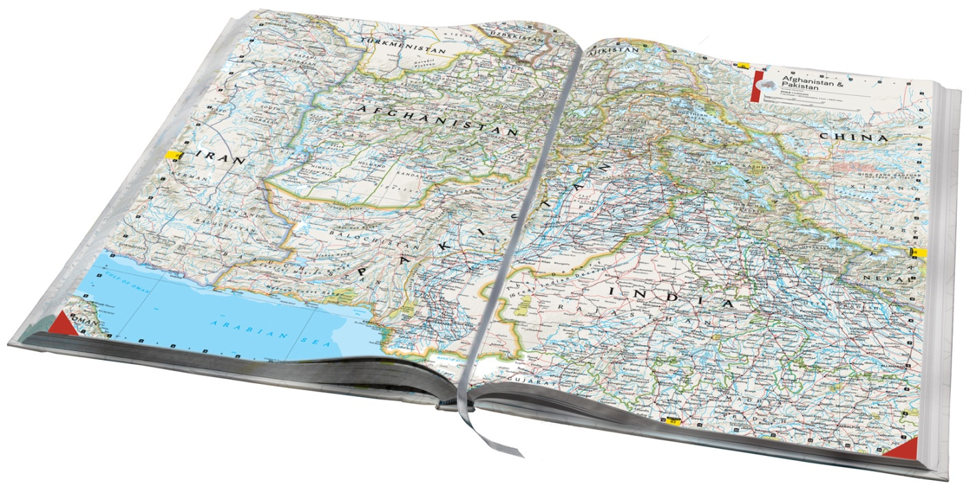
Reading/Language Arts Vocabulary - Grade 2
Atlas
A collection of maps in book form

Slide 15
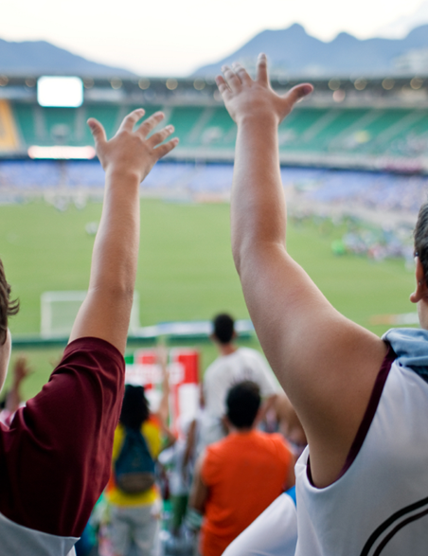
Reading/Language Arts Vocabulary - Grade K
Audience
A group of people gathered to see or hear something

Slide 16
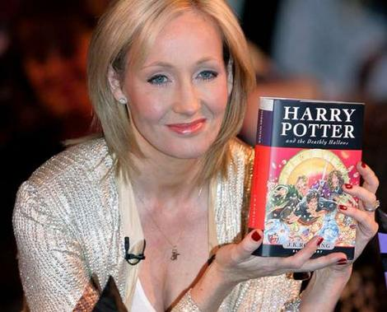
Reading/Language Arts Vocabulary - Grade 2
Author
A person who writes books, stories, or plays

Slide 17
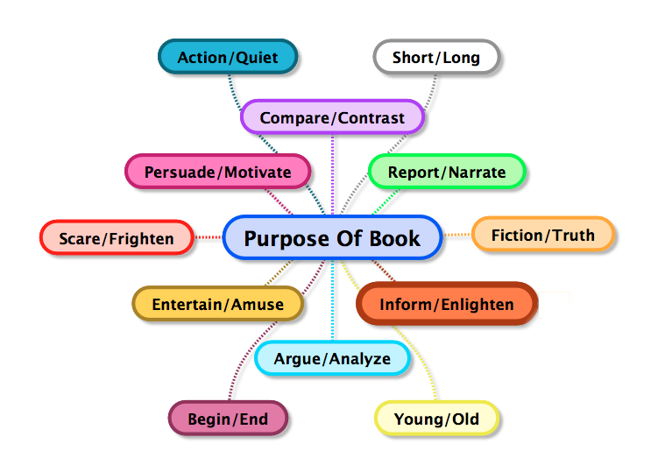
Reading/Language Arts Vocabulary - Grade 2
Author’s Purpose
The reason for creating a work

Slide 18
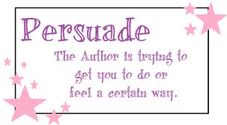
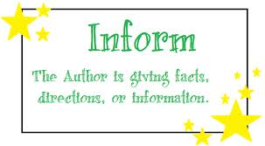
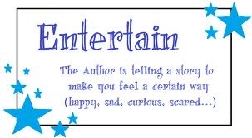
Reading/Language Arts Vocabulary - Grade 2
Author’s Intent
The writer's plan or focus

Slide 19
Reading/Language Arts Vocabulary - Grade 2
Bias
Tommy’s mom says he is the best soccer player. But this may not be true because Tommy’s mom shows favoritism towards Tommy. Her opinion is bias.
A preference that prevents one from being impartial; prejudice

Slide 20
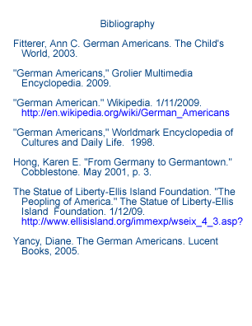
Reading/Language Arts Vocabulary - Grade 2
Bibliography
Sample Bibliography:
A list of titles about a certain subject

Slide 21
Reading/Language Arts Vocabulary - Grade 2
Biography
Sample Biography:
George Washington was born in 1732 in Virginia. He became the first President of America in 1789. He died in 1799.
A form of nonfiction in which a writer tells the life of another person

Slide 22
Reading/Language Arts Vocabulary - Grade 2
Bold Print
If you want to make some of your writing stand out, you can put in in bold print.
Set in heavy type that stands out

Slide 23
Reading/Language Arts Vocabulary - Grade 2
Business letter
Sample business letter
To Whom it May Concern:
I will need to have the documents mailed to my assistant by Friday. Thank you for your help with this matter.
Sincerely,
John Smith
A letter dealing with business

Slide 24
Reading Vocabulary Grade 2
Capital
T
he dog is fast.
The first letter in a sentence is a capital letter.
A big letter in the alphabet often used on the first letter of a word at the beginning of a sentence, or the first letter of the name of a person or place.

Slide 25
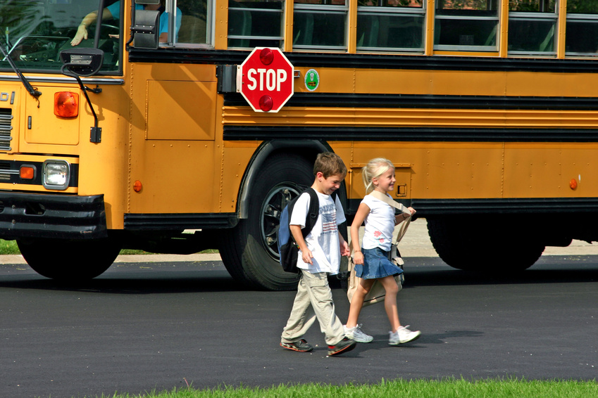
Reading Vocabulary Grade 2
Caption
Caption
Brian and Sarah on the first day of school
A sentence or phrase written under a picture to tell about or explain the picture

Slide 26
Reading/Language Arts Vocabulary - Grade 2
Category
Animals
Cat
Dog
Horse
Monkey
Bear
Belonging to a certain group of things

Slide 27
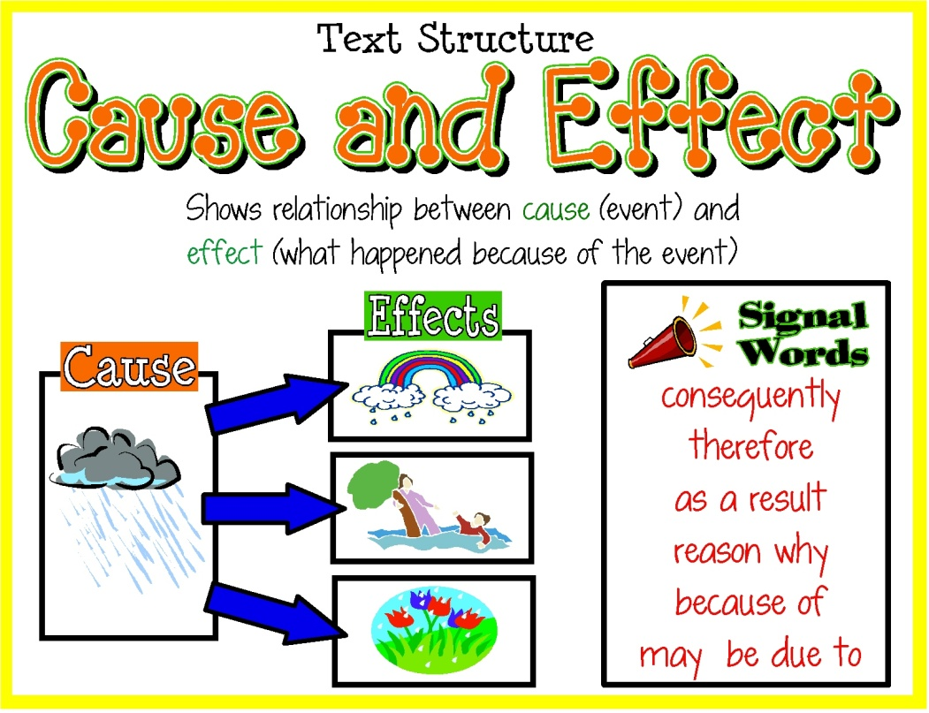
Reading/Language Arts Vocabulary - Grade 2
Cause and Effect
A text structure that explains why things happen; the events that happen first are the causes and the events that happen as a result are the effects

Slide 28
Reading/Language Arts Vocabulary - Grade 2
Central Message
The central message of the story was to be honest.
The most important part of the spoken or written information sent from one person or group to another

Slide 29
Reading/Language Arts Vocabulary - Grade 2
Challenges
I am very shy so making friends is one of my biggest challenges.
To do something that requires courage or skill

Slide 30
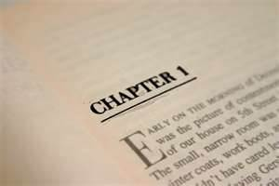
Reading/Language Arts Vocabulary - Grade 2
Chapter
A section of a book

Slide 31
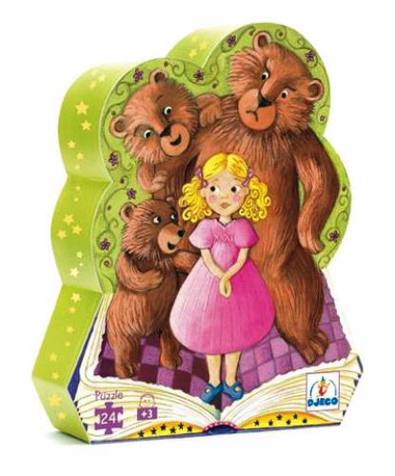
Reading/Language Arts Vocabulary - Grade 2
Character
A person in a story, play, or movie.

Slide 32
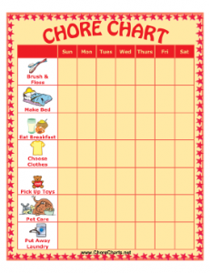

Reading/Language Arts Vocabulary - Grade 2
Charts
Sheet that gives information in the form of a table or graph

Slide 33

Reading/Language Arts Vocabulary - Grade 2
Checklist
My morning Checklist
Eat breakfast
Brush teeth
Get dressed
Feed the dog
A complete list of items compiled for checking or other reference purposes

Slide 34
Reading/Language Arts Vocabulary - Grade 2
Chronological Order
I wake up
I eat breakfast
I brush my teeth
I get on the bus
I get to school
According to the order in which things happen

Slide 35
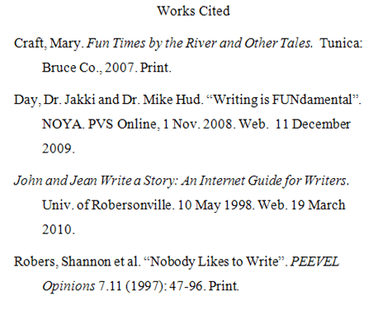
Reading/Language Arts Vocabulary - Grade 2
Citation Page
Citation Page
The act of citing or quoting sources listed a sheet of printed paper

Slide 36
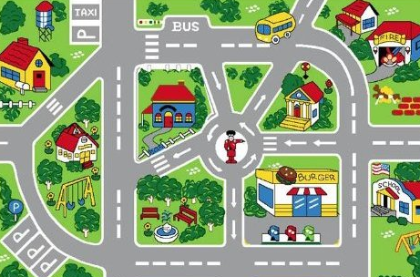
Reading/Language Arts Vocabulary - Grade 2
Clarify
To clarify the directions to her house, Maggie drew a map.
To make easier to understand

Slide 37
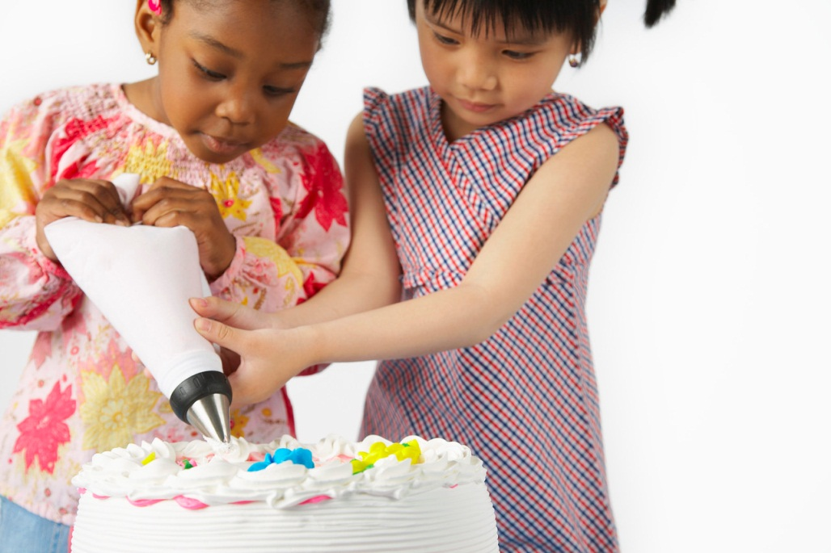
Reading/Language Arts Vocabulary - Grade 2
Collaboration
Becky and Emma worked together on the collaboration of a cake for the class party.
A cooperative effort by which people or organizations work together to accomplish a common project or mission

Slide 38
Reading/Language Arts Vocabulary - Grade 2
Collective Noun
The family is on vacation.
A noun that denotes a collection of persons or things regarded as a unit

Slide 39

Reading/Language Arts Vocabulary - Grade 2
Comments
It looks like you are doing a great job so far on your paper.
Written or spoken statements of opinion

Slide 40
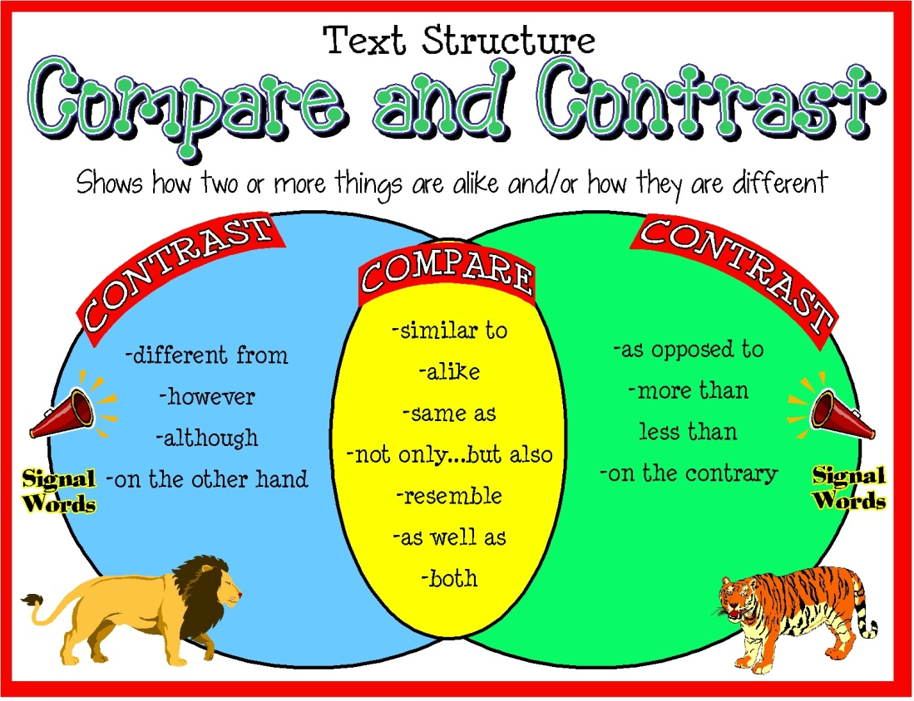
Reading/Language Arts Vocabulary - Grade 2
Compare and Contrast
A text structure which explains the similarities and/or differences of two or more things, ideas, traits, etc…

Slide 41
Reading/Language Arts Vocabulary - Grade 2
Compound Sentence
We went to the park and we went to the zoo.
A sentence of two or more coordinate independent clauses, often joined by a conjunction

Slide 42
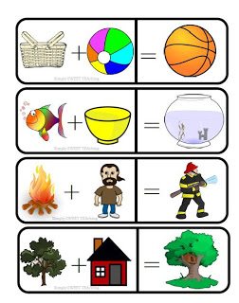
Reading Vocabulary Grade 2
Compound Word
Two words put together to make a new word.

Slide 43
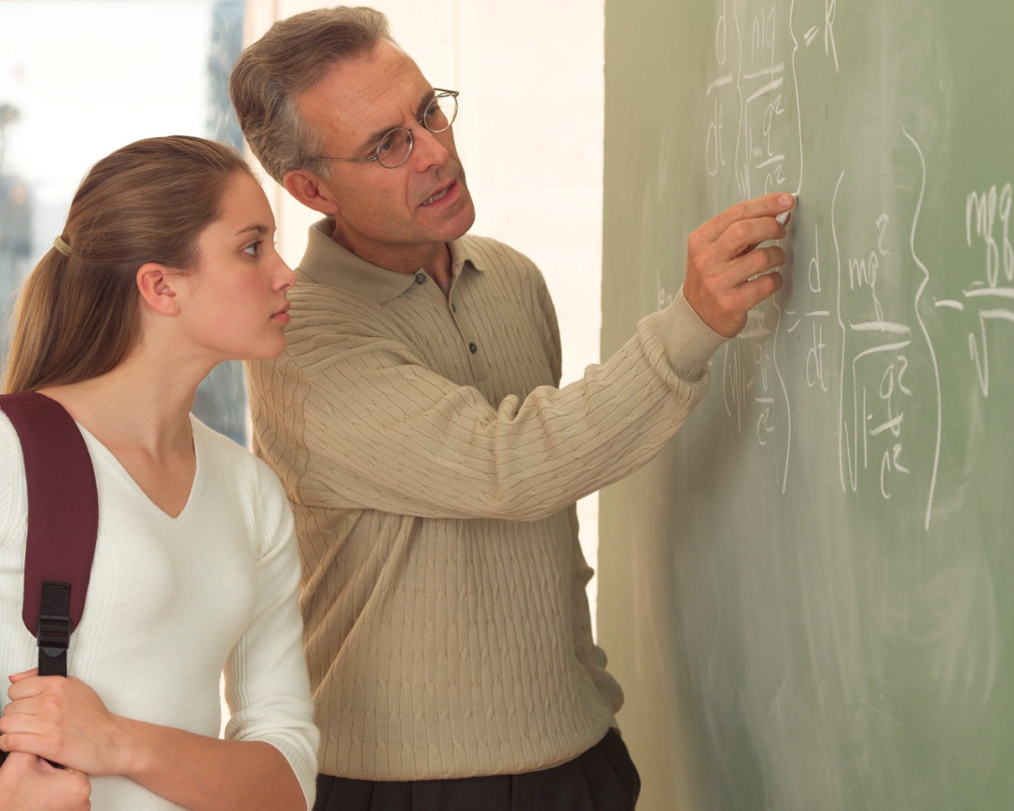
Reading Vocabulary Grade 2
Comprehend
The act, process, or result of understanding

Slide 44
Reading/Language Arts Vocabulary - Grade 2
Conclusion
Intro:
My favorite day of the year is my birthday.
For my birthday, I always get a chocolate cake and pizza for dinner. My family comes to my house and we have a party.
Because I always have a good day, my birthday is my favorite day of the year.
Body:
Conclusion:
The final event of a story’s plot

Slide 45
Reading Vocabulary Grade 2
Context
She greeted him in a very cold manner.
cold in this sentence refers to an unfriendly attitude.
COLD
It’s very cold outside.
cold in this sentence refers to the temperature.
The setting of a word or phrase that affects its meaning

Slide 46
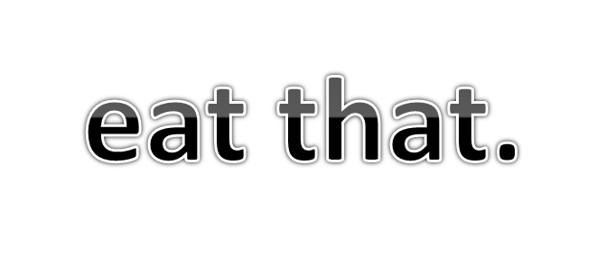
Reading/Language Arts Vocabulary - Grade 2
Contraction
Don’t
Don’t is a contraction of do and not.
The shortening of a word or word group by omitting letters and replacing them with an apostrophe.

Slide 47
Reading/Language Arts Vocabulary - Grade 2
Contrast
They have different shapes
One is red
The other is yellow
A difference that one can see when things are compared or put side by side

Slide 48
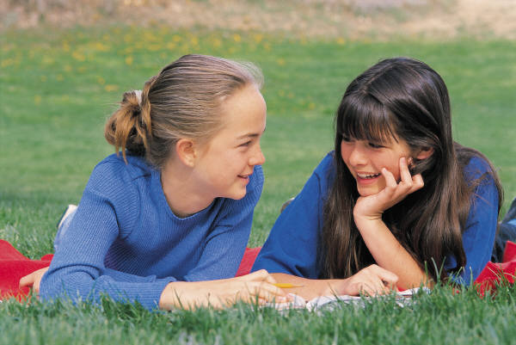
Reading/Language Arts Vocabulary - Grade 1
Conversation
Talk between people

Slide 49

Reading/Language Arts Vocabulary - Grade 2
Cookbook
A book of recipes and cooking directions

Slide 50
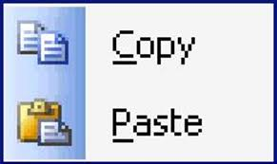
Reading/Language Arts Vocabulary - Grade 2
Copy and Paste
The act of duplicating and moving to a different location

Slide 51
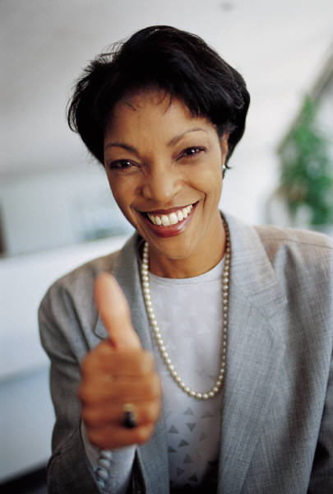
Reading/Language Arts Vocabulary - Grade 2
Credit
Good job on your math worksheet!
Approval or praise given to a person or group for something that has been done

Slide 52
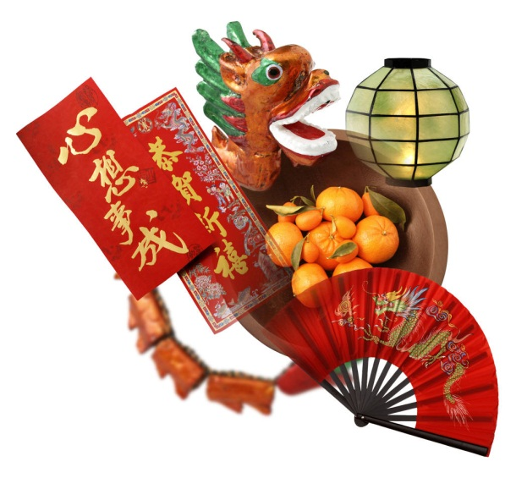
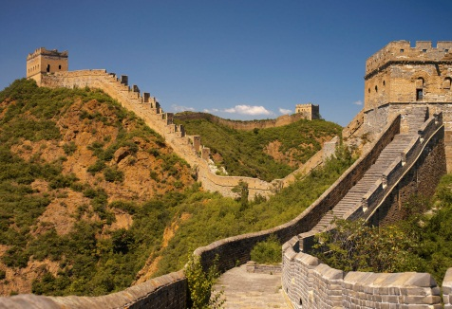

Reading/Language Arts Vocabulary - Grade 2
Culture
The language, ideas, inventions, and art of a particular group of people

Slide 53
Reading/Language Arts Vocabulary - Grade 2
Definition
School
noun \ˈskül\
Definition of SCHOOL
1: an organization that provides instruction: as
a : an institution for the teaching of children
b : college, university
A statement of the meaning of a word or phrase

Slide 54
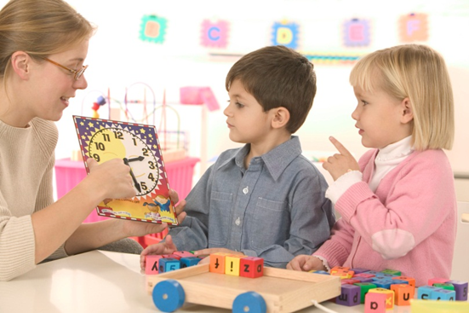
Reading/Language Arts Vocabulary - Grade 2
Demonstrate
The teacher demonstrates how to tell time.
To show how to do something

Slide 55
Reading/Language Arts Vocabulary - Grade 2
Describe/Description
Describe your dog:
My dog has long, brown fur. He is very fluffy. He has floppy ears and a black spot on his back.
To tell or write about

Slide 56
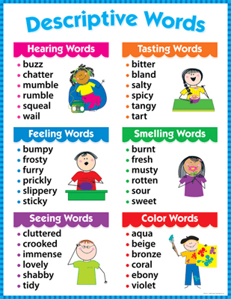
Reading/Language Arts Vocabulary - Grade 2
Descriptive Words
Words that explain or give detail

Slide 57
Reading/Language Arts Vocabulary - Grade 2
Details
Main Idea:
What the story or passage is mostly talking about
Details
The facts that tell more about the main idea
Pieces of information that support or tell more about the main idea

Slide 58
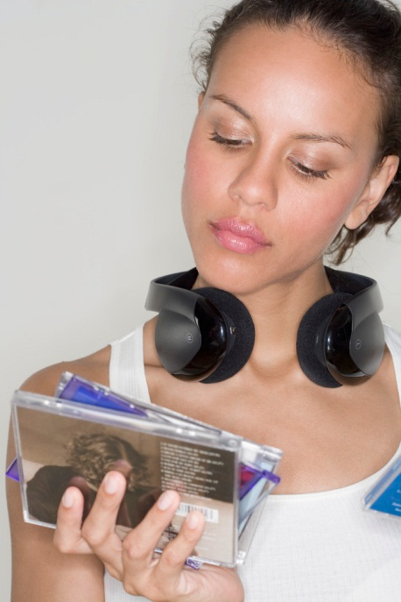
Reading/Language Arts Vocabulary - Grade 2
Determine
Emily had to determine which music to buy.
To decide or set

Slide 59
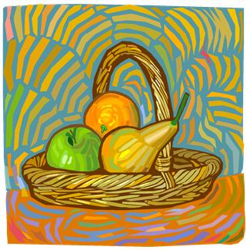
Reading/Language Arts Vocabulary - Grade 2
Develop
She wanted to develop her art skills so she started to paint pictures of fruit.
To grow or cause to grow

Slide 60
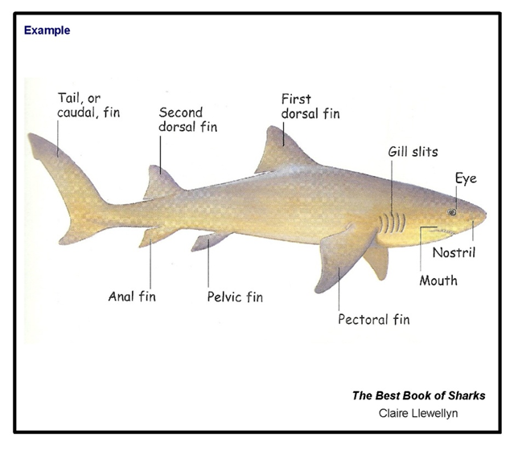
Reading/Language Arts Vocabulary - Grade 2
Diagram
A drawing or plan that shows the parts of something or how the parts work together

Slide 61
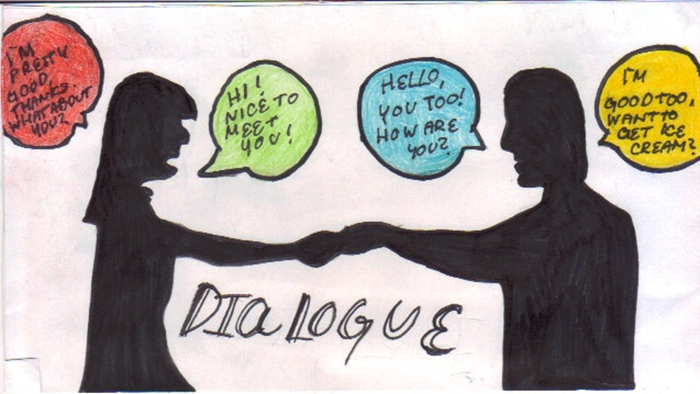
Reading/Language Arts Vocabulary - Grade 2
Dialogue
A talk between two or more people or between characters in a play, movie or book

Slide 62
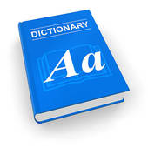
Reading/Language Arts Vocabulary - Grade 2
Dictionary
A reference book containing an alphabetical list of words with definitions and information

Slide 63
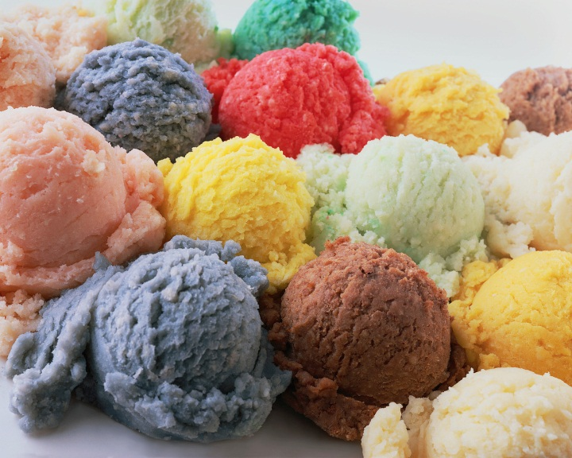
Reading/Language Arts Vocabulary - Grade 2
Difference/Different
There were many different ice cream flavors to choose from.
Not the same; not being the same

Slide 64
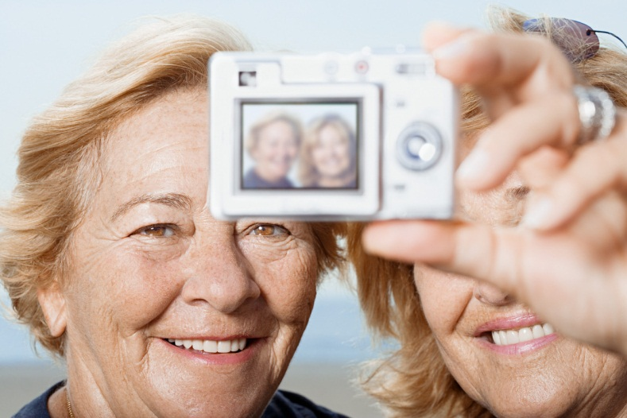
Reading/Language Arts Vocabulary - Grade 2
Digital
A digital camera
Using information in the form of an electronic signal

Slide 65
Reading/Language Arts Vocabulary - Grade 2
Digital Dictionary
You can use the internet to access a digital dictionary.
Using electronic signal to access a list the words of a language, with information about their meaning, spelling, and pronunciation

Slide 66
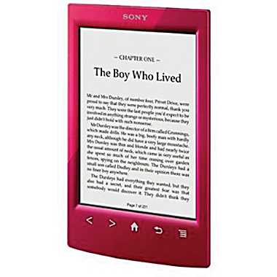
Reading/Language Arts Vocabulary - Grade 2
Digital Text
Words that appear in anything written or printed using an electronic signal

Slide 67
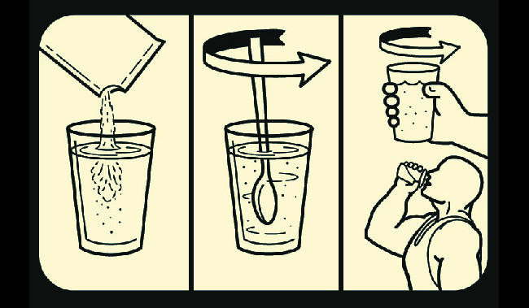
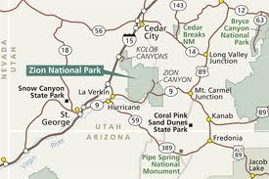
Reading/Language Arts Vocabulary - Grade 2
Directions
How to do something or how to get somewhere

Slide 68

Reading/Language Arts Vocabulary - Grade 2
Discussion
The act of talking or writing about something

Slide 69
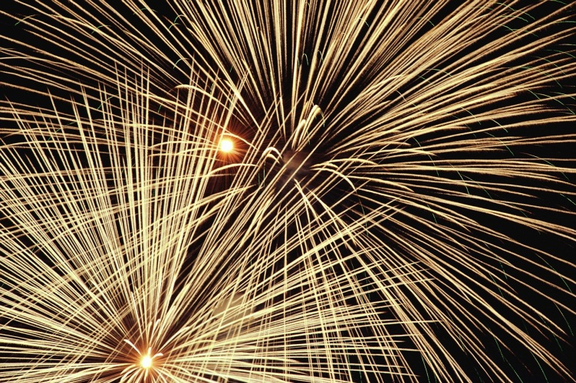
Reading/Language Arts Vocabulary - Grade 2
Display
A firework display.
To cause to be seen; show

Slide 70

Reading/Language Arts Vocabulary - Grade 2
Distinguish
You can distinguish the different flavors by their color.
To tell apart by seeing differences.

Slide 71
Reading/Language Arts Vocabulary - Grade 2
Edit/Editing
Original
the wagon is red
Edit
T .
he wagon is red
To correct and revise

Slide 72
Reading/Language Arts Vocabulary - Grade 2
Effect
Identifies the result of a cause

Slide 73
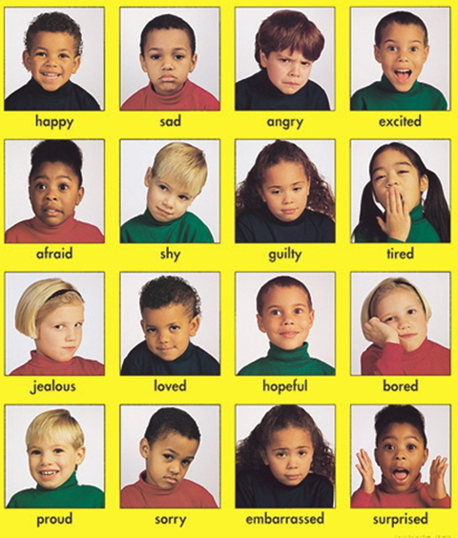
Reading/Language Arts Vocabulary - Grade 2
Emotion
A state or condition that is marked by such a feeling or response

Slide 74
Reading/Language Arts Vocabulary - Grade 2
Emphasize/Emphasizing
The principal’s speech was emphasizing the importance of staying safe on the playground.
To give special attention to something

Slide 75
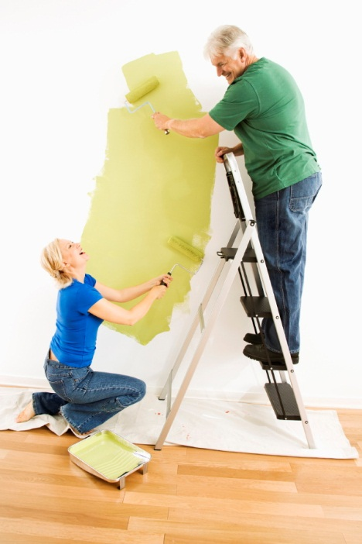
Reading/Language Arts Vocabulary - Grade 2
Enhance
Painting the walls really enhanced the living room.
To improve or add to the quality, value, or attractiveness of

Slide 76
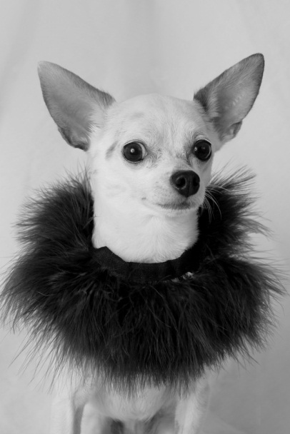
Reading/Language Arts Vocabulary - Grade 2
Entertain
Paco always wears silly clothes to entertain the students.
To amuse; keep someone interested

Slide 77
Reading/Language Arts Vocabulary - Grade 2
Essay
A fish is the best pet a person can have. I think that fish are the best pet because they are easy to take care of. If you remember to feed it and clean its tank, your fish will be happy. I also think fish are the best because they can swim really fast.
A short piece of writing that gives author’s opinions on a subject

Slide 78
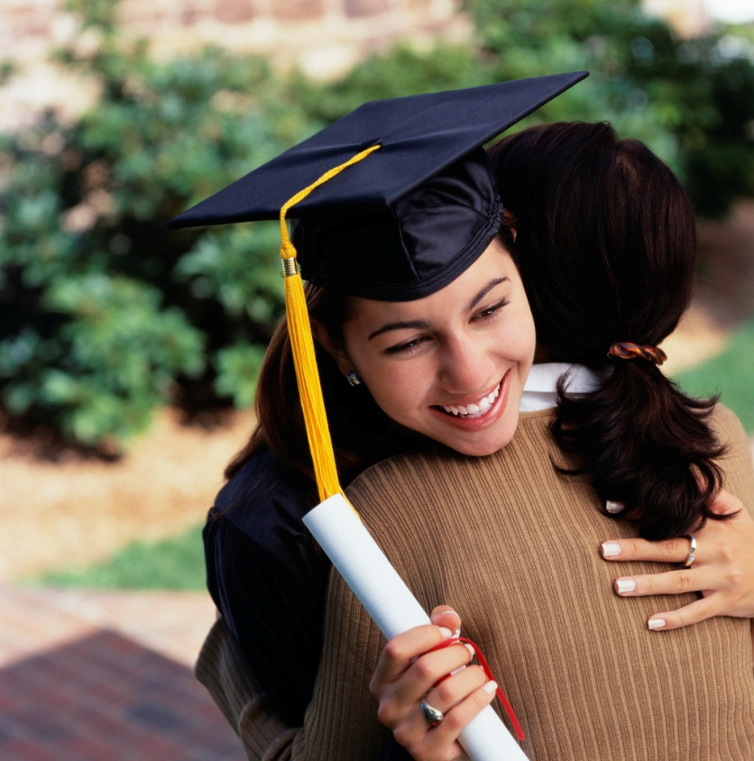
Reading/Language Arts Vocabulary - Grade 2
Events
Something that happens, especially an important thing that happens

Slide 79
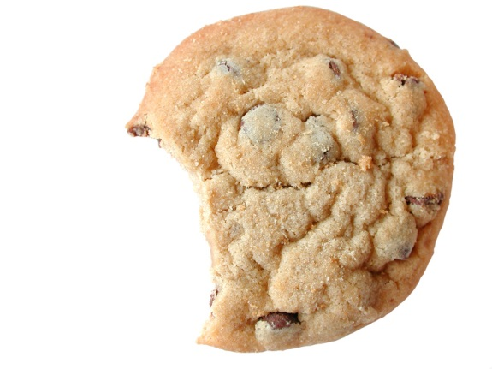
Reading/Language Arts Vocabulary - Grade 2
Evidence
The chocolate on Tommy’s hands was evidence that he had stolen the cookie.
Something that gives proof of or a reason to believe something

Slide 80

Reading/Language Arts Vocabulary - Grade 2
Example
Tanya’s dad shows her an example of how to swim.
Something that shows what a group of things is like

Slide 81
Reading/Language Arts Vocabulary - Grade 2
Exclamation Point
Don’t eat that
!
A punctuation mark ( ! ) used chiefly after an exclamation to show a forceful way of speaking or a strong feeling

Slide 82


Reading/Language Arts Vocabulary - Grade 2
Experiences
Surfing and river rafting might be experiences of an adventurous person.
Something that a person has done or lived through

Slide 83

Reading/Language Arts Vocabulary - Grade 2
Explain/Explanation
To give information so that another person can understand something

Slide 84




Reading/Language Arts Vocabulary - Grade 2
Expression
The act of telling or showing thoughts or feelings

Slide 85

Reading/Language Arts Vocabulary - Grade 2
Fable
A short story with a moral (lesson), often with animal characters

Slide 86
Reading/Language Arts Vocabulary - Grade 2
Fact
George Washington was the first President of the United States of America.
A statement that has been proven

Slide 87

Reading/Language Arts Vocabulary - Grade 2
Fantasy
A story containing unreal, imaginary features like talking animals or fairies

Slide 88
Reading/Language Arts Vocabulary - Grade 2
Feedback
After the company released their new product, they got a lot of positive feedback meaning that the customers liked the new product.
The returning of opinions, corrections after exposure to a product, process, or event

Slide 89

Reading/Language Arts Vocabulary - Grade 2
Fluently
The ability to speak or write smoothly and easily

Slide 90

Reading/Language Arts Vocabulary - Grade 12
Focus
Today in math we will focus on adding.
The area of greatest attention or activity

Slide 91

Reading Vocabulary Grade 2
Folk Tale
A cultural story passed down from generations

Slide 92
Reading Vocabulary Grade 2
Formal English
You should always use formal English for writing papers in school.
A form of speaking and writing used in formal settings

Slide 93
Reading Vocabulary Grade 2
General
Our teacher gave us a general idea of what would be on the spelling test but didn’t give us the exact words.
Not detailed; not specific

Slide 94

Reading/Language Arts Vocabulary - Grade 2
Glossary
An alphabetical listing of key words from a book and their definitions with page numbers where the word appears

Slide 95

Reading/Language Arts Vocabulary - Grade 2
Google
Internet search engine

Slide 96

Reading/Language Arts Vocabulary - Grade 2
Grammar
The study of the way the words of a language are put together and used for communication

Slide 97

Reading/Language Arts Vocabulary - Grade 2
Graph
A drawing that shows information and the relationships between pieces of that information

Slide 98

Reading/Language Arts Vocabulary - Grade 2
Graphic Organizer
An example of a graphic organizer:
A chart or other visual means of displaying relationships between pieces of information

Slide 99

Reading/Language Arts Vocabulary - Grade 2
Graphics
Related to pictures or writing such as photography, painting, and printing

Slide 100

Reading/Language Arts Vocabulary - Grade 2
Greeting
A word or gesture of welcome

Slide 101


Reading/Language Arts Vocabulary - Grade 2
Historical
Based upon history

Slide 102

Reading/Language Arts Vocabulary - Grade 2
Holiday
Happy
Independence
Day!
Independence Day is on the 4th of July and is a holiday that celebrates America’s independence.
A day to remember or celebrate something

Slide 103

Reading/Language Arts Vocabulary - Grade 2
Icons
A small picture on the screen of a computer

Slide 104
Reading/Language Arts Vocabulary - Grade 2
Important
It is important to remember to be nice to your classmates.
Having great meaning or value

Slide 105

Reading/Language Arts Vocabulary - Grade 2
Independently
Chris can now read independently.
Not needing the support or advice of another person

Slide 106

Reading/Language Arts Vocabulary - Grade 2
Index
A list of subjects, names, or other information in a book, with page numbers given for each thing on the list

Slide 107

Reading/Language Arts Vocabulary - Grade 2
Inform
To give knowledge to; tell.

Slide 108

Reading/Language Arts Vocabulary - Grade 2
Informal English
We can use informal English when we talk or write to our friends.
A casual way of speaking or writing

Slide 109


Reading/Language Arts Vocabulary - Grade 2
Information
Knowledge or facts about any thing or event.

Slide 110
Reading/Language Arts Vocabulary - Grade 2
Informational Text
Knowledge or facts that come from printed work

Slide 111

Reading/Language Arts Vocabulary - Grade 2
Interaction of Characters
In this movie scene, there is an interaction of characters at a meeting.
Action of one upon another in a story, play or movie

Slide 112

Reading/Language Arts Vocabulary - Grade 2
Internet Search
You can use Google for an internet search.
To find something in the world's largest computer network, which is made of millions of computers that are linked together

Slide 113

Reading/Language Arts Vocabulary - Grade 2
Irregular
Irregular Verbs
Being an exception to the general rules of grammar or spelling

Slide 114
Reading/Language Arts Vocabulary - Grade 2
Irregular Verbs
Irregular Verbs
Live by their own set of rules and are the exception to the grammar rules

Slide 115
Reading/Language Arts Vocabulary - Grade 2
Journal
September 3, 2012
Today was the first day of school. I was nervous at first but I actually had a really fun day. My teacher is very nice and I made two new friends. One of my new friends is named Sam. Sam lives just down the street from me. I am excited to go back to school tomorrow!
A daily record of events and the writer’s thoughts and feelings about those events

Slide 116

Reading/Language Arts Vocabulary - Grade 2
Justify
Brandy didn’t have any good reasons to justify her need for the new video game so her parents would not buy it for her.
To show good reasons or cause for

Slide 117
Reading/Language Arts Vocabulary - Grade 2
Key Details
Main Idea:
What the story or passage is mostly talking about
Key Details
Important information that tell more about the main idea
The important points of information.

Slide 118

Reading/Language Arts Vocabulary - Grade 2
Key Words
Key Words for Math
A word or concept of great significance

Slide 119

Reading/Language Arts Vocabulary - Grade 2
Label
Identifying or classifying an item or group

Slide 120
Reading/Language Arts Vocabulary - Grade 2
Legible
If you use nice handwriting, your assignments will be legible.
Able to be understood or read

Slide 121

Reading Vocabulary Grade 2
Letter
The written form of a sound

Slide 122

Reading Vocabulary Grade 2
Library Sources
A place that provides information in books, records, and other materials

Slide 123

Reading Vocabulary Grade 1
List
Names or items written one after another.

Slide 124
Reading Vocabulary Grade 1
Literal Meaning
The literal meaning of a word or phrase means exactly what it says.
In accordance with the ordinary, exact, or primary meaning of a word or words

Slide 125

Reading Vocabulary Grade 1
Literature
Stories, poems, plays, and other written work that people consider to have value in a culture

Slide 126
Reading/Language Arts Vocabulary - Grade 2
Main character
Main character
The most important character in a story, poem, or play

Slide 127
Reading Vocabulary Grade 2
Main Idea
Detail
Detail
They are playful.
They like to cuddle.
Main Idea
I like cats.
Detail
Detail
My cat is friendly.
Cats are cute.
The most important idea expressed in a piece of writing.

Slide 128
Reading Vocabulary Grade 2
Main Purpose
The main purpose of this assembly is to stop bullying.
The most important reason or plan that guides an action

Slide 129
Reading Vocabulary Grade 2
Main Topic
Detail
Detail
They are playful.
They like to cuddle.
Main Topic
I like cats.
Detail
Detail
My cat is friendly.
Cats are cute.
A sentence that states or suggests the main idea

Slide 130

Reading Vocabulary Grade 2
Major Character
Woody is a major character in Toy Story.
The one the story is about

Slide 131

Reading Vocabulary Grade 2
Major Event
A major event in this story is when the bears come home.
A special or important happening

Slide 132

Reading/Language Arts Vocabulary - Grade 2
Make-believe
To pretend, imagine

Slide 133



Reading/Language Arts Vocabulary - Grade K
Media
The means of bringing information to large numbers of people through newspapers, magazines, radio, computers, and television.

Slide 134

Reading/Language Arts Vocabulary - Grade K
Minor Character
Mr. and Mrs. Potato Head are both minor characters.
They support the main character in the story without major growth or change

Slide 135
Reading/Language Arts Vocabulary - Grade K
Minor Event
A minor event in this story is when Goldilocks tries the porridge.
Not as important as major events

Slide 136
Reading/Language Arts Vocabulary - Grade 2
Moral
The moral of this story is that slow and steady wins the race.
A story that teaches a lesson

Slide 137

Reading/Language Arts Vocabulary - Grade 2
Multi-paragraph
More than one paragraph in an essay or story

Slide 138

Reading/Language Arts Vocabulary - Grade 2
Multiple Meaning
Words that can have multiple meanings depending on how they are used in a sentence

Slide 139

Reading/Language Arts Vocabulary - Grade 2
Multi-syllable
More than one single vowel sound with or without surrounding consonants

Slide 140

Reading/Language Arts Vocabulary - Grade 2
Narrative
A story or tale

Slide 141

Reading/Language Arts Vocabulary - Grade 2
Newspaper
A daily or weekly publication of current events (news)

Slide 142

Reading/Language Arts Vocabulary - Grade 2
Nonfiction
The kids are getting on the bus to go to school.
Writing that tells about real people, places, and events

Slide 143

Reading/Language Arts Vocabulary - Grade 2
Note-taking
The practice of writing down pieces of information in a systematic way

Slide 144



Reading/Language Arts Vocabulary - Grade 2
Online
Connected to or reached through a computer or computer network

Slide 145

Reading/Language Arts Vocabulary - Grade 2
Opinion
A personal judgment that someone thinks is true, but that may be true or false

Slide 146

Reading/Language Arts Vocabulary - Grade 2
Oral
Spoken, rather than written; carried out by speaking

Slide 147

Reading/Language Arts Vocabulary - Grade 2
Organize
To set in order; arrange in an orderly way

Slide 148
Reading/Language Arts Vocabulary - Grade 2
Outline
Topic
  Detail
  Detail
  Detail
Topic
  Detail
  Detail
  Detail
A special form to plan and organize writing

Slide 149

Reading/Language Arts Vocabulary - Grade 2
Pace
She worked at a fast pace and was finished with her homework in one hour.
Rate of movement; how fast something moves

Slide 150
Reading Vocabulary Grade 2
Paragraph
Sample paragraph
Sunday is Father’s Day, and Maria wants to buy a special gift for her father. She looked at the Father’s Day ads in the newspaper, but they mostly had sales on ties and bottles of cologne. Her father doesn’t like to wear ties, and he never wears cologne. He used to go fishing or bowling on the weekends, but lately he’s been staying home and working in the garden.
A group of sentences about the same topic

Slide 151
Reading/Language Arts Vocabulary - Grade 2
Paraphrase
Quote | Paraphrase | Summarize
Use an exact copy of the author’s words | Use the authors ideas in your own words | Putting main ideas into your own words
Author’s words and ideas | Author’s ideas in your words | Present only the most important ideas of the author
Must use “quotation marks” and cite your source | Must site your source | Must site your source
To restate in somewhat different word

Slide 152
Reading Vocabulary Grade 2
Passage
Sample passage
Yesterday we went to the zoo. We saw all kinds of animals. My favorite animals were the monkeys. The monkeys swung around the trees and ropes in their enclosure.
A part of a written or musical work

Slide 153
Reading Vocabulary Grade 2
Past Tense
She walked to school yesterday.
He ate pizza for dinner.
We talked about that this morning.
Shows an action or state happened in the past

Slide 154

Reading Vocabulary Grade 2
Persuade
Becky tried to persuade her sister to clean her room for her.
To cause someone to believe or do something through reasoning or arguing

Slide 155
Reading/Language Arts Vocabulary - Grade 2
Persuasive Writing
Everyone should own a pet goldfish. Pet goldfish are the best to own because they are very easy to take care of. All you need to do is remember to care for your goldfish and feed it every day. Since a fish is so easy to care for, everyone should own a pet goldfish.
A text type that is designed to convince the reader to adopt a particular opinion or perform a certain action

Slide 156
Reading/Language Arts Vocabulary - Grade 2
Phrase
That box is full of toys.
Example of a phrase
Two or more words that express an idea and are part of a sentence

Slide 157

Reading/Language Arts Vocabulary - Grade 2
Plan
Sarah used a map to plan where she would take her next vacation.
An action one intends to take; aim

Slide 158
Reading/Language Arts Vocabulary - Grade 2
Poetry
On the road,
There lives a toad.
He is green,
And he is not mean.
If you meet him,
You should greet him.
That nice toad,
Who lives on the road.
The work of a poet

Slide 159
Reading/Language Arts Vocabulary - Grade 2
Point of View
From point of view of the writer:
I was walking to the store one day and I found a five dollar bill. I was so excited to find that money but then I started to think about the person who may have lost it. What if they need the five dollars more than I do? I decided to turn the five dollars in to the store manager and they found who it belonged to.
The vantage point from which a writer tells a story

Slide 160

Reading/Language Arts Vocabulary - Grade 2
PowerPoint
A program on the computer that allows you to create slideshow presentations

Slide 161
Reading/Language Arts Vocabulary - Grade 2
Precise
She gave us precise directions so it was easy to find her house.
Stated in a clear way and with details

Slide 162
Reading/Language Arts Vocabulary - Grade 2
Prefix
Un
wrap
The prefix un means not, or opposite of
A letter or a group of letters added to the beginning of a word that changes the meaning

Slide 163

Reading/Language Arts Vocabulary - Grade 2
Presentation
The act of presenting

Slide 164

Reading/Language Arts Vocabulary - Grade 2
Problem
A question to be discussed or solved.

Slide 165

Reading/Language Arts Vocabulary - Grade 2
Produce
The artist will produce a new painting.
To cause a new thing to come into the world; to make something.

Slide 166


Reading/Language Arts Vocabulary - Grade 2
Product Names
The name of something produced by means of either human or mechanical work

Slide 167

Reading/Language Arts Vocabulary - Grade 2
Proficiently
Jamal can read proficiently.
Well-advanced or competent in any art, science, or subject

Slide 168

Reading/Language Arts Vocabulary - Grade 2
Pronoun
A word that is used as a substitute for a noun

Slide 169
Reading/Language Arts Vocabulary - Grade 2
Proofread
Before proofread
lets go to the stoore. we should get some ice cream. then we should watch a movie
After proofread
Let’s go to the store. We should get some ice cream. Then we should watch a movie.
To read over and fix mistakes

Slide 170

Reading/Language Arts Vocabulary - Grade 2
Punctuation
The use of standard marks and signs in writing and printing to separate words into sentences, clauses, and phrases in order to clarify meaning

Slide 171

Reading/Language Arts Vocabulary - Grade 2
Purpose
The reason that something exists or happens.

Slide 172
Reading/Language Arts Vocabulary - Grade 2
Question
Where is Sally?
A sentence that asks for an answer

Slide 173
Reading/Language Arts Vocabulary - Grade 2
Question mark
Where is it
?
A punctuation symbol (?) written at the end of a sentence or phrase to indicate a direct question

Slide 174
Reading/Language Arts Vocabulary - Grade 2
Quote
Becky said, “I think we
should do our homework first.”
To repeat the exact words used by someone else

Slide 175
Reading/Language Arts Vocabulary - Grade 2
Real Life Connections
The story had a few real life connections that we could relate to our own lives.
Connecting to the realm of practical or actual experience, as opposed to the abstract

Slide 176
Reading/Language Arts Vocabulary - Grade 2
Reasons
Reasons for going to school
To learn to read
To make friends
To learn how to do math
A cause or explanation for an action, opinion, or event.

Slide 177
Reading/Language Arts Vocabulary - Grade 2
Recall
Do you recall the
first day of school?
To bring a past event into your mind.

Slide 178
Reading/Language Arts Vocabulary - Grade 2
Recount
She recounted the events of her childhood.
To tell a history of events; relate; narrate

Slide 179
Reading/Language Arts Vocabulary - Grade 2
Reflection
After careful reflection, Sarah decided to take the new job.
The process of deep or serious thinking, or a particular thought that results from this process

Slide 180

Reading/Language Arts Vocabulary - Grade 2
Relate
My sister was sick at the same time as me so she could relate to how I was feeling.
To have a connection with something

Slide 181
Reading/Language Arts Vocabulary - Grade 2
Relevant
We were talking about vacations so Mary’s comment about her trip to Disneyworld was relevant.
Related to what is being discussed or is presently important

Slide 182
Reading/Language Arts Vocabulary - Grade 2
Repetition
The key to memorization is repetition.
The act or process of repeating

Slide 183

Reading/Language Arts Vocabulary - Grade 2
Report
To tell about what happened

Slide 184

Reading/Language Arts Vocabulary - Grade 2
Research
Careful and organized study or gathering of information about a specific topic

Slide 185
Reading/Language Arts Vocabulary - Grade 2
Resolution
I’m sorry
I am too
A solution or end to an argument or other conflict

Slide 186

Reading/Language Arts Vocabulary - Grade 2
Respond
To answer or give a reply in some way.

Slide 187
Reading/Language Arts Vocabulary - Grade 2
Revise/Revising
The original:
we are goin to the store we are goin to get some food
After you revise:
We are going to the store. We are going to get some food.
To look over again in order to correct or improve

Slide 188

Reading/Language Arts Vocabulary - Grade 2
Rhyme
Words that have the same ending sound

Slide 189
Reading/Language Arts Vocabulary - Grade 2
Rhythm
Poetry and songs have rhythm.
Movement marked by the regular repetition of sounds

Slide 190
Reading/Language Arts Vocabulary - Grade 2
Root Word
Prefix
Un
wrap
Root word
The base word you start with before adding prefixes or suffixes

Slide 191
Reading/Language Arts Vocabulary - Grade 2
Rule
Class Rule
Do not run in the hallway.
A statement telling what must or must not be done

Slide 192
Reading/Language Arts Vocabulary - Grade 2
Scanning
We will be scanning the story to find the main idea.
To read or look at something for a short time

Slide 193
Reading/Language Arts Vocabulary - Grade 2
Schedule
A list of times at which things are planning to occur

Slide 194

Reading/Language Arts Vocabulary - Grade 2
Science Fiction
Writing that tells about imaginary events that involve science or technology

Slide 195

Reading/Language Arts Vocabulary - Grade 2
Scientific
Requiring or demonstrating systematic knowledge and skills, exactness in observation and testing

Slide 196
Reading/Language Arts Vocabulary - Grade 2
Search Engine
A software program that searches a database or network, esp. the Internet, for data, files, or documents containing terms specified by the user

Slide 197

Reading/Language Arts Vocabulary - Grade 2
Section
Section of the news paper
A part that is different or apart from the whole

Slide 198

Reading/Language Arts Vocabulary - Grade 2
Selection
A menu lists a selection of food that you can order from a restaurant.
A group from which things or people may be selected

Slide 199
Reading/Language Arts Vocabulary - Grade 2
Self-Monitoring
You can use self-monitoring to stay calm in a stressful situation.
Control of one's feelings or behavior

Slide 200
Reading/Language Arts Vocabulary - Grade 2
Sequence
First, we went to the store. Next, we went to the park. Then, we went to see my grandma. Finally, we went back home.
A text structure in which one event or action follows another

Slide 201
Reading/Language Arts Vocabulary - Grade 2
Sequence of Events
First, we went to the store. Next, we went to the park. Then, we went to see my grandma. Finally, we went back home.
Define the process steps or tasks that are required to complete each process

Slide 202
Reading/Language Arts Vocabulary - Grade 2
Sequential Order
Plant a seed in soil
Water the seed each day
The seed starts to sprout
The sprout will bloom
You will have a beautiful flower
The following of one thing after another; succession

Slide 203

Reading/Language Arts Vocabulary - Grade 2
Setting
The time and place of the action in a story, play, or poem.

Slide 204
Reading/Language Arts Vocabulary - Grade 2
Shades of Meaning
Toss: gently
Throw: normal
Hurl: powerful, hard
Small differences in meaning between similar words. ex. toss, throw, hurl

Slide 205
Reading/Language Arts Vocabulary - Grade 2
Short Story
Once upon a time, there was a young girl named Sally. Sally always wanted to have a pet puppy. One day, Sally’s mom brought her home a puppy. Sally was so happy and now her puppy is her best friend. The end.
A story that isn’t very long

Slide 206

Reading/Language Arts Vocabulary - Grade 2
Sign
A mark to represent a command

Slide 207

Reading/Language Arts Vocabulary - Grade 2
Similarities
A specific point of being similar

Slide 208
Reading/Language Arts Vocabulary - Grade 2
Simple Sentences
The dog jumped.
We had ice cream.
Today is sunny.
A sentence consisting of a single main clause

Slide 209
Reading/Language Arts Vocabulary - Grade 2
Skimming
You can miss important information by just skimming through any type of writing.
To glance through in a hurry

Slide 210

Reading/Language Arts Vocabulary - Grade 2
Sources
People or things that give information

Slide 211

Reading/Language Arts Vocabulary - Grade 2
Speaker
A person who speaks publicly

Slide 212


Reading/Language Arts Vocabulary - Grade 2
Specific
The pet store only sells specific pets including lizards and kittens.
Special or unique to something

Slide 213

Reading/Language Arts Vocabulary - Grade 2
Speech
A formal talk given in front of an audience

Slide 214

Reading/Language Arts Vocabulary - Grade 2
Spellcheck
A computer program that checks the spelling in a document

Slide 215

Reading/Language Arts Vocabulary - Grade 2
Spelling
The forming of words from letters

Slide 216
Reading/Language Arts Vocabulary - Grade 2
Statement
Her name is Sally.
A sentence that tells something

Slide 217

Reading/Language Arts Vocabulary - Grade 2
Story
A story tells you about things that have happened, some are real while some are make believe

Slide 218
Reading/Language Arts Vocabulary - Grade 2
Strategies
Paul’s strategies helped him to finish all of his homework on time.
A method or plan of action that you intend to use for some purpose

Slide 219
Reading/Language Arts Vocabulary - Grade 2
Style
Each author uses a different style of writing.
The manner in which something is said or done

Slide 220

Reading/Language Arts Vocabulary - Grade 2
Subheading
Heading
Subheading
The heading or title of a section or subdivision of a printed text

Slide 221
Reading/Language Arts Vocabulary - Grade 2
Substantive Topics
Substantive topics relate to the main topic.
Relating to, containing, or being the essential element of the subject

Slide 222
Reading/Language Arts Vocabulary - Grade 2
Suffix
Work
ed
The suffix ed means happened in the past
One or more letters added to the end of a root word that changes the word’s meaning

Slide 223
Reading/Language Arts Vocabulary - Grade 2
Summarize
Quote | Paraphrase | Summarize
Use an exact copy of the author’s words | Use the authors ideas in your own words | Putting main ideas into your own words
Author’s words and ideas | Author’s ideas in your words | Present only the most important ideas of the author
Must use “quotation marks” and cite your source | Must site your source | Must site your source
To restate in a concise form

Slide 224

Reading/Language Arts Vocabulary - Grade 2
Support
To provide proof or evidence for

Slide 225
Reading/Language Arts Vocabulary - Grade 2
Support Claims
Support claims help to support an idea or statement.
Establish as valid or genuine

Slide 226
Reading/Language Arts Vocabulary - Grade 2
Supporting Ideas
Supporting Idea
Supporting Idea
They are playful.
They like to cuddle.
Main Idea
I like cats.
Supporting Idea
Supporting Idea
My cat is friendly.
Cats are cute.
Support your main idea by explaining it, describing it, defining it

Slide 227
Reading/Language Arts Vocabulary - Grade 2
Tall Tale
The Giant Cat
There once lived a giant cat named Phil. Phil was a big as an elephant. He could talk and dance. He also could sing.
An absurd, exaggerated, humorous story that is obviously unbelievable

Slide 228

Reading/Language Arts Vocabulary - Grade 2
Technical
Having a special meaning within a certain field, or containing words that have a special meaning

Slide 229


Reading/Language Arts Vocabulary - Grade 2
Technology
Products that are developed using knowledge from science and industry

Slide 230
Reading/Language Arts Vocabulary - Grade 2
Text
Sample Text:
One day, I went to the park with my friend Sam. Sam and I thought it would be fun to play on the monkey bars. When we went to the monkey bars, there was a bar that was broken. It looked dangerous so we decided to go and tell my mom. My mom was able to find someone to fix the broken bar. When the monkey bars were fixed, we went back to the park and had a great time. The end.
The words in a written work

Slide 231

Reading/Language Arts Vocabulary - Grade 2
Textbook
A book used in school to study a subject

Slide 232

Reading/Language Arts Vocabulary - Grade 2
Textual Features
Text features are parts of your textbook that have been created to help you locate and learn information

Slide 233

Reading/Language Arts Vocabulary - Grade 2
Theme
The theme is winter sports.
The main subject or topic

Slide 234

Reading/Language Arts Vocabulary - Grade 2
Thesaurus
A book that lists words with their synonyms or antonyms

Slide 235

Reading/Language Arts Vocabulary - Grade 2
Timeline
A graphic presentation of a chronology of events and their dates, listed from left to right along a horizontal line or in a vertical column

Slide 236

Reading/Language Arts Vocabulary - Grade 2
Title
The name of a book or story

Slide 237
Reading/Language Arts Vocabulary - Grade 2
Tone
Mr. Perkins used a friendly tone when he talked to his students.
The sound of words as they show a feeling

Slide 238

Reading/Language Arts Vocabulary - Grade 2
Toolbar
A strip of icons that you can click on in a computer program

Slide 239

Reading/Language Arts Vocabulary - Grade 2
Topic
A subject of discussion, conversation, or writing

Slide 240
Reading/Language Arts Vocabulary - Grade 2
Topic Sentence
Sunday is Father’s Day, and Maria wants to buy a special gift for her father. She looked at the Father’s Day ads in the newspaper, but they mostly had sales on ties and bottles of cologne. Her father doesn’t like to wear ties, and he never wears cologne. He used to go fishing or bowling on the weekends, but lately he’s been staying home and working in the garden.
A sentence at the beginning of a paragraph, that states or suggests the main idea of a passage

Slide 241

Reading/Language Arts Vocabulary - Grade 2
Understand/Understanding
To know what something means

Slide 242
Reading/Language Arts Vocabulary - Grade 2
Valid Reason
She had a valid reason for not turning in her homework so her teacher let her turn it in the next day.
Truth or fact explained for an action, opinion, or event

Slide 243

Reading/Language Arts Vocabulary - Grade 2
Title Page
A page of a book displaying the title, author and publisher

Slide 244
Reading/Language Arts Vocabulary - Grade 2
Verb
is
She very nice.
verb
A word that expresses action or a state of being

Slide 245

Reading/Language Arts Vocabulary - Grade 2
Video
A movie or other program that is recorded

Slide 246

Reading/Language Arts Vocabulary - Grade 2
Visual
Having to do with or using pictures or video

Slide 247

Reading/Language Arts Vocabulary - Grade 2
Vocabulary
The set of words that a particular person or group knows or uses

Slide 248
Reading/Language Arts Vocabulary - Grade 2
Word order
Different word order:
Yesterday was his birthday.
His birthday was yesterday.
The arrangement of words in a sentence

Slide 249

Reading/Language Arts Vocabulary - Grade 2
Word Processing
The creation of typed documents with a computer

