Slide 1
Visual Vocabulary eSlides
English Language Arts (ELA)
Grade 11-12
Partners for Learning, Inc.
(208) 322-5007
resources@partnersforlearning.org
www.partnersforlearning.org

Slide 2
SITE LICENSE / TERMS OF USE
The academic vocabulary power point slides are sold on a per grade, per school basis.
TERMS OF USE:
All slides included in this presentation are for use only by the purchasing school
  Additional copies can be purchased for use
By using the slides you agree to only use the slides in the school for which they were purchased.
You further agree not to copy or distribute the slides for use outside of the purchasing school.
Thank You

Slide 3
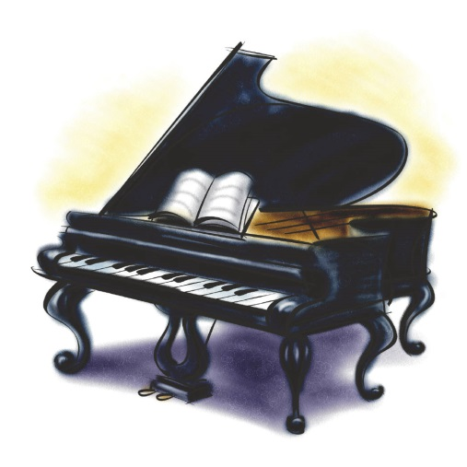
18th century
Fire Extinguisher - 1722
Piano - 1709
American Revolution
The time period from January 1, 1701 to December 31, 1800.

Slide 4
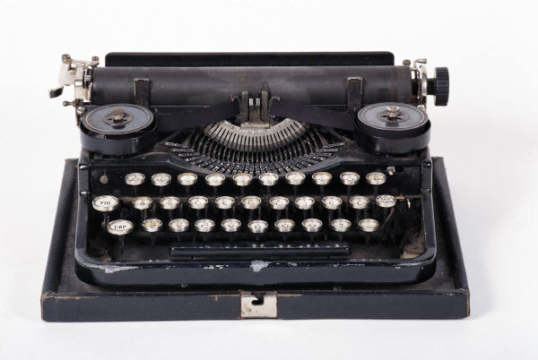
19th century
American Civil War
Typewriter - 1829
Printing Press - 1810
Safety Pin - 1849
The time period from January 1, 1801 to December 31, 1900.

Slide 5
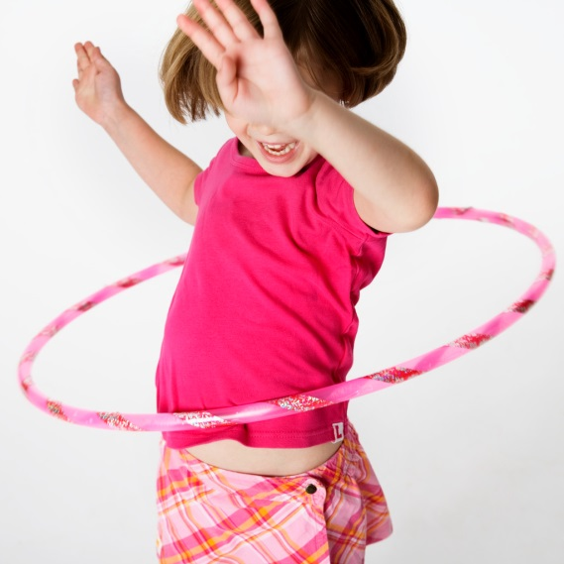
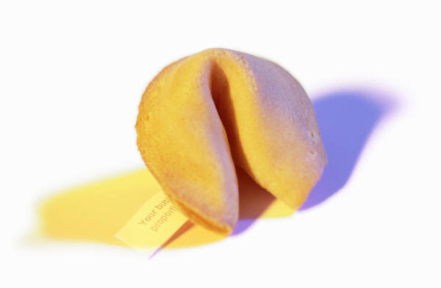

20th century
Ballpoint Pen - 1938
Fortune Cookie - 1918
Hula Hoop - 1958
The time period from January 1, 1901 to December 31, 2000.

Slide 6
Accounts
Both drivers had a different account of the accident.
Descriptions of events or experiences.

Slide 7
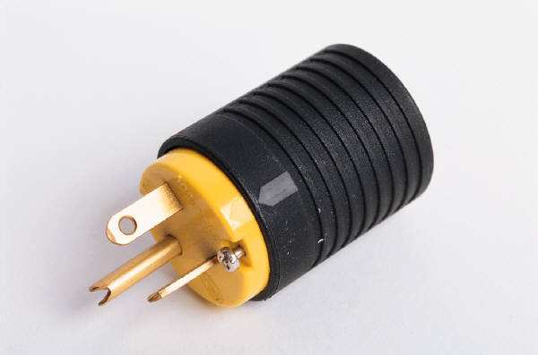
Adapt
To change for a particular use.

Slide 8
Address
The purpose of her speech is to address the issue of bullying in schools today.
To give attention to; deal with.

Slide 9
Adjective clause
My sister has an apartment that overlooks the park.
A clause that modifies a noun or a pronoun.

Slide 10
Adjective phrase
My sister has an apartment overlooking the park.
A word group with an adjective at its head.

Slide 11
Adverb clause
I saw the movie before I read the book.
A dependent clause used as an adverb in a sentence to indicate time, place, condition, contrast, concession, reason, purpose, or result.

Slide 12
Advocacy
The giving of support to an idea, person, or cause.

Slide 13

Aesthetic
Relates to the beauty of form in works of art, including literature, dance, music, and the like.

Slide 14
Affix
Unwrapped
The prefix un means not, or opposite of.
The suffix ed means happened in the past.
affix
An affix can be added to the root of a word to change its meaning. Added to the beginning of the word, it is a prefix. Added to the end of a word, it is a suffix.

Slide 15
Allegory
A story with characters and events that are symbols representing truths about human life.

Slide 16
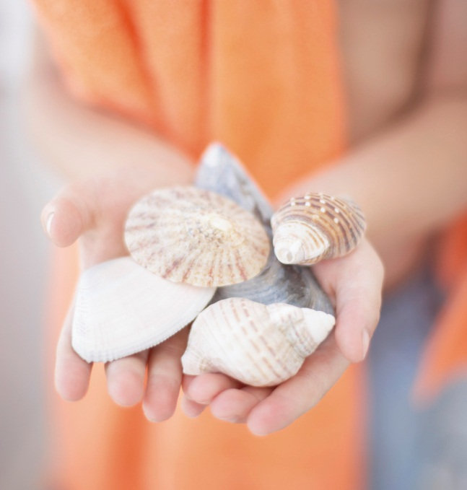
Alliteration
Sally Sells Seashells by the Seashore.
The repetition of the same initial letter in successive words; it is done for effect.

Slide 17
Allusion
He has told so many lies, I’m surprised his nose isn’t a mile long.
The connection between lies and a growing nose is an allusion to the story of Pinocchio.
A passing or casual reference; an incidental mention of something.

Slide 18
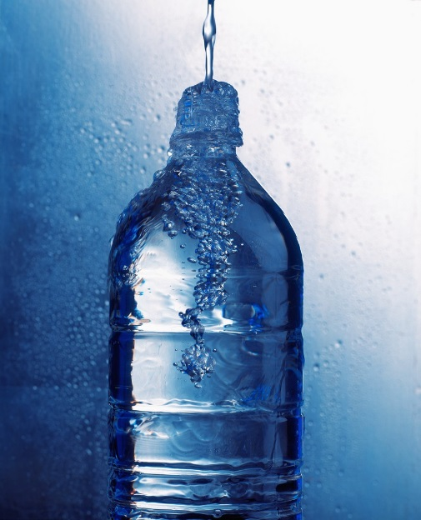
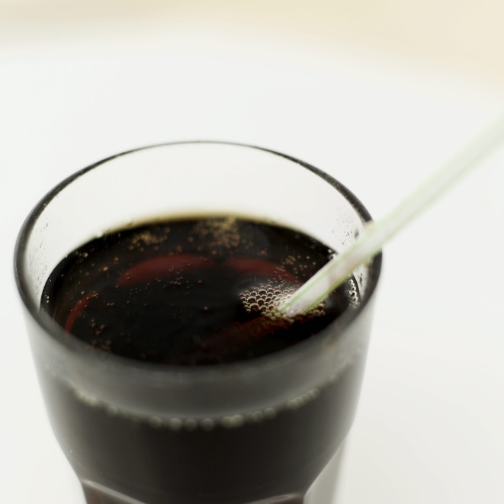
Alternative
Water is a healthy alternative to soda.
Offering or allowing a choice.

Slide 19
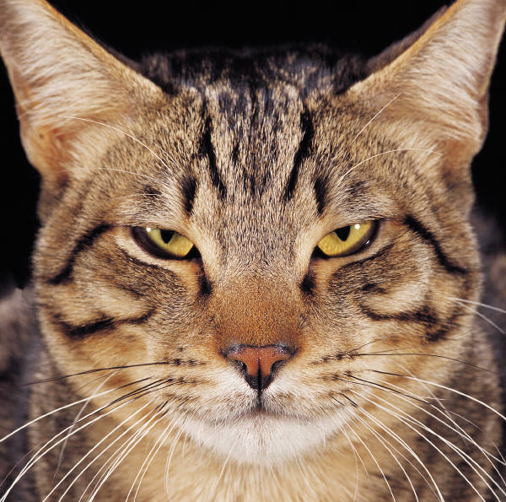
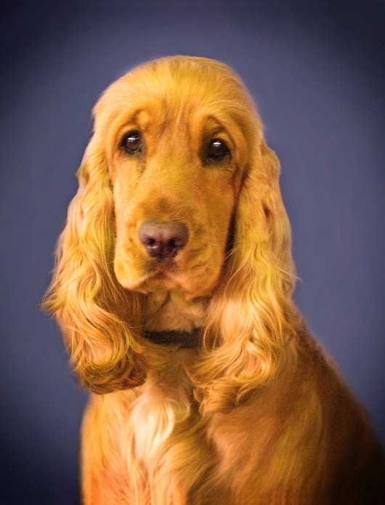
Analogy
Meow is to Cats
as
Bark is to Dogs
A comparison of two different things that are similar in some way.

Slide 20
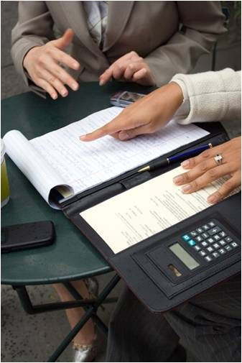
Analysis/Analyze
Examining parts to understand how they work together to create meaning as a whole.

Slide 21
Anecdote
A lady was at the grocery store, trying to find a turkey large enough for her family Thanksgiving, but they were all too small.
She found a clerk and asked, "Do these turkeys get any bigger?"
The clerk replied, "No, ma'am, they are dead."
A short account of a particular incident or event.

Slide 22
Antagonist
Red Riding Hood
protagonist
Big Bad Wolf
antagonist
A principal character or force in opposition to a protagonist, or main character.

Slide 23
Antithesis
RIGHT
LEFT
The exact opposite.

Slide 24
Antonym
Happy
Sad
A word having a meaning opposite to that of another word.

Slide 25
Apostrophe
apostrophe
Can’t
A mark used to show that letters or figures are missing.

Slide 26
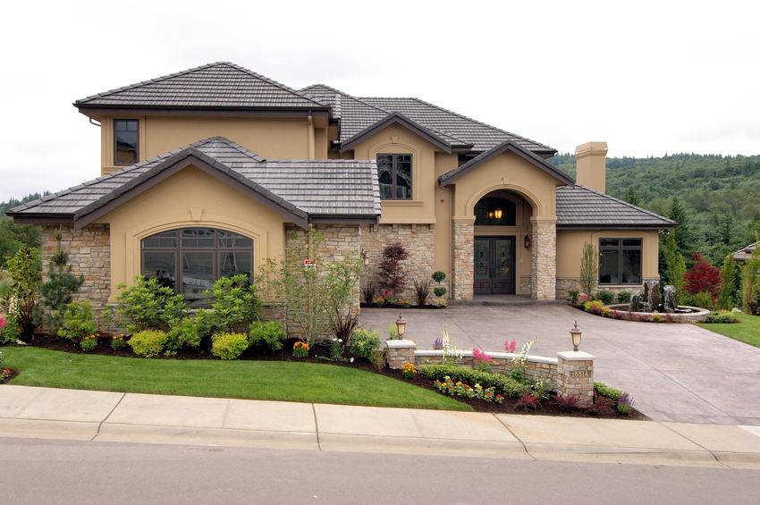
Appeal
This house has great curb appeal.
Attraction, interest, attention.

Slide 27
Appositive
appositive
"The Otis Elevator Company, the world’s oldest and biggest elevator manufacturer, claims that its products carry the equivalent of the world’s population every five days.“
(Nick Paumgarten, "Up and Then Down." The New Yorker, Apr. 21, 2008)
A noun, noun phrase, or series of nouns placed next to another word or phrase to identify or rename it.

Slide 28
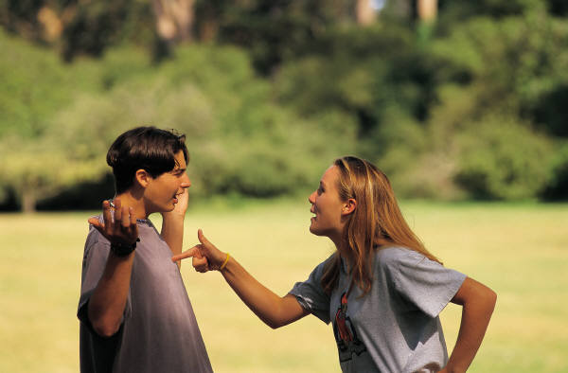
Argument
Verbal exchange between people with opposite views

Slide 29
Articulate
The guest speaker was very articulate.
Able to speak or express oneself in a clear way.

Slide 30
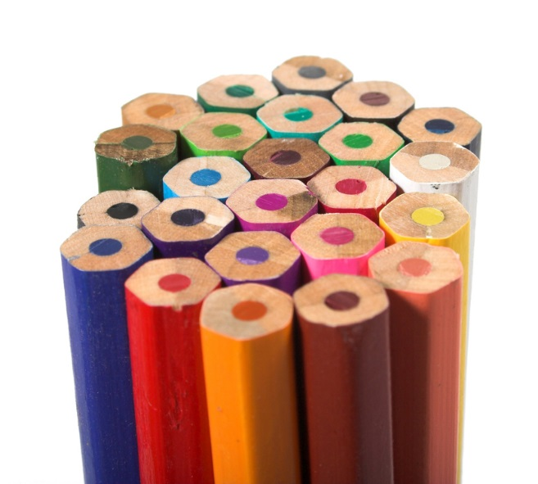
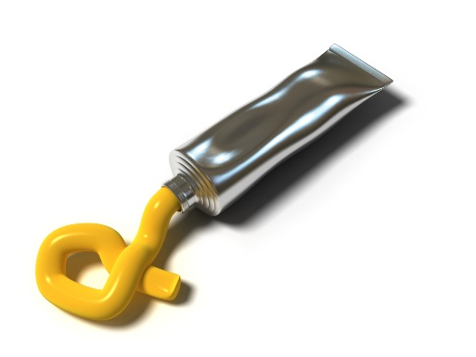

Artistic medium
Oils
Watercolors
Colored Pencil
The substance or material the artistic work is made from, and may also refer to the technique used.

Slide 31
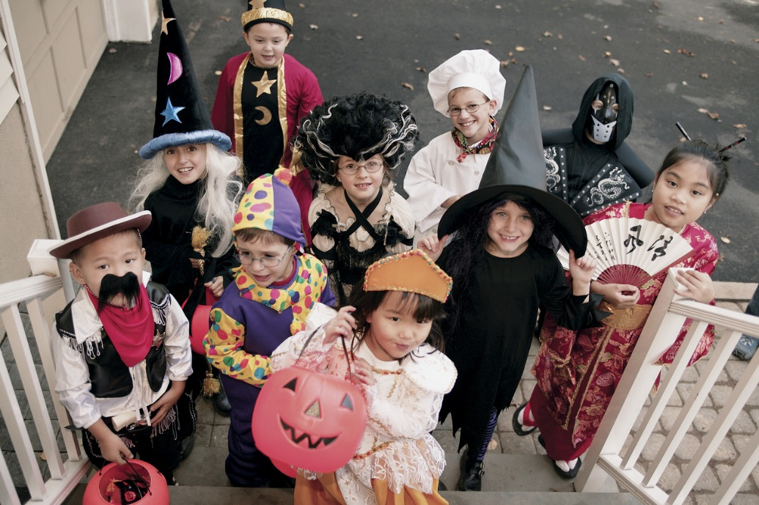
Assertion
Halloween is the best holiday!
A declaration or statement, often without support or proof.

Slide 32
Assess
The paramedics are trying to assess the patient.
To set or try to find the importance or value of; evaluate; estimate.

Slide 33
Audience
A group that listens or watches.

Slide 34
Author’s purpose
Narrate
Argue
Amuse
Scare
Entertain
Purpose
Report
Persuade
Inform
Motivate
Analyze
Compare/Contrast
Enlighten
The reason the author created a writing.

Slide 35
Base word
UNBELIEVEABLE
A complete word that can stand alone without a prefix or suffix.

Slide 36
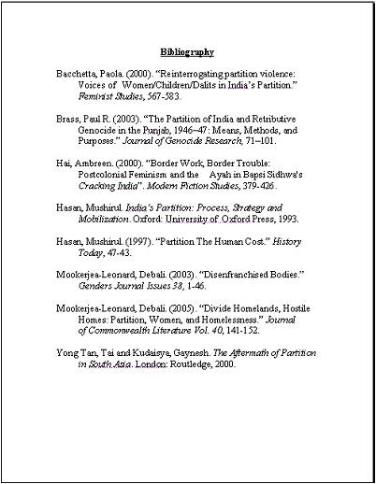
Bibliography
A list of writings used as sources, with year and place of publication.

Slide 37
Cause and effect
It rained last night, so the grass is all wet.
cause
effect
A text structure that explains why things happen; the events that happen first are the causes and the events that happen as a result are the effects.

Slide 38
Central idea
Detail
Detail
Cats are playful.
Cats like to cuddle.
Central Idea
key details
Why I like cats.
key details
Detail
Detail
My cat is friendly.
Cats are cute.
The main thought of focus of a piece of writing.

Slide 39
Chapter
The Hobbit
~by J.R.R. Tolkien
Table of Contents
Chapter
Page
1
2
3
4
5
6
An Unexpected Party
Roast Mutton
A Short Rest
Over Hill and Under Hill
Riddles in the Dark
Out of the Frying-Pan into the Fire
15
40
55
64
76
96
A section of a book.

Slide 40
Character
A person or animal who takes part in the action of a literary work.

Slide 41
Character development
Surrounding Environment
Physical Details
Other Characters
The method(s) a writer uses to create and develop characters.

Slide 42

Chart
A group of facts about something in the form of a diagram, table, graph, etc.

Slide 43


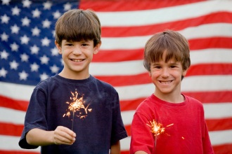


Chronological order
New Years Day – January 01
Valentine’s Day – February 14
St. Patrick’s Day – March 17
Independence Day – July 04
Halloween – October 31
Christmas Day – December 25
A list of events in the order in which they occur.

Slide 44
Citation page
As the story went on, it became quite clear that Peter’s intentions were mischievous. This was made evident when Greg said, “I have found Peter’s notebook, and I’m sure that he is the one behind this crime.” (Smith, 2006)
Works Cited
Smith, Mary (2006). A Great Day. Hoboken, New Jersey: Willardson & Briggs.
A page dedicated to recognizing the source of any quoted passage.

Slide 45
Cite
As the story went on, it became quite clear that Peter’s intentions were mischievous. This was made evident when Greg said, “I have found Peter’s notebook, and I’m sure that he is the one behind this crime.” (Smith, 2006)
Works Cited
Smith, Mary (2006). A Great Day. Hoboken, New Jersey: Willardson & Briggs.
citation
Make reference to; to quote (a passage, book, author, etc.).

Slide 46
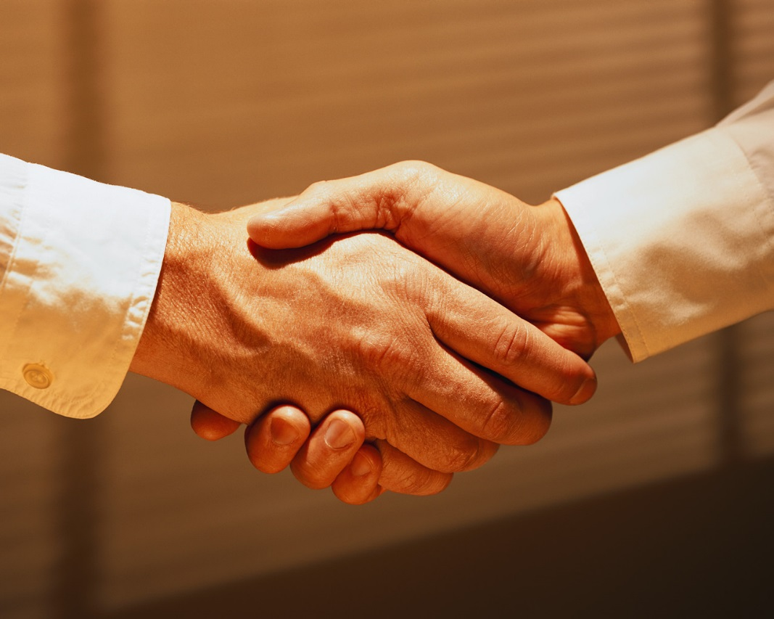
Civil
Observing socially acceptable standards of politeness and courtesy.

Slide 47
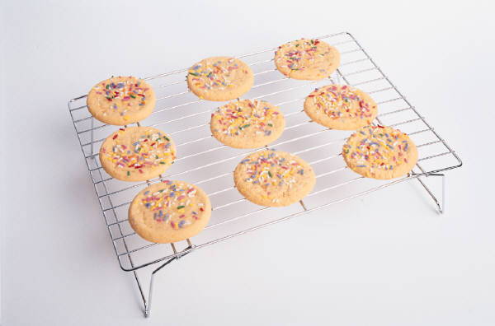
Claim
My grandma bakes the best cookies.
To state (something) as true although not proven to be; assert, contend.

Slide 48
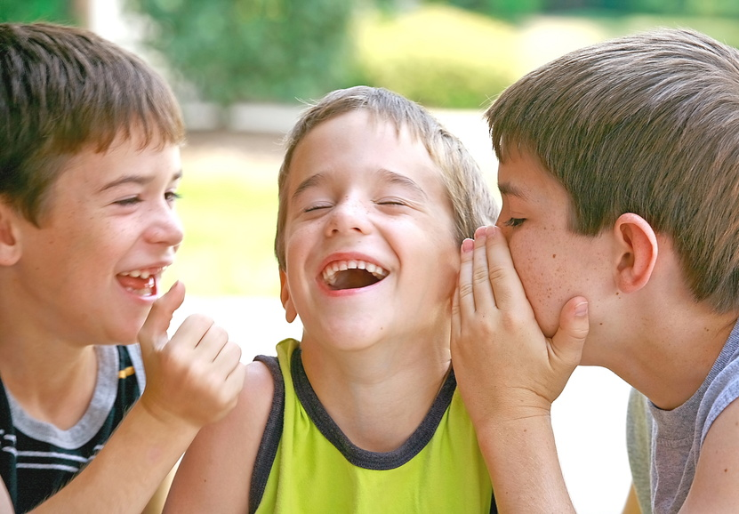
Cliché
Laughter is the best medicine.
An overly used expression or idea.

Slide 49
Coherent
The boy is riding a unicycle.
Logical and clear.

Slide 50
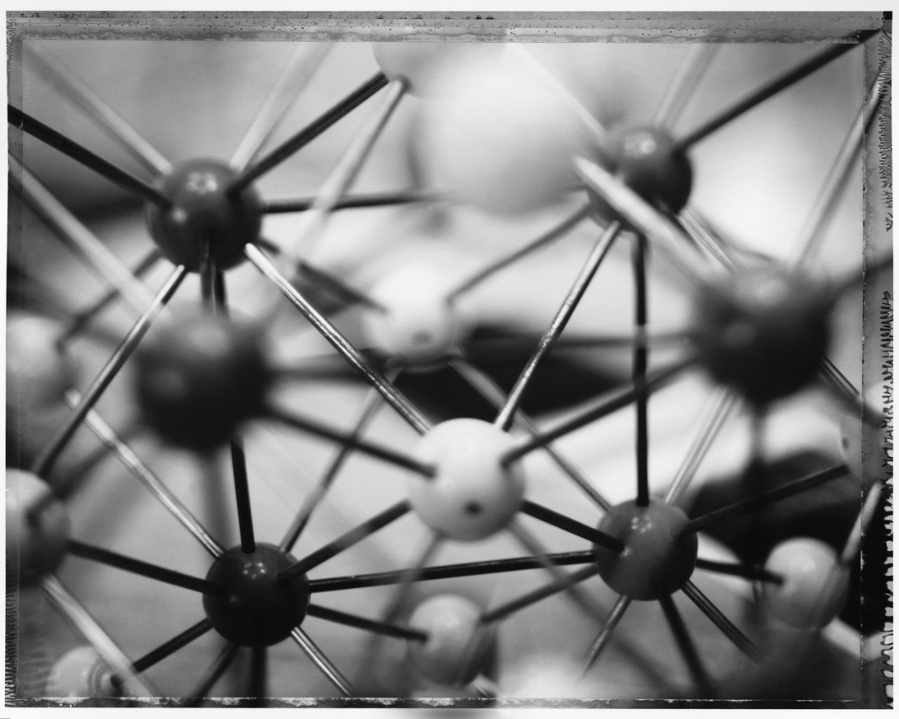
Cohesion
To lump, hold, or stick together.

Slide 51

Collaborative
Working together toward a common goal.

Slide 52
Colloquialism
It’s raining
cats and dogs.
A conversational expression.

Slide 53


Compare and Contrast
red or green skin
grown in many climates
edible skin
fruit
seeds
grown on trees
good for you
juicy
sweet
orange skin
grown in subtropical climate
don’t eat skin
How two or more things are alike and/or different.

Slide 54
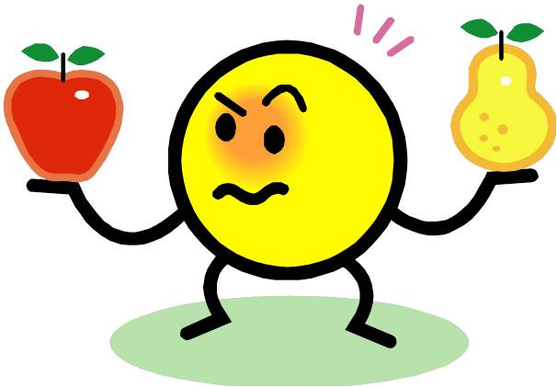
Comparison
Both fruits
Both grow on trees
Both are edible
An examination of how two or more things are similar or alike.

Slide 55
Complex
Complicated in structure; consisting of interconnected parts.

Slide 56

Compound adjective
Josh got a part-time job delivering pizzas.
A single adjective comprised of more than one word, usually grouped together using hyphens.

Slide 57

Compound nouns
Toothpaste
TOOTHPASTE
Two or more simple nouns used together as a single noun.

Slide 58
Comprehend/Comprehension
To understand or grasp the meaning of.

Slide 59
Concept
A general idea or thought.

Slide 60
Conclude/Conclusion
Climax
Conflict
Resolution
Rising Action
Falling Action
Introduction
Conclusion
To bring to an end or close; the final part.

Slide 61
Concrete details
The bite of the frigid air was
nearly unbearable as I made my
way through the frozen forest.
Explicit details adding to the visual perception of the text, describes in great detail how things might feel, smell, look like, sound like, and/or taste like.

Slide 62
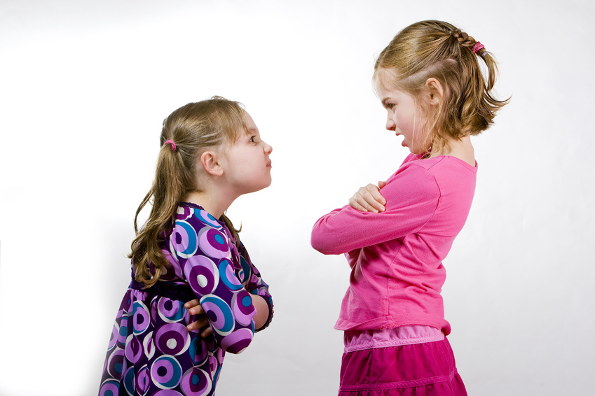
Conflict
A problem or disagreement between people, society, or nature.

Slide 63
Connection
A relationship or association.

Slide 64
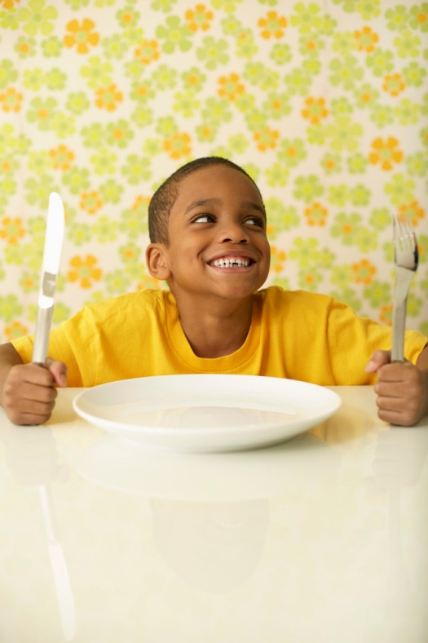
Connotative/Connotation
I’m wasting away.
I’m famished.
I’m starving.
I’M HUNGRY
A meaning suggested by a word or an expression in addition to its exact meaning.

Slide 65
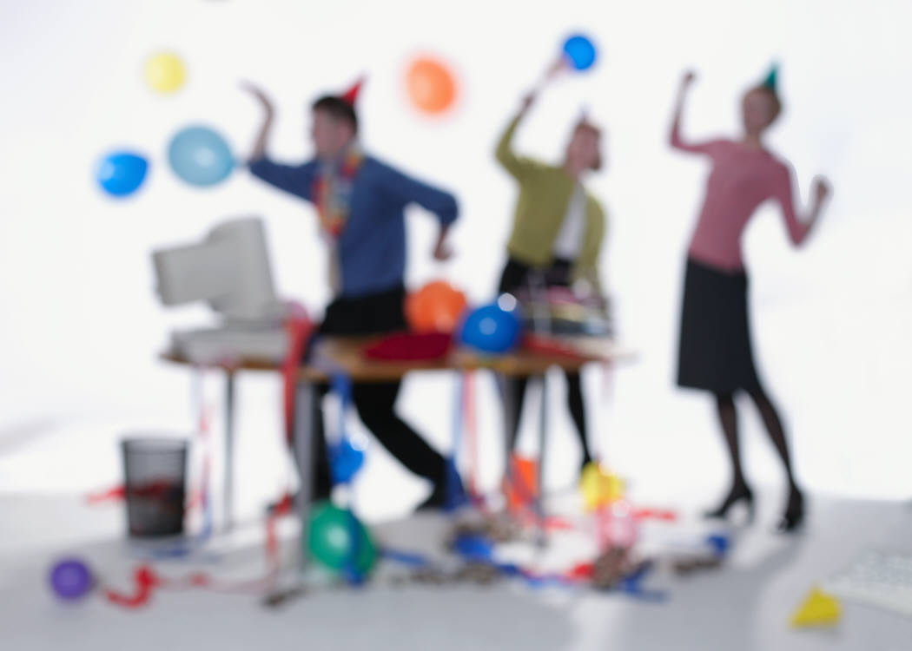
Consensus
There was a general consensus regarding ideas for the office party.
General agreement in opinions, values, preferences, or the like.

Slide 66
Constitutional
Having to do with a constitution (a set of laws by which a nation, state, or other organization is governed).

Slide 67

Consumer documents
INSTRUCTION
MANUAL
Printed materials that accompany products and services…manuals, instructions, warranties, etc.

Slide 68
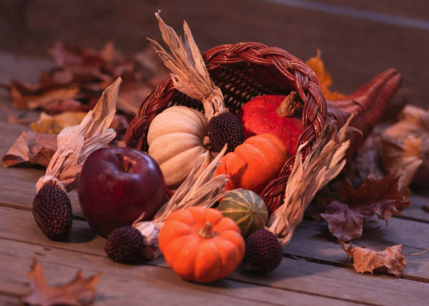
Content
Whatever is held or contained in something.

Slide 69
Context
She greeted him in a very cold manner.
cold in this sentence refers to an unfriendly attitude.
COLD
It’s very cold outside.
cold in this sentence refers to the temperature.
The set of facts or circumstances that surround a situation or event.

Slide 70
Context clues
She greeted him in a very cold manner.
cold in this sentence refers to an unfriendly attitude.
context clue
COLD
context clue
It’s very cold outside.
cold in this sentence refers to the temperature.
Clues given in a passage as to the meaning of the word.

Slide 71
Contribute
To give for a purpose.

Slide 72
Conventions
This is conventional classroom.
Things that are normal, ordinary, and following the accepted way.

Slide 73
Convey
To communicate; express.

Slide 74
Convincing
The prosecution provided very convincing evidence.
Able to cause someone to believe or accept.

Slide 75
Credible
She was a credible witness.
Believable or plausible.

Slide 76
Critique
Review of somebody's work.

Slide 77
Dash
Even the simplest tasks—washing, dressing, and going to work—were nearly impossible after I broke my leg.
A punctuation mark that is used to indicate an abrupt pause or break in the thought or structure of a sentence.

Slide 78
Deconstruct
To take apart, analyze, or break it down into its parts in order to understand how and why it was created.

Slide 79
Delineate
The bite of the frigid air was
nearly unbearable as I made my
way through the frozen forest.
To describe or portray in precise or vivid detail.

Slide 80
Democratic
Of, relating to, or supporting democracy or its principles.

Slide 81
Denotation
I’m wasting away.
I’m famished.
I’m starving.
I’M HUNGRY
denotation
The direct meaning of a word or expression.

Slide 82
Descriptive language
The bite of the frigid air was
nearly unbearable as I made my
way through the frozen forest.
Words intended to create a mood, person, place, thing, event, emotion, or experience.

Slide 83
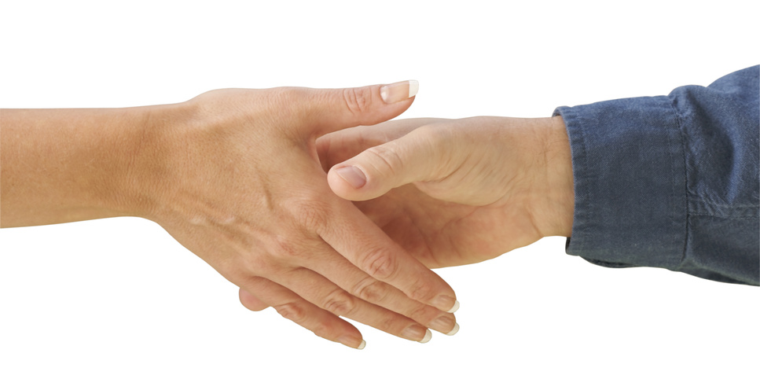
Determine
To decide or settle finally and without question.

Slide 84
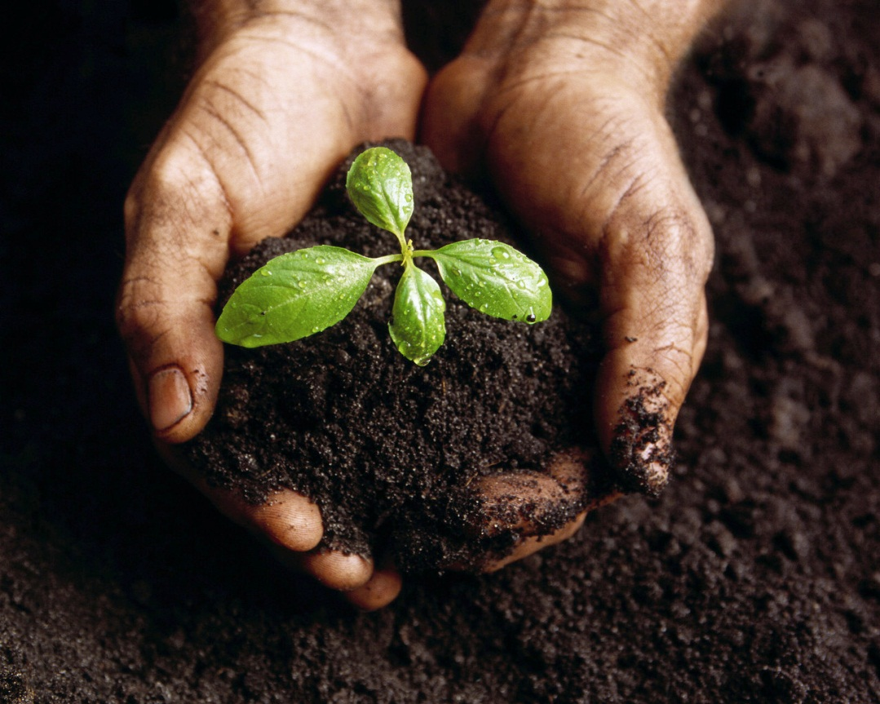
Develop
To grow or cause to grow.

Slide 85
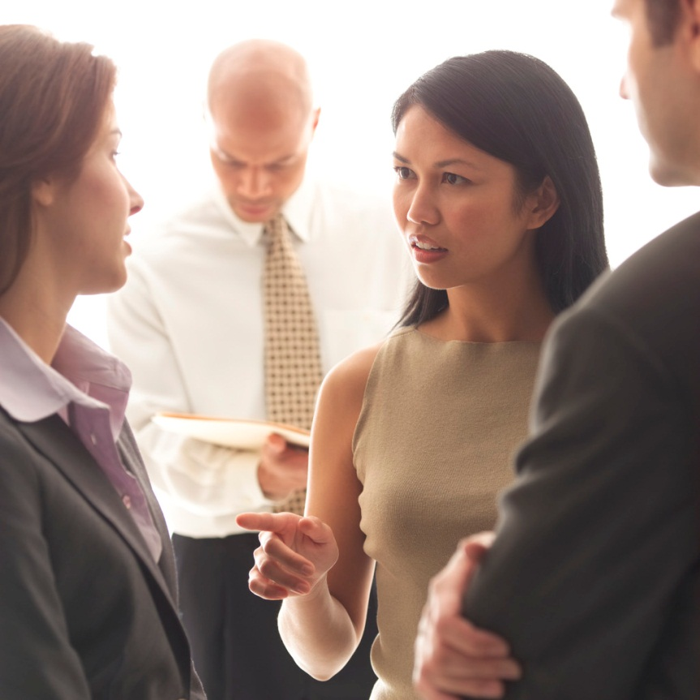
Dialogue
A talk between two or more people or between characters in a play, film, or novel.

Slide 86
Discrepancies
Lack of agreement; difference; inconsistency.

Slide 87
Dissent
A difference of opinion; disagreement.

Slide 88
Distinction
Different or set apart; separate.

Slide 89
Distinguish
Can you distinguish which one is different?
To tell apart by seeing differences.

Slide 90
Divergent
Deviating or differing.

Slide 91
Diverse
Of different kinds or sorts.

Slide 92

Document
A written or printed paper, often of a legal or official nature, that provides information, evidence, or proof of something.

Slide 93
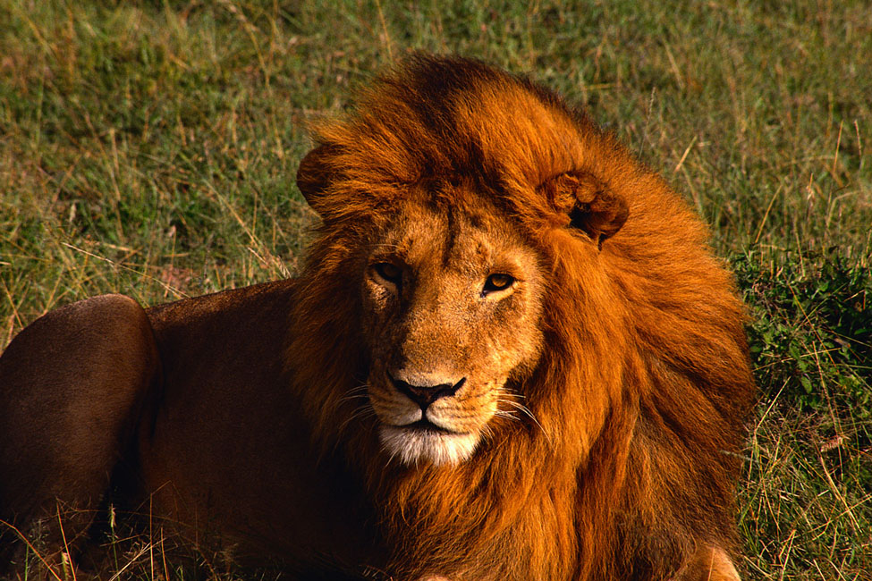
Domain
The lion, King of his domain.
A particular environment or walk of life.

Slide 94
Drawing conclusions
There are puddles on the ground.
We can draw the conclusion that it rained recently.
Making a decision or voicing an opinion based on reasoning or inferring.

Slide 95
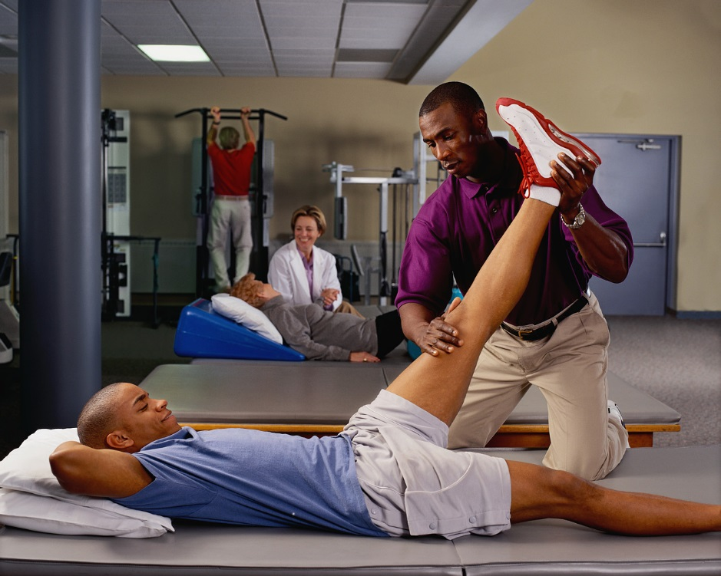
Effectiveness
Physical therapy has a high level of effectiveness in injury recovery.
The quality or condition of working as intended or of having the desired result.

Slide 96
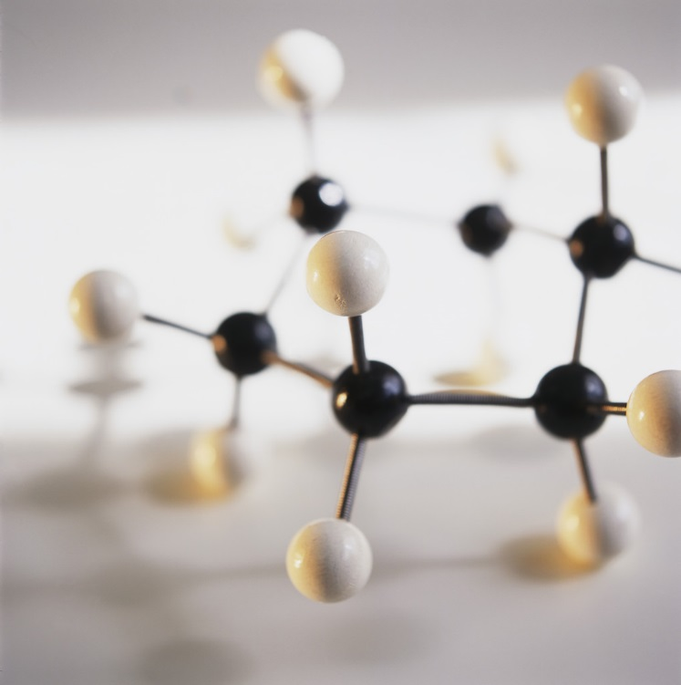
Elements
A part of any whole.

Slide 97
Ellipsis
Original sentence from Lincoln’s Gettysburg Address
Rewritten using ellipsis
“Four score and seven years ago our fathers brought forth, upon this continent, a new nation, conceived in liberty, and dedicated to the proposition that all men are created equal.”
“Four score and seven years ago our fathers brought forth . . . a new nation, conceived in liberty.”
~Abraham Lincoln
The leaving out of one or more words that are not necessary for a phrase to be understood.

Slide 98
Emphasis/Emphasize
Boldface, italic, and underlined font is often used to emphasize important pieces of text.
To give particular attention to; stress.

Slide 99
Engaging
The comedian did a great job of engaging the audience.
Holding the interest of.

Slide 100
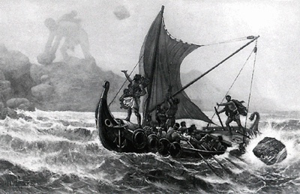
Epic poem
The Odyssey
-Homer
A long, narrative poem telling of a hero's deeds.

Slide 101
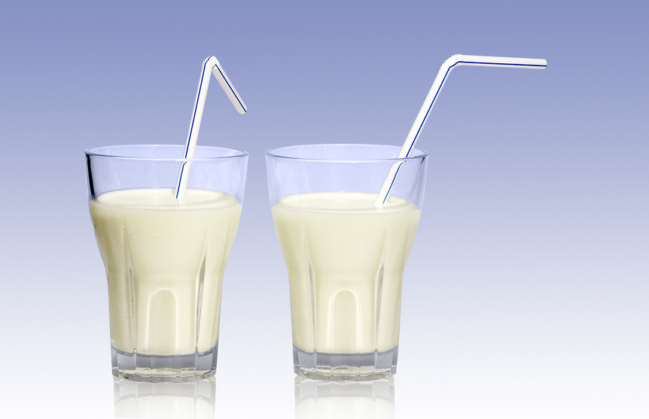
Essential
Milk provides many essential nutrients.
Fundamental; necessary; indispensable.

Slide 102


Euphemism
“Powdering your nose” is a euphemism for going to the bathroom.
An inoffensive or indirect expression that is substituted for one that is considered offensive or too harsh.

Slide 103

Evaluate
To judge the value or worth of someone or something.

Slide 104
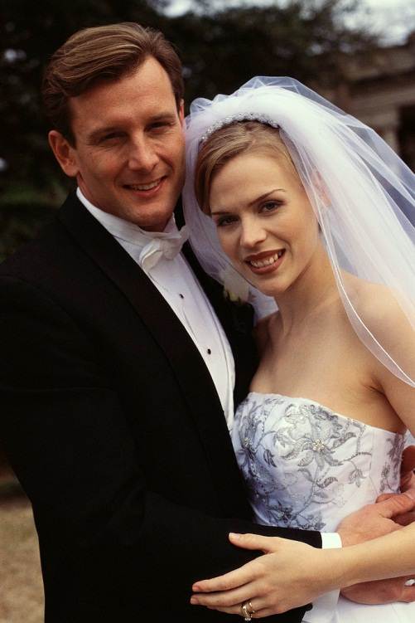
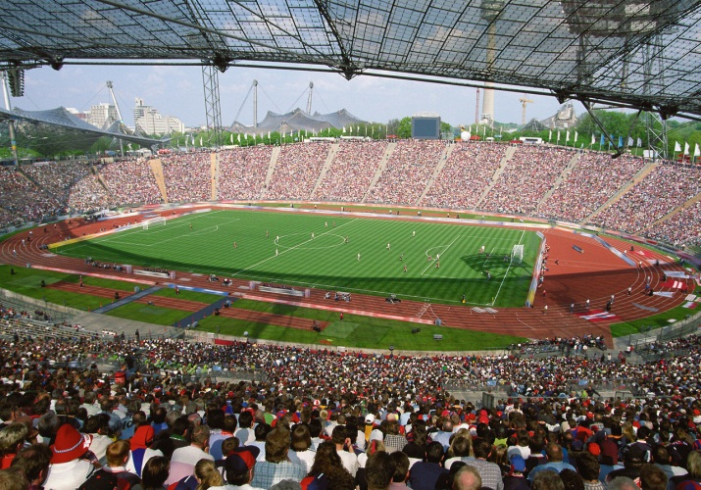

Event
Sporting Event
Graduation
Wedding
Something that happens.

Slide 105
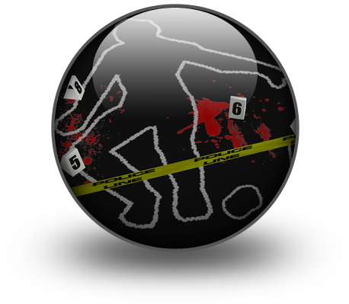
Evidence
Anything that can be used to prove something.

Slide 106
Excerpt
an excerpt from The Gettysburg Address:
“Four score and seven years ago our fathers brought forth on this continent a new nation, conceived in liberty, and dedicated to the proposition that all men are created equal.”
~Abraham Lincoln, November 19, 1863
A passage or segment taken from a text…phrase, sentence, paragraph, or chapter.

Slide 107
Experience
Something that a person has done or lived through.

Slide 108
Explanatory text
Text that clarifies or explains.

Slide 109
Explicit
Close the refrigerator door.
Said or written in a clear and direct way.

Slide 110
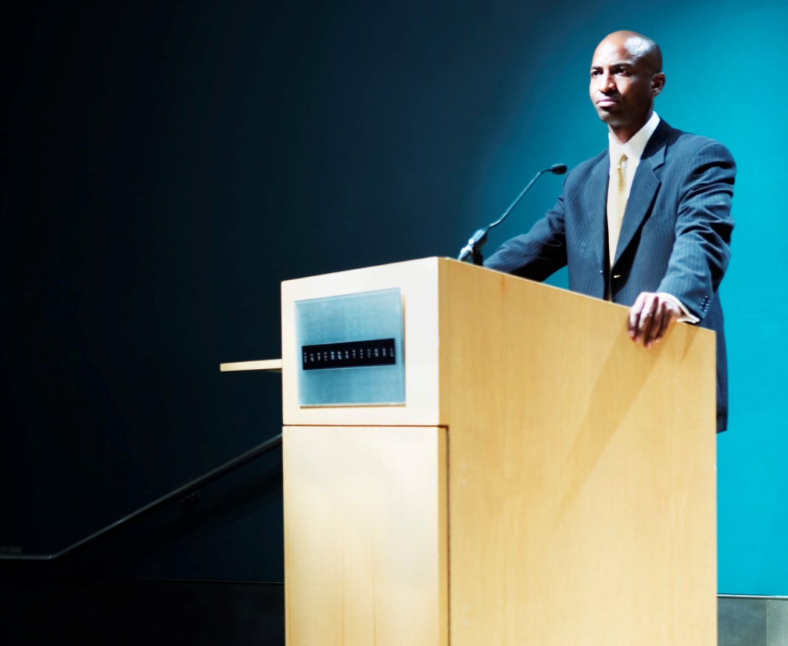
Exposition
Writing or speech primarily intended to convey information or to explain; a detailed statement or explanation.

Slide 111
Expository writing
Nonfiction writing that explains and describes with the aim of conveying information or presenting certain opinions or points of view.

Slide 112
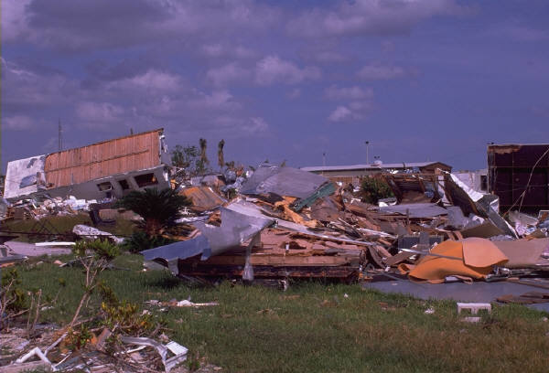
External conflict
A struggle against an outside force, which may be another character, society, or nature.

Slide 113
Fable
A short story with a moral (lesson), often with animal characters.

Slide 114

Fact
George Washington was the first president of the United States of America.
A statement that can be proven.

Slide 115
Fallacious
“It rained yesterday, and today I have a cold.
Therefore, the rain gave me a cold.”
Based on unsound logic; in error; illogical.

Slide 116
Falling action
Climax
Conflict
Resolution
Rising Action
Falling Action
Introduction
Conclusion
In the plot, this action occurs after the climax, when conflicts are resolved and problems solved.

Slide 117
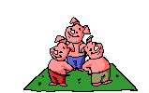
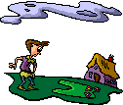
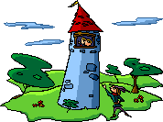


Fiction
A story that is not true or is made up.

Slide 118
Figurative language
It’s raining
cats and dogs.
Language that goes beyond the literal meaning of the words.

Slide 119
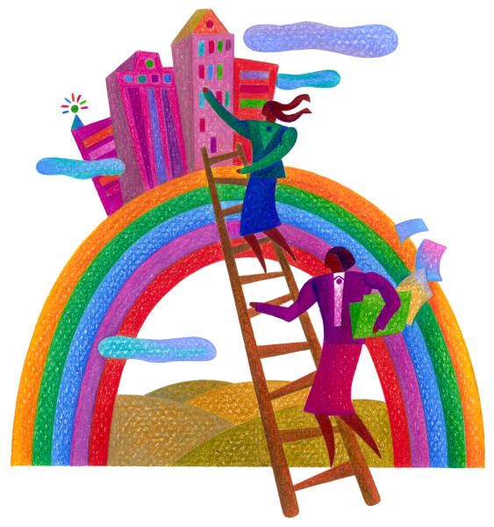
Figures of speech
“Climbing the ladder of success.”
An expression with a special meaning.

Slide 120
Footnote
The teacher was trying to educate¹ the class.
footnote
1. educate: teach
A printed note or definition placed below the text at the bottom of the page or the back of the book.

Slide 121
Foreshadowing
He had no idea of the excitement that awaited him.
A writer’s use of hints or clues to suggest events that will occur later in the plot.

Slide 122
Formal language
informal
Thanks a bunch!
formal
Thank you very much!
Language spoken according to the rules of English. It sounds more educated and professional.

Slide 123
Formal outline
Essay Title
Introduction
Body
  Main Idea
    Supporting Idea/Argument
    Supporting Idea/Argument
  Main Idea
    Supporting Idea/Argument
    Supporting Idea/Argument
Conclusion
Citations
Organized using a number/letter system which lists the main and supporting ideas of your essay.

Slide 124
Format
Title of Book:
Author:
Introduction: (Introduce your book report)
Main Characters:
Story:
Beginning:
Middle:
End:
Conclusion: (Give your opinion of the book)
Example format for a book report.
To arrange or organize so that a particular appearance is achieved.

Slide 125
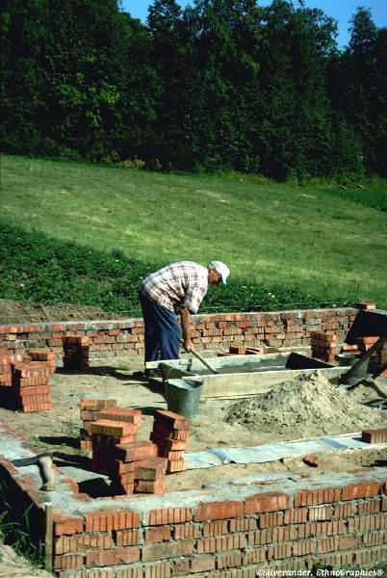
Foundational
The basis of something such as an action, substance, structure, or opinion.

Slide 126
Functional materials
A form of informational nonfiction…websites, how-to-articles, brochures, fliers, etc.

Slide 127

Genre
Science-Fiction
Fantasy
Historical
A category of art, music or literature.

Slide 128
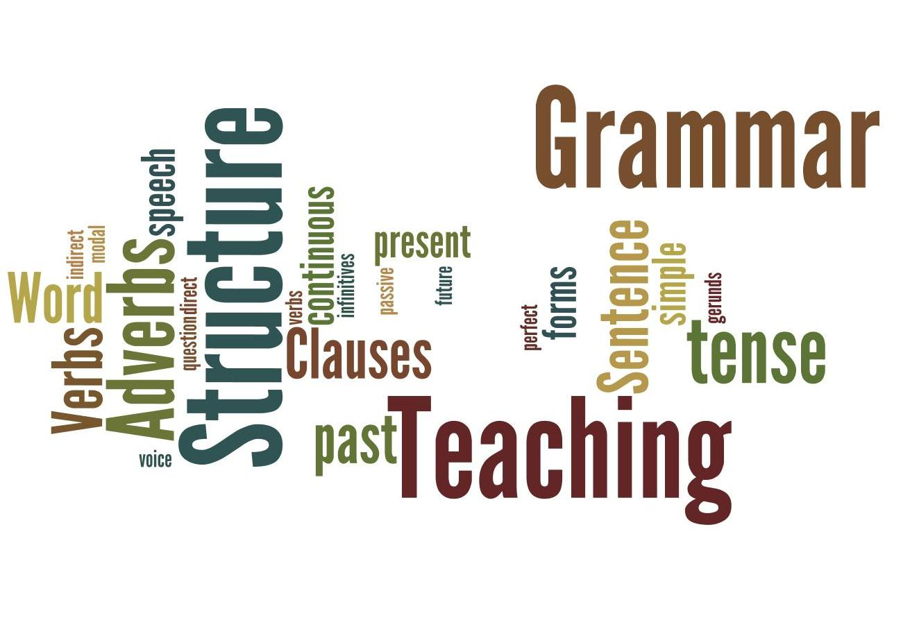
Grammar
The rules for forming words and sentences in a language.

Slide 129
Grasp
To take hold of mentally; understand.

Slide 130
Historical
Belonging to the past; of what is important or famous in the past.

Slide 131
Hyperbole
I’m so hungry I could eat a whole cow.
A figure of speech in which a statement is exaggerated for emphasis or for humorous effect.

Slide 132
Hyphen
How to
-
A punctuation mark used to divide or to compound words or word elements.

Slide 133
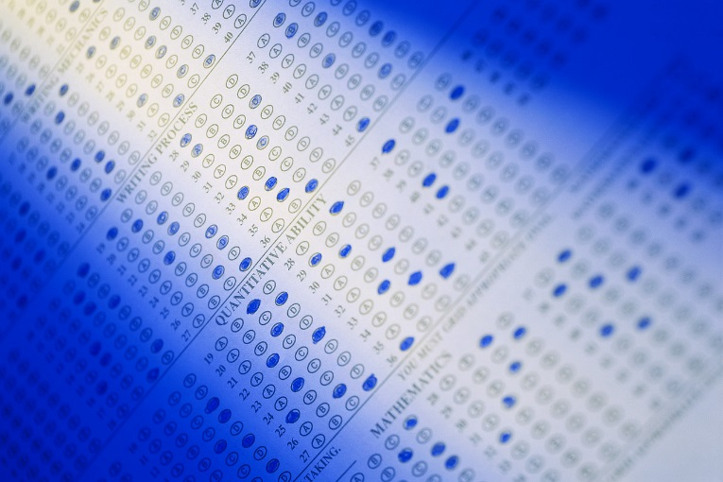
Hypothesis
More students get sick during the final week of testing that at other times.
A prediction or educated guess.

Slide 134
Iambic pentameter
A bazillion stars twinkle in the night
sky; pinpoints on black velvet, perfect
jewels created by the universe
for us to gaze upon in wonderment.
~Carol Fillmore
A five-beat poetic line.

Slide 135
Imagery
The bite of the frigid air was
nearly unbearable as I made my
way through the frozen forest.
Language that appeals to the senses…sight, hearing, smell, taste, and touch.

Slide 136
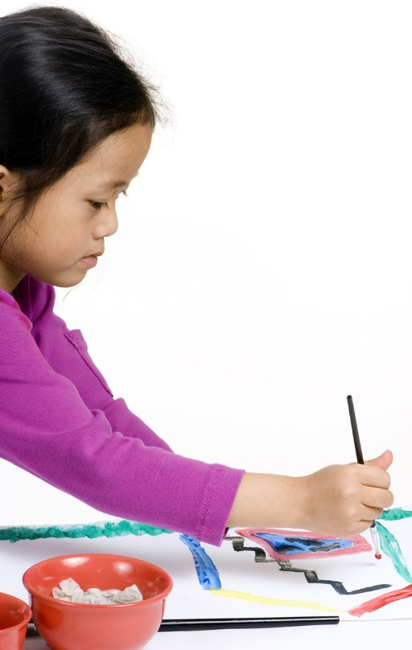
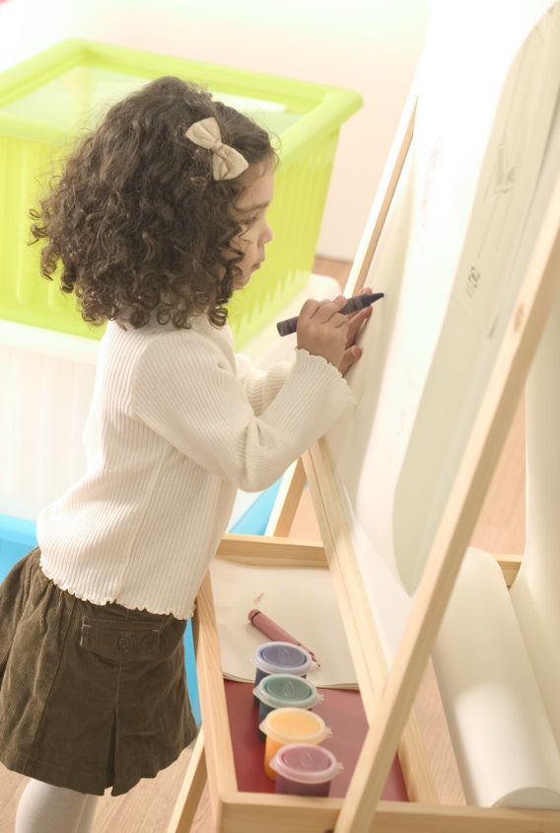
Imaginative
Having the ability to be creative.

Slide 137
Impact
The tornado had a tremendous impact on the community.
To have a strong effect upon someone or something.

Slide 138
Independent
Not needing the support or advice of another person.

Slide 139
Individual
A single thing or person.

Slide 140
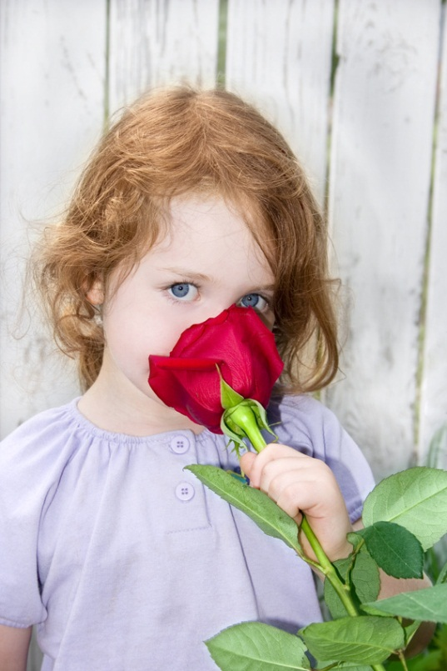
Inference
What we know:
The little girl is smelling a beautiful rose.
We might infer that roses are her favorite flower.
A conclusion reached using facts, observations, logic and reasoning.

Slide 141
Infinitive
We intend to leave early.
The simple form of a verb that has no subject and does not show past, present or future tense.

Slide 142
Informal language
informal
Thanks a bunch!
formal
Thank you very much!
Characteristic of or appropriate for ordinary, casual, or familiar use.

Slide 143
Informational text
INSTRUCTION
MANUAL
Writing that provides factual information and that often explains ideas or teaches processes.

Slide 144
Integral
A balanced breakfast is an integral part of a healthy diet.
Being an essential part of the whole.

Slide 145

Integrate
To bring together and mix into a whole.

Slide 146

Interact
To respond to one another in a social situation.

Slide 147

Internal conflict
A struggle between opposing needs, desires, or emotions within a single character.

Slide 148
Interpret
To translate, analyze, or give examples drawn from a text.

Slide 149
Investigate/Investigation
To look into carefully and closely so as to learn the facts; examine.

Slide 150

Irony
You finally got the puppy you’ve been begging for,
but you find out you’re allergic to dogs.
A contrast between what is expected and what actually exists or happens.

Slide 151
Italics
Please listen carefully.
Words that are in a slanted type to indicate that a word, phrase, or sentence is important.

Slide 152
Key point
The key point of this function is to raise money for charity.
The main meaning or purpose of a statement or action.

Slide 153

Limitations
A weakness or shortcoming that restricts one's abilities.

Slide 154
Listing
How to Make a Peanut Butter & Jelly Sandwich:
Take out two slices of bread.
Put peanut butter on one slice.
Put jelly on the other slice.
Put your two slices of bread together.
Enjoy your sandwich!
Pieces of information (facts, reasons, ideas, examples, features, steps, etc.) that are listed.

Slide 155
Literal
The Concord is faster than the speed of sound.
Ordinary, exact, or primary meaning of a word or words; not figurative or metaphorical.

Slide 156
Literary device
Metaphor
Alliteration
Figurative Language
Anagram
Onomatopoeia
A technique used to achieve a particular effect.

Slide 157
Literary element
Plot
Setting
Characters
Includes all the elements in a story.; setting, characters, plot (problem, solution, conclusion)

Slide 158

Literary nonfiction
Author: Susie Caldwell Rinehart
Illustrator: Anisa Claire Hovemann
Like fiction, except that the characters, setting, and plot are real rather than imaginary.

Slide 159
Literature
Writings that have lasting value.

Slide 160
Logical
Suzie is the most popular kid in our class. It is logical to assume she will be elected class president.
Something that makes sense; reasonable.

Slide 161
Main idea
Detail
Detail
They are playful.
They like to cuddle.
Main Idea
I like cats.
Detail
Detail
My cat is friendly.
Cats are cute.
The most important idea expressed in a piece of writing.

Slide 162
Media
The means of distributing information to large numbers of people, through newspapers, magazines, radio, and television.

Slide 163


Medium
Books
Conversation
Television
A means or tool.

Slide 164
Metaphor
Laughter is the
music of the soul.
A comparison of two things that have something in common.

Slide 165
Metric feet
Name | Description | Sample Word
Amphimacer | 3 Syllables; Strong/Weak/Strong | M&M’s
Anapest | 3 Syllables; Weak/Weak/Strong | Illinois
Dactyl | 3 Syllables; Strong/Weak/Weak | Entropy
Lamb | 2 Syllables; Weak/Strong | Reprieve
Spondee | 2 Syllables; Strong/Strong | Paul’s Cat
Trochee | 2 Syllables; Strong/Weak | Peacock
A group of 2 or 3 syllables forming the basic unit of poetic rhythm metrical unit.

Slide 166
Mood
The bite of the frigid air was
nearly unbearable as I made my
way through the frozen forest.
The feeling or atmosphere that a writer created for the reader.

Slide 167
Moral
The moral found in the story of Pinocchio is:
“Don’t tell lies.”
The lesson learned from a story.

Slide 168
Motivation
Providing incentive or inspiration.

Slide 169
Multimedia
The combination of sound, still pictures, and video.

Slide 170
Multiple meaning
She greeted him in a very cold manner.
cold in this sentence means unfriendly.
COLD
It’s very cold outside.
cold in this sentence means temperature.
When something has more than one meaning.

Slide 171
Mystery
A movie, play, book, or other piece of writing that is usually about a crime.

Slide 172
Myth
An imaginary or fictitious thing or person.

Slide 173

Narrative
Writing that tells a story.

Slide 174
Narrator
narrator
Someone who tells a story.

Slide 175
Nominative pronoun
I am walking the dog.
The pronoun that is doing the action.

Slide 176
Non-fiction
Writing that tells about real people, places, and events.

Slide 177
Objective
Not influenced by personal feelings or opinions.

Slide 178

Objective pronoun
Emma gave her flowers.
The direct or indirect object of a verb, or the object of a preposition.

Slide 179

Omniscient
She is very smart, but she’s not omniscient.
Having total knowledge.

Slide 180
Onomatopoeia
The use of words whose sounds suggest their meaning.

Slide 181

Opinion
In my opinion, dogs make the best pets.
A personal judgment that someone thinks is true, by that may be true or false.

Slide 182
Opposing
To think, act, or be against; resist.

Slide 183
Organizational patterns
Chronological/Sequential
Cause and Effect
Compare and Contrast
Problem/Solution
Text structures found in all types of nonfiction and some fiction.

Slide 184
Outline
Title
Introduction
Body
  Main Idea
    Supporting Idea/Argument
    Supporting Idea/Argument
  Main Idea
    Supporting Idea/Argument
    Supporting Idea/Argument
Conclusion
Citations
A special form to plan and organize writing.

Slide 185

Overstate
It’s a matter of life and death!!!!!
To inflate the importance of; exaggerate.

Slide 186
Oxymoron
Deafening Silence
A combination of contradictory words.

Slide 187
Paradox
The following statement is true.
The previous statement is false.
A statement that seems to go against common sense but may still be true.

Slide 188
Parallelism
Not only is Ricky strong he is also fast.
Occurs when a writer or speaker expresses ideas of equal worth with the same grammatical form.

Slide 189

Paraphrasing
The Golden Gate Bridge in San Francisco is a
must-see attraction if you’re visiting the state.
Whenever you visit California, be sure to check out the Golden Gate Bridge.
A restatement of a passage or text in different words so as to simplify or clarify.

Slide 190



Particular
Do you have a particular car in mind?
Being the only one in mind or referred to out of many possibilities; specific; special.

Slide 191
Parts of speech
Interjections
Noun
Adverbs
Prepositions
Pronouns
Conjunctions
Verbs
Adjectives
A class of words (as adjectives, adverbs, conjunctions, interjections, nouns, prepositions, pronouns, or verbs) identified according to the kinds of ideas they express and the way they work in a sentence.

Slide 192

Pathetic fallacy
My pillow is calling my name.
The treatment of inanimate objects as if they had human feelings.

Slide 193
Personification
Opportunity is knocking,
To give human qualities to something that isn’t human.

Slide 194
Perspective
First Person
Second Person
I, Me, My, Mine
You, Your, Yours, You’re
Third Person
He, She, They, Their
A position from which something is considered or evaluated; standpoint.

Slide 195

Persuade/Persuasive
If you finish all your chores,
you can have some ice cream.
To talk someone into doing or believing something; convince.

Slide 196
Pertinent
The police are asking anyone with pertinent information to come forward.
Having to do with or connected to a subject; relevant.

Slide 197

Phrase
The girl with the brown
hair is planting a flower.
Two or more words that express an idea and are part of a sentence.

Slide 198
Plagiarism
To quote an author without proper citation is plagiarism.
To steal and pass off (as the ideas or words of another) as one's own.

Slide 199
Plot
Climax
Conflict
Resolution
Rising Action
Falling Action
Introduction
Conclusion
The story line or order of events in a book, play, or movie.

Slide 200
Plot lines
Dialogue that advances the plot.

Slide 201
Point of view
First Person
Second Person
I, Me, My, Mine
You, Your, Yours, You’re
Third Person
He, She, They, Their
The vantage point from which a writer tells a story.

Slide 202
Precise
Close the refrigerator door.
Stated in a clear way and with details.

Slide 203
Predict
To say in advance (what one believes will happen); foretell (a future event or events).

Slide 204
Prefix
Un
wrap
The prefix un means not, or opposite of
A letter or a group of letters added to the beginning of a word, that changes the meaning.

Slide 205
Premises
A statement that forms the basis of an argument and that is usually accepted.

Slide 206
Preparation
The speech required many hours of preparation.
The act of getting something ready.

Slide 207

Presenting
The act of showing, displaying, explaining, introducing etc.

Slide 208
Primary source
He used an interview with the star as the primary source for his article.
An original source of the information being discussed such as a person with direct knowledge of a situation, or a document created by such a person.

Slide 209

Principle
Treat others the way you would like to be treated.
A basic law or truth on which action or behavior is based.

Slide 210

Problem/Solution
The girl wouldn’t stop yelling, so I put on my headphones and listened to music.
A text structure which identifies and describes a problem and then offers one or more possible solutions.

Slide 211
Proficient
Having or showing knowledge, skill, or aptitude.

Slide 212

Progression
First, we went to the store.
Next, we went to the park.
Then, we went to see my grandma.
Finally, we went back home.
A sequence, as of items in a series; succession.

Slide 213

Propel
To cause to move forward; thrust, push, or drive.

Slide 214
Proposition
Anything offered for the purpose of discussion or thought.

Slide 215
Protagonist
Robin Hood
The main character in fiction or drama; the person who sets the plot in motion.

Slide 216

Pun
Why are teddy bears never hungry?
Because they’re stuffed.
Play on multiple meanings of a word or on two words that sound alike but have different meanings.

Slide 217

Purpose
Hard work is necessary to achieve success.
action
purpose
A reason or plan that guides an action; design or goal.

Slide 218

Quantitative
A liter of water weighs 1000 grams.
Of, concerning, or capable of being measured or expressed as, a quantity.

Slide 219
Question/Answer
When the author poses questions about a topic, then provides support to answer them.

Slide 220
Quote
"Four score and seven years ago, …”
To repeat the exact words used by someone else.

Slide 221
Reasoning
There are puddles on the ground.
Using reasoning, we can conclude that it rained recently.
The process of using reason to draw conclusions based on a premise or known facts.

Slide 222

Reference materials
Text containing facts and information, items that you can look at to find information.

Slide 223
Reflection
The process of deep or serious thinking, or a particular thought that results from this process.

Slide 224
Relevant
U.S. Presidents
George Washington
1st President
Grover Cleveland
22nd President
Barack Obama
44th President
Related to or connected with the present matter; pertinent.

Slide 225
Resolution
Climax
Conflict
Resolution
Rising Action
Falling Action
Introduction
Conclusion
The portion of a play or story where the central problem is solved.

Slide 226
Rising action
Climax
Conflict
Resolution
Rising Action
Falling Action
Introduction
Conclusion
The events in a story that move the plot forward, which involves conflicts and complications.

Slide 227
Root word
Unwrapped
The base word you start with before adding prefixes or suffixes.

Slide 228
Sarcasm
He, who laughs last, thinks slowest.
A form of verbal irony, usually harsh, that is often used as an insult.

Slide 229
Secondary sources
Reference Books
Journal Articles
Historical Works/Monographs
History Textbooks
Periodical Literature
Documents or recordings that relate or discuss information originally presented elsewhere.

Slide 230
Selective
Very careful in choosing.

Slide 231
Sensory language
The cool morning sun cast long fingers of shadow and light across the green field as our visitors tramped across the dewy grass.
Wording that describes how something feels, tastes, looks, or sounds.

Slide 232
Sequence/Sequence of events
First, we went to the store.
Next, we went to the park.
Then, we went to see my grandma.
Finally, we went back home.
A text structure in which one event or action follows another.

Slide 233

Setting
…In
A
Castle
Far, Far
Away…
Once
Upon
A
Time…
The time and place of the action in a story, play, or poem.

Slide 234
Shades of meaning
When Johnny’s dog went missing,
he was ________________.
(distressed, heartsick, troubled)
All of these words mean sad.
Small, subtle differences in meaning between similar words or phrases.

Slide 235
Simile
Quiet as a mouse.
A figure of speech comparing two things using like or as.

Slide 236
Situation
It was a very dangerous situation.
The combination of circumstances at a given time.

Slide 237

Skimming
Bobby is skimming through a picture book at the library.
Reading or looking at something for a short time.

Slide 238

Software
Any of the programs that are written to operate a computer.

Slide 239

Source
Encyclopedia
Dictionary
Interview
Any person, place, or thing by which something is supplied.

Slide 240
Specific
Komodo dragons are naturally specific to a group of islands in Indonesia.
Special or unique to something.

Slide 241
Standard English
informal
Thanks a bunch!
standard
Thank you very much!
The model of English that is written and spoken by educated individuals.

Slide 242
Stereotype
Boys are more messy than girls.
A standardized mental picture that represents an oversimplified opinion, attitude, or uncritical judgment.

Slide 243
Stimulate
To bring about to activity or action.

Slide 244
Strategic
Relating to an elaborate and systematic plan of action.

Slide 245

Structure
The way in which such a thing is joined together.

Slide 246
Substance
Romeo & Juliet is a story of great substance.
The important part of something; meaning.

Slide 247
Suffix
Unwrapped
suffix
The suffix ed means happened in the past
One or more letters added to the end of a root (base) word

Slide 248
Summary statement
Versatile, reliable, and efficient administrative professional with 12+ years experience supporting managers and executives to advance internal operations.
Example summary statement from experience section of a resume.
A general statement that presents the main points or facts in condensed form.

Slide 249
Summary/Summarize
Goldilocks and The Three Bears, is a story about a young girl who happens upon the home of a family of bears.
While the bears are away, the young girl makes herself at home.
To describe the main idea and important details of a passage using your own words.

Slide 250
Supporting details
Detail
Detail
They are playful.
They like to cuddle.
Main Idea
Supporting details
Why I like cats.
Supporting details
Detail
Detail
My cat is friendly.
Cats are cute.
Ideas in a paragraph or piece of text that explain or support the main idea of the text.

Slide 251
Supporting evidence
The prosecution provided enough supporting evidence to ensure a conviction.
Factual details that support, or help prove, claims that are made.

Slide 252

Suspense
Pleasant excitement caused by wondering what will happen.

Slide 253
Symbolism/Symbolize
In Mrs. Jones’ class, gold stars symbolize a job well done!
The use of something concrete that is used to represent something more than itself.

Slide 254

Synecdoche
He got a new set of wheels.
Set of wheels means car.
A figure of speech in which the word for part of something is used to mean the whole.

Slide 255
Synonym
Danger Hazard
A word that has the same or almost the same meaning as another word.

Slide 256

Syntax
We are going to your house.
To your house we are going.
The way in which words are put together to form phrases, sentences, and clauses.

Slide 257

Table
A type of graphic aid that presents a group of facts in rows and columns.

Slide 258

Technical terms
Home Run
Line Drive
Batter Up
Foul Ball
Baseball
Written or oral communication that has specialized content.

Slide 259

Technique
The artist’s technique is amazing.
A particular way of doing something.

Slide 260
Text box
This
Is
A
Text
Box
A box for text that can be placed and formatted independently of other text.

Slide 261
Text features
Table of Contents
Title
Heading
Glossary
Design elements that include structure of a text and help with the understanding of the text.

Slide 262
Theme
Winter Sports
Figure Skating
Hockey
Luge
Snowboarding
The main subject for a work of literature, art, or music.

Slide 263

Thesis statement
Thesis Topic:
Year-round Schooling
Thesis Statement:
Year-round schooling offers the most benefit to a community.
The sentence or two in your text that contains the focus of your essay and tells your reader what the essay is going to be about.

Slide 264
Thoroughly
The refrigerator is thoroughly stocked.
Completely; throughout.

Slide 265
Tone
The bite of the frigid air was
nearly unbearable as I made my
way through the frozen forest.
This selection sets a cold, lonely tone.
An expression of a writer’s attitude toward a subject.

Slide 266

Topic
The subject about which the author is writing.

Slide 267

Tragedy
A serious drama with a sorrowful or disastrous conclusion.

Slide 268
Tragic
It was a tragic accident.
Very sad; causing pity.

Slide 269


Transition
A changing from one state, stage, place, or subject to another.

Slide 270
Uncertainty
That which is unknown, indefinite, changeable, or the like.

Slide 271
Underlining
Underlining key words helps them to stand apart from the other text.
To draw a line under.

Slide 272

Valid/Validity
Based on truth, fact, or logic.

Slide 273
Version
Both drivers had a different version of the accident.
A description or report in a particular style or from one point of view.

Slide 274
Vivid
The bite of the frigid air was
nearly unbearable as I made my
way through the frozen forest.
Producing powerful feelings or strong, clear images in the mind.

Slide 275
Workplace documents
Materials that are produced or used within a work setting.

