Slide 1
Visual Vocabulary eSlides
with Common Core and Academic Vocabulary words
Mathematics
Sample K-12
© Partners for Learning, Inc. 2013

Slide 2
SITE LICENSE / TERMS OF USE
The academic vocabulary power point slides are sold on a per grade, per school basis.
TERMS OF USE:
All slides included in this presentation are for use only by the purchasing school
Additional copies can be purchased for use
By using the slides you agree to only use the slides in the school for which they were purchased.
You further agree not to copy or distribute the slides for use outside of the purchasing school.
Thank You

Slide 3
Add/Addition
4 + 2 = 6
To bring two or more numbers (or things) together to make a new total.

Slide 4
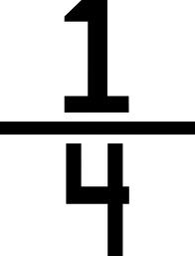
Fourths
One or more of four equal parts.

Slide 5
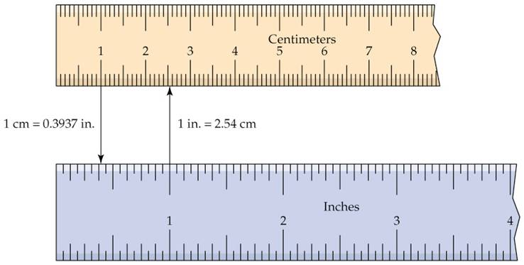
Centimeter
A metric unit of length equal to one hundredth of a meter.

Slide 6
Factor
There are 3 groups of 5 flowers.
3 X 5 = 15
factors
product
A number that is multiplied by another number to find a product.

Slide 7
Quotient
quotient
dividend
$$27÷9=3$$
divisor
The result of dividing one number by another.

Slide 8
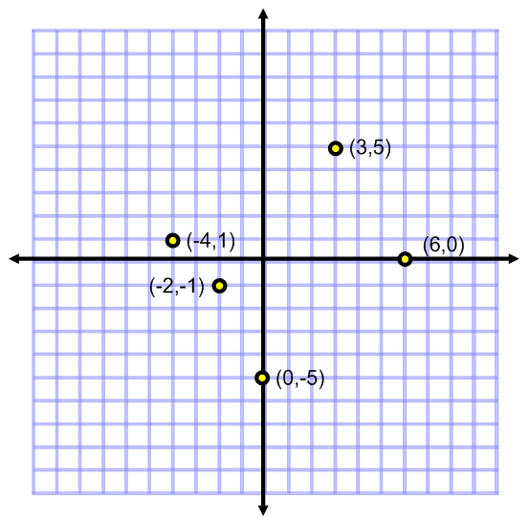
Coordinates
coordinates
A pair of numbers that define and exact location or point on grid. (x,y)

Slide 9
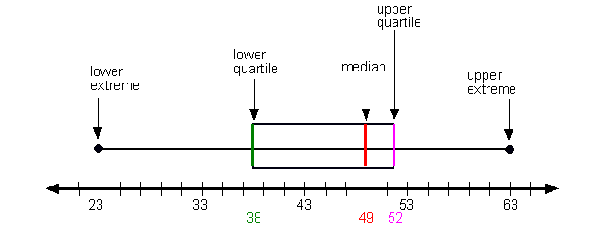
Mathematics Vocabulary - Grade 6
Box plot
A diagram or graph using a number line to show the distribution of a set of data

Slide 10
Mathematics Vocabulary - Grade 7
Distributive property
5 x 8
Is the same as
5 x (6 + 2)
Which equals
(5 x 6) + (5 x 2)
Which equals
30 + 10
Which equals
40
A number outside the parenthesis can be multiplied to each term within the parenthesis.

Slide 11
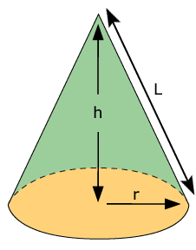
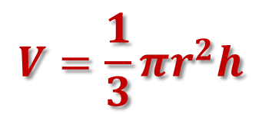
Cone volume formula
$$V=\frac{1}{3}πr^{2}h$$
The volume V of a cone is equal to $\frac{1}{3}πr^{2}h.$

Slide 12
Statistics
100 People were asked about their favorite color.
The graph to the left represents the data collected.
A branch of applied mathematics concerned with collecting, organizing, and interpreting data.

